Slide 1
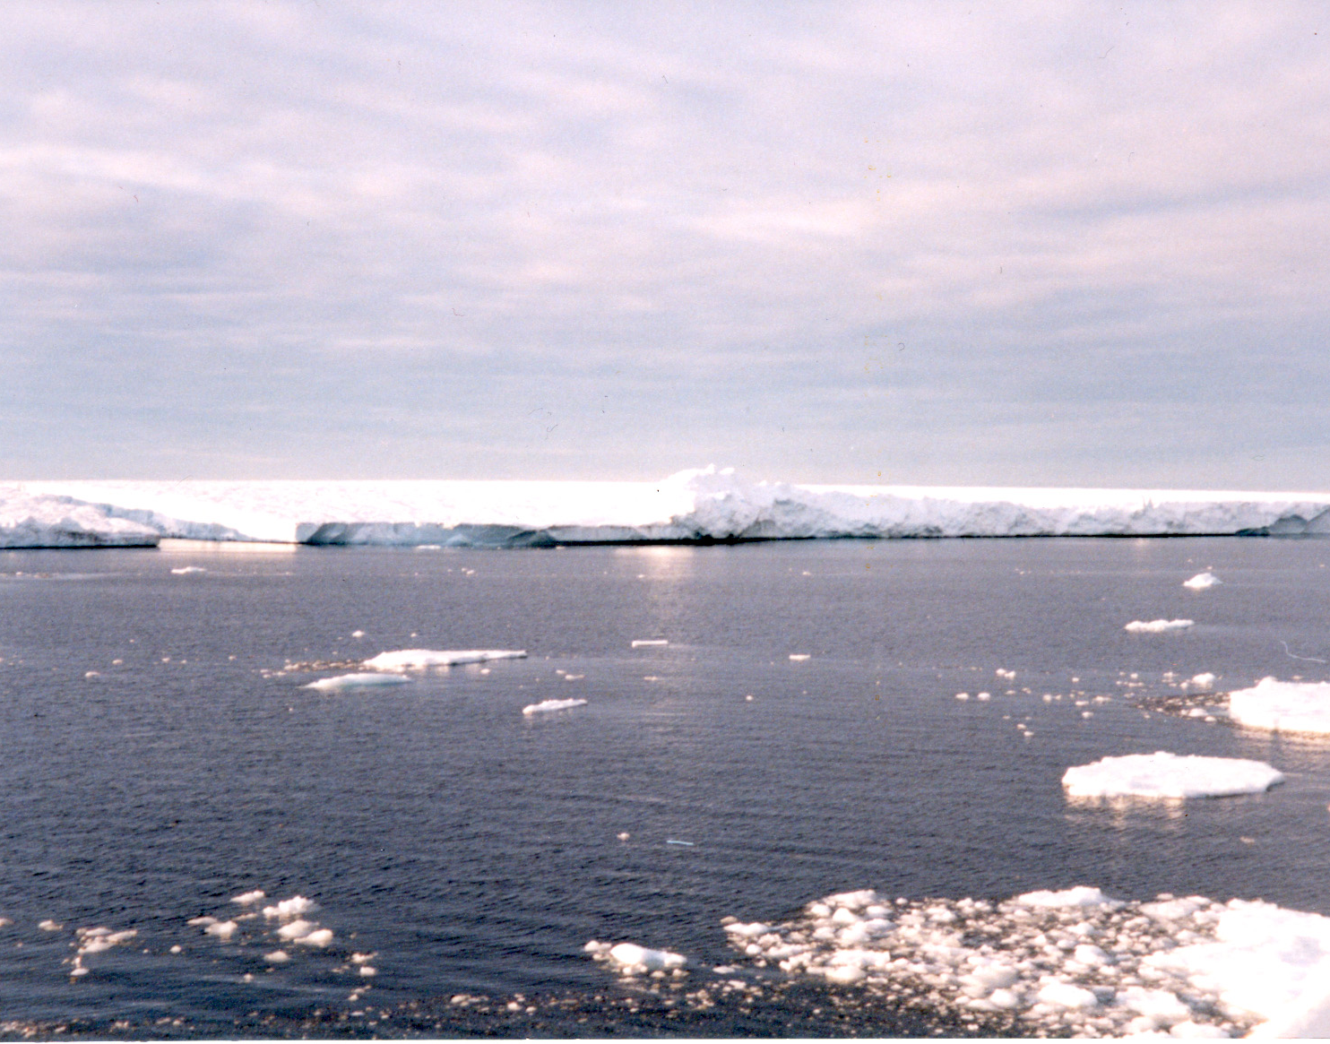


Иванов В.В.^{1,2}
Обратные связи в системе "океан - морской лед - атмосфера", связанные с сокращением арктического морского льда
¹ МГУ им. М.В.Ломоносова, Москва
² Арктический и антарктичечкий НИИ, Санкт-Петербург
CITES-2021, ИВМ, 23.11.21

Slide 2
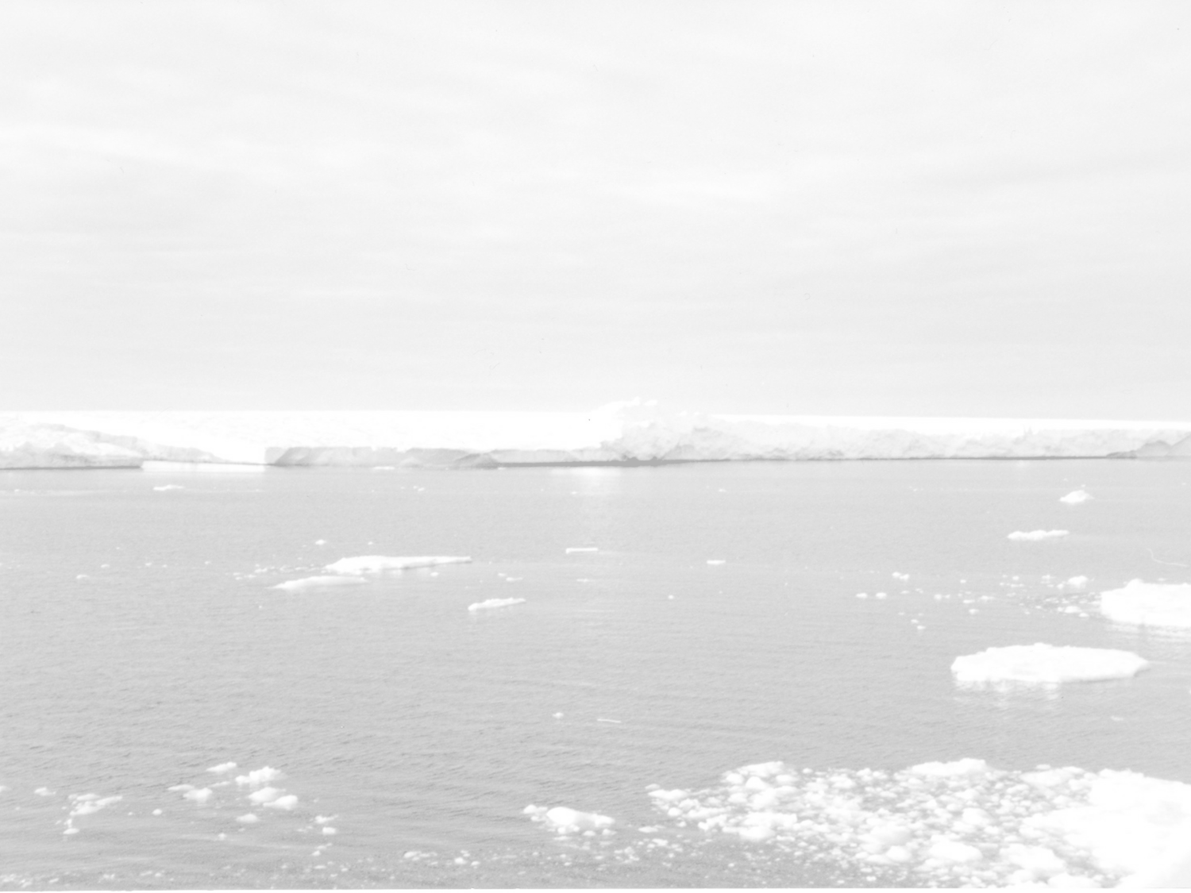
OUTLINE
1. Definitions
2. Reduction of the Arctic sea ice in 2000-2010s
3. Atlantic Water (AW) impact on the ice cover
3.1. Features of Atlantic Water distribution in the Arctic Ocean
3.2. Winter thermohaline convection in the Atlantic sector of the Arctic Ocean
3.3. Significance of sea ice properties
3.4. Conclisions-1
4. Impact of sea ice reduction on the upper ocean layer
4.1. Change of thermohaline conditions in the upper ocean layer
4.2. Increasing role of ocean-air interaction under changed conditions at the surface
4.3. Intensification of seasonal signal?
4.4. Conclusions-2
5. Summary and possible perspective

Slide 3
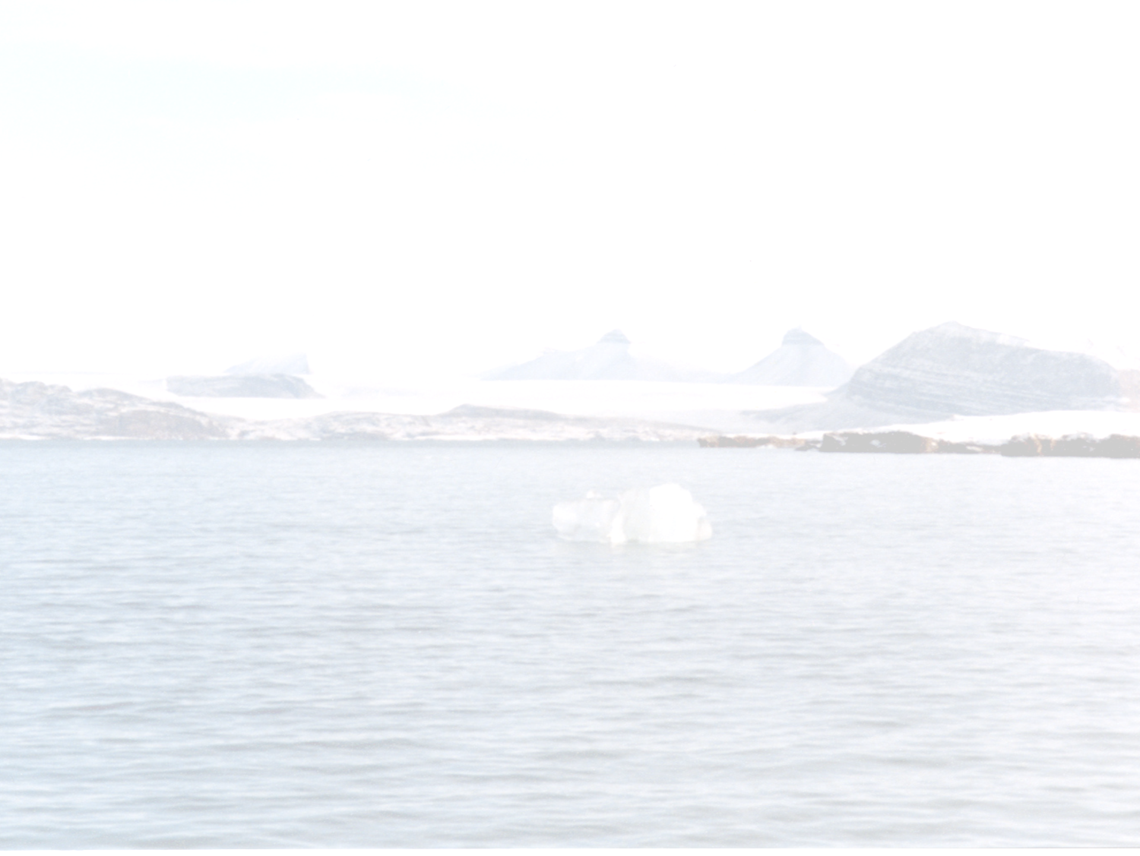
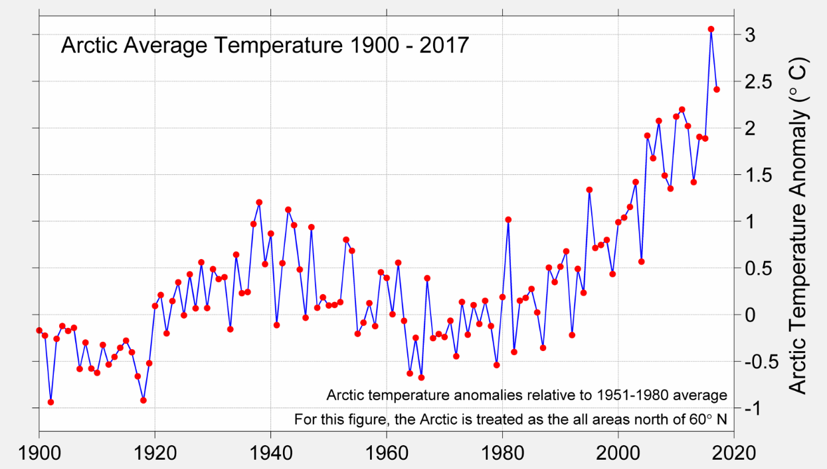
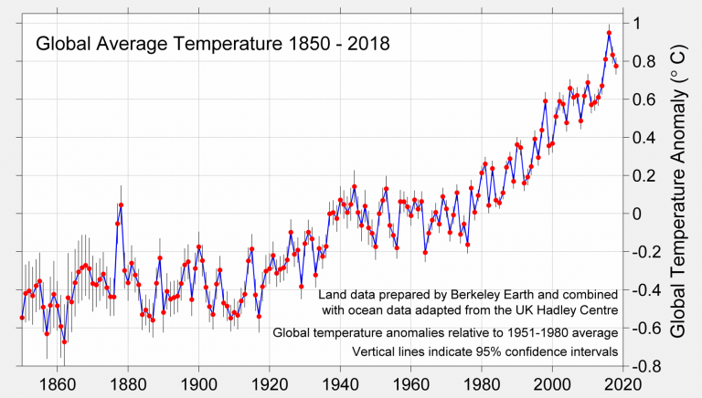
Polar (Arctic) amplification
http://berkeleyearth.org/global-temperatures-2017/

Slide 4
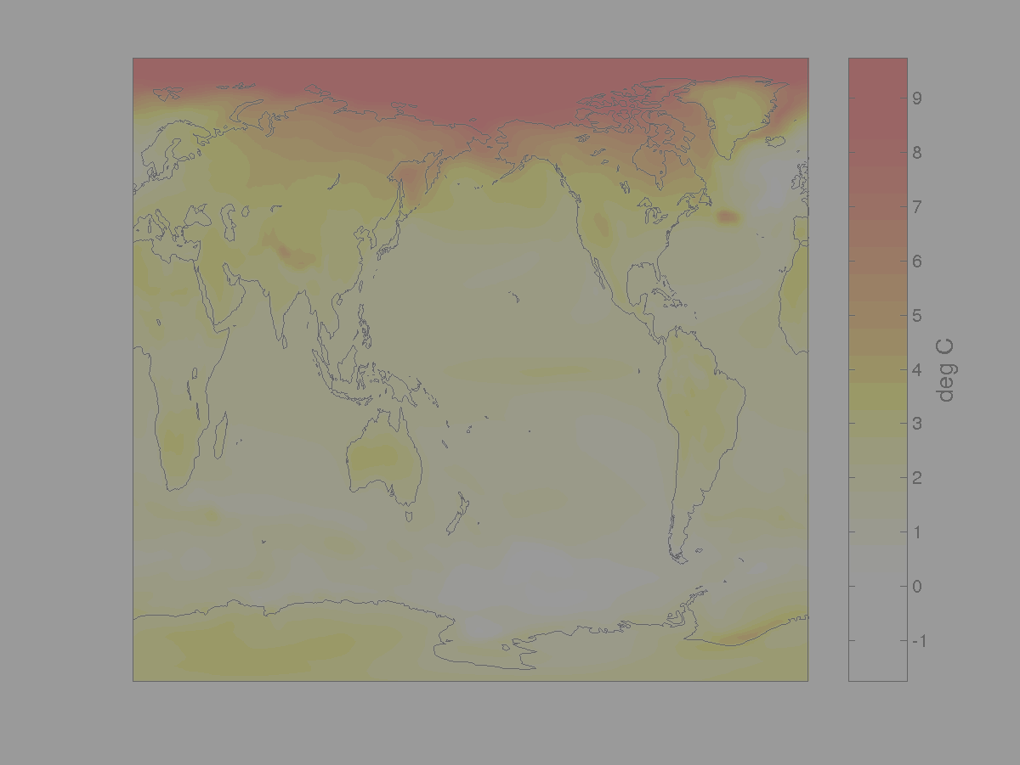
Обратные связи
С действием положительных обратных связей связывают феномен так называемого Полярного усиления, благодаря которому увеличение приземной температуры воздуха в Арктике в последние десятилетия примерно в 2.5 раза больше, чем в других широтных зонах.
Сокращение арктического морского льда стало «спусковым механизмом», обеспечившим интенсификацию обратных связей, которые в условиях преобладания толстого сплоченного льда либо вообще не проявлялись, либо были малоэффективными.
В дополнение к хорошо известным и описанным в литературе обратным связям, актуальным для высоких широт в докладе рассмотрены два новых механизма: «сезонная память» в характеристиках ледяного покрова и «атлантификация».

Slide 5
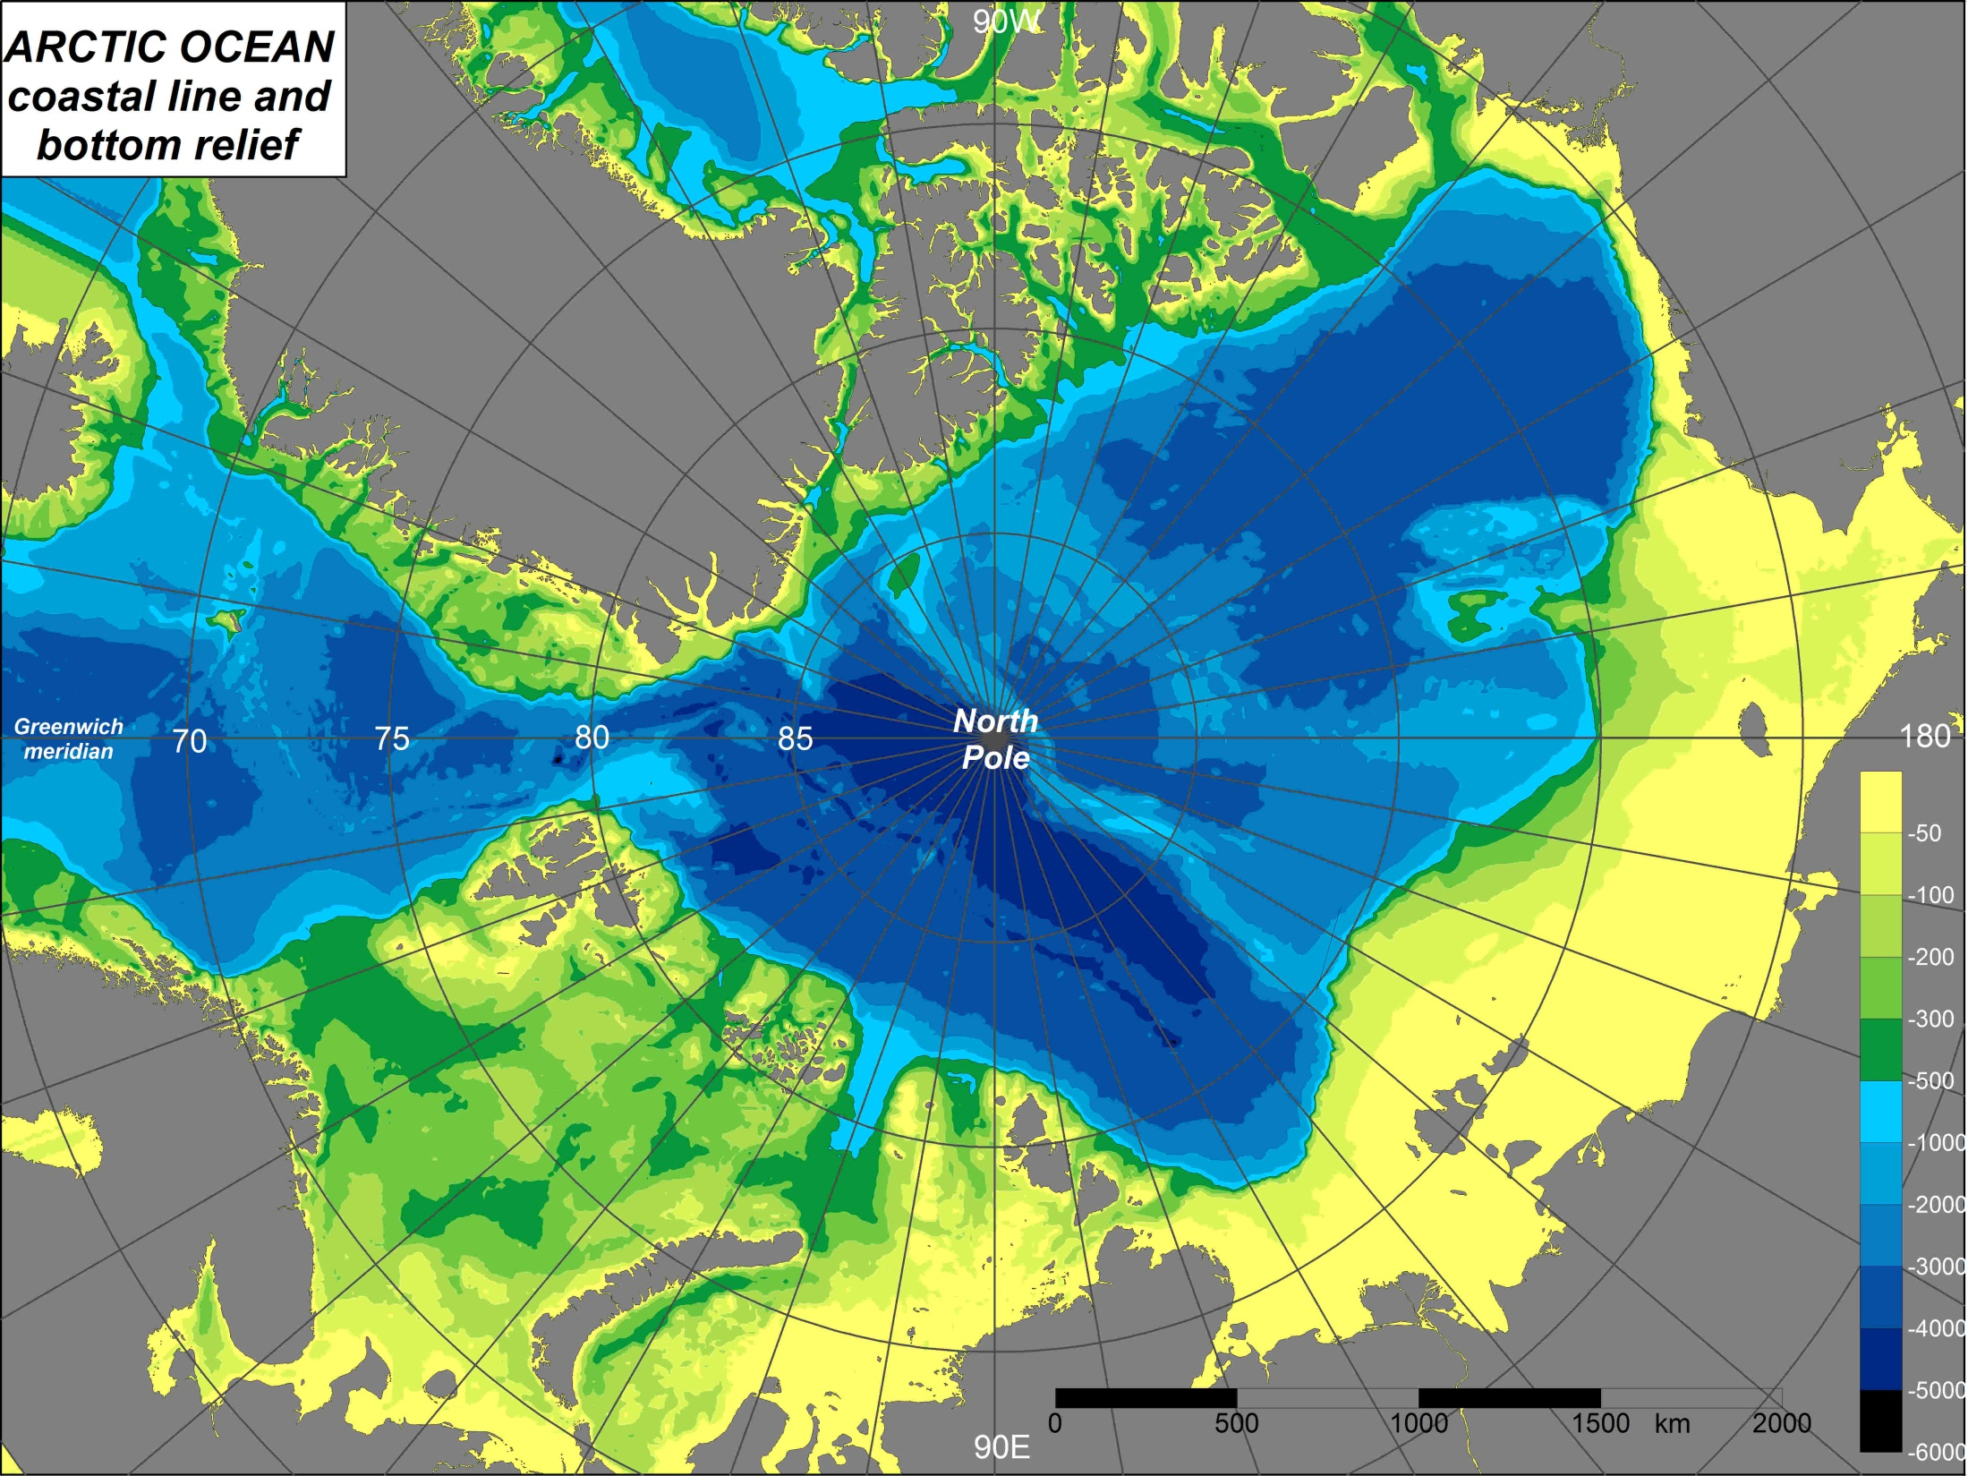








Baffin
Bay
Canadian Arctic
archipelago
Davis
Strait
Beaufort
Sea
Alaska
Canadian
Basin
Iceland
Sea
Lincoln
Sea
Chukchi
Sea
Bering
Strait
Greenland
Sea
Alpha – Mendeleev Ridge
Makarov
Basin
Vrangel
island
Fram
Strait
Norwegian
Sea
Spitsbergen
Lomonosov Ridge
Amundsen
Basin
Nansen – Gakkel Ridge
East Siberian
Sea
Nansen
Basin
Franz Joseph
Land
St.Anna
Trough
Barents
Sea
Laptev
Sea
Novosibirskiye
isles
Severnaya
Zemlya
Kara
Sea
Siberia
White
Sea
Novaya Zemlya

Slide 6
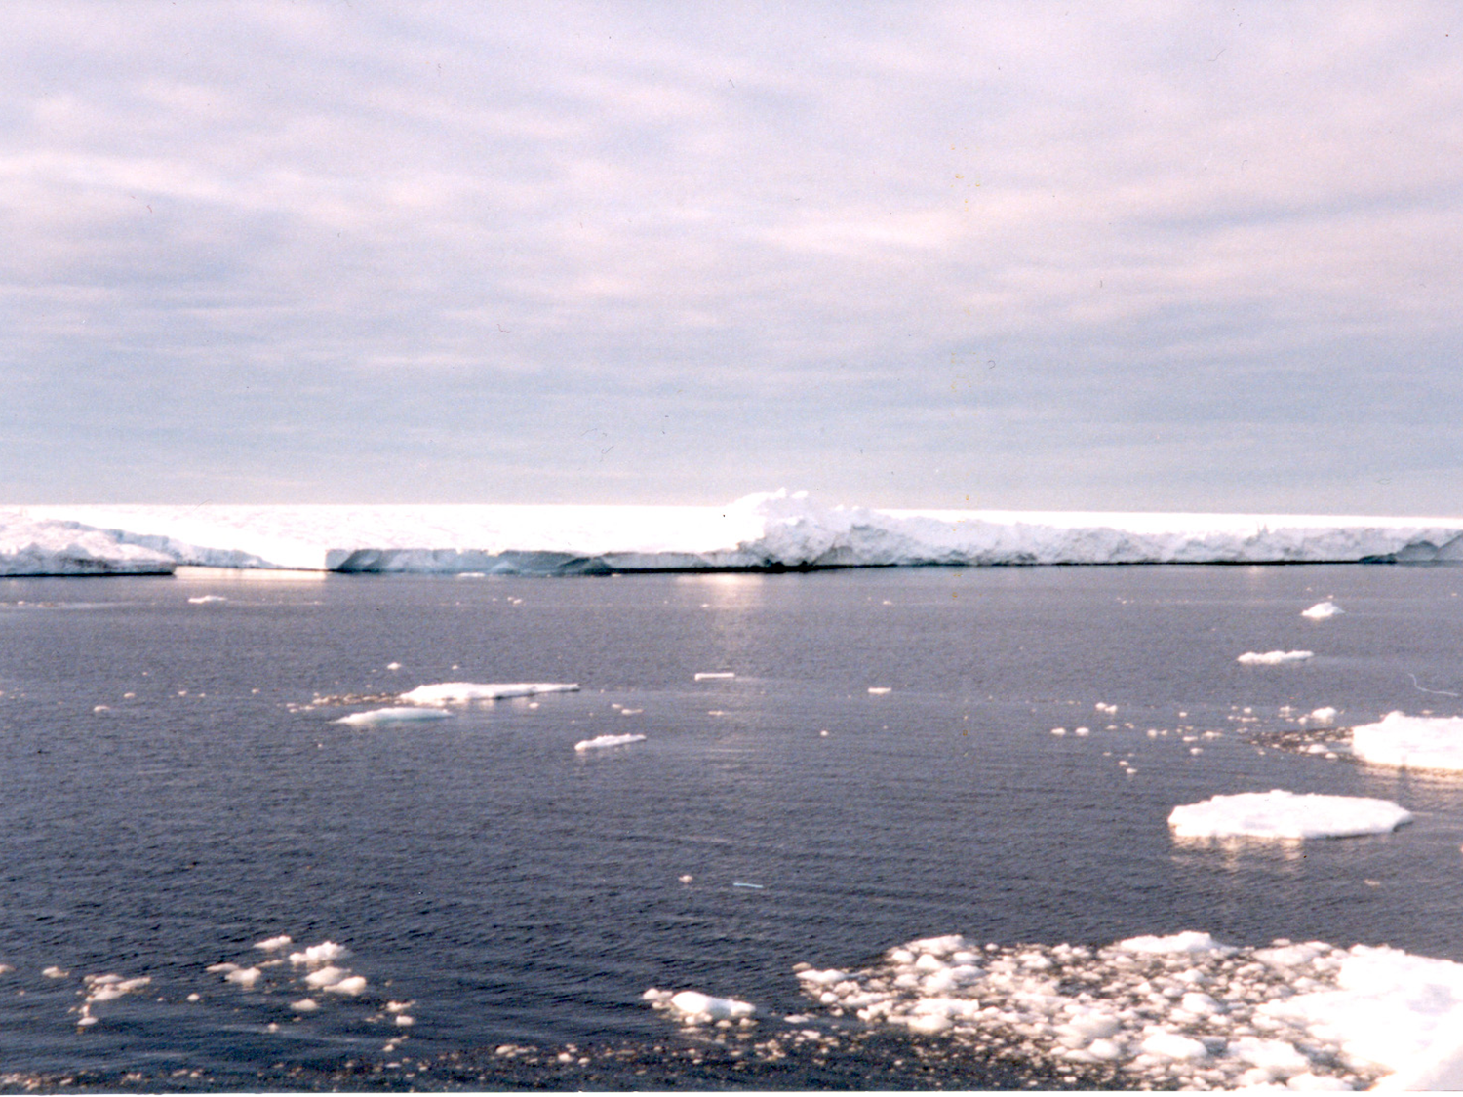
«Atlantification»
“An interannually variable ‘‘atlantification’’ of the water mass on Sentralbanken [Central Barents Sea] changed the bank from being part of the MIZ [marginal ice zone] characterized by melt water to a deeper mixed region.”
(Rengstad et al., 2002)
“…if the general positive trend in Atlantic heat input remains, winter cooling will likely be insufficient to produce ice over an increasing area, leading to further ‘‘Atlantification’’ of the Barents Sea.”
(Arthun et al., 2012)
“We present recent observation and modelling results, which suggest that retreat of the sea-ice edge in the Atlantic sector of the Arctic Ocean over several recent years may be an indication of the growing influence of Atlantic Water on the hydrographic regime (“Atlantification”).”
(Ivanov et al., 2015)
“This encroaching “atlantification” of the Eurasian Basin represents an essential step toward a new Arctic climate state, with a substantially greater role for Atlantic inflows.”
(Polyakov,… Ivanov et al., 2017)
Recent refer to “atlantification”: Oziel et al (2017), Barton et al. (2018), Lind et al (2018)

Slide 7
OUTLINE
1. Definitions
2. Reduction of the Arctic sea ice in 2000-2010s
3. Atlantic Water (AW) impact on the ice cover
3.1. Features of Atlantic Water distribution in the Arctic Ocean
3.2. Winter thermohaline convection in the Atlantic sector of the Arctic Ocean
3.3. Significance of sea ice properties
3.4. Conclisions-1
4. Impact of sea ice reduction on the upper ocean layer
4.1. Change of thermohaline conditions in the upper ocean layer
4.2. Increasing role of ocean-air interaction under changed conditions at the surface
4.3. Intensification of seasonal signal?
4.4. Conclusions-2
5. Possible perspective

Slide 8
Why the Arctic Ocean is permanently covered by the pack ice?
Negative radiation balance at the sea surface over the most part of the year.
The ocean heat is accumulated deep below the sea surface and does not play significant role in ice melt over the major part of the Arctic Ocean.
Intensive fresh water inflow leads to formation of protective layer with strong density stratification, the so-called “cold halocline”, which impedes vertical mixing.

Slide 9

Atlantic Water and sea ice
“… It does not seem unreasonable to believe that the … portions of the Gulf Stream and Kuro Siwo that penetrate the Arctic Ocean, carry with them warmth enough not only to dissolve all the ice and snow they encounter in their paths, but enough also to keep an open sea about the Pole” …
Navigator Silas Bent on “Expedition to the North Pole”
A letter to Charles P. Daly, Esq., President American Geographical and Statistical Society, New York, October 12, 1868

Slide 10
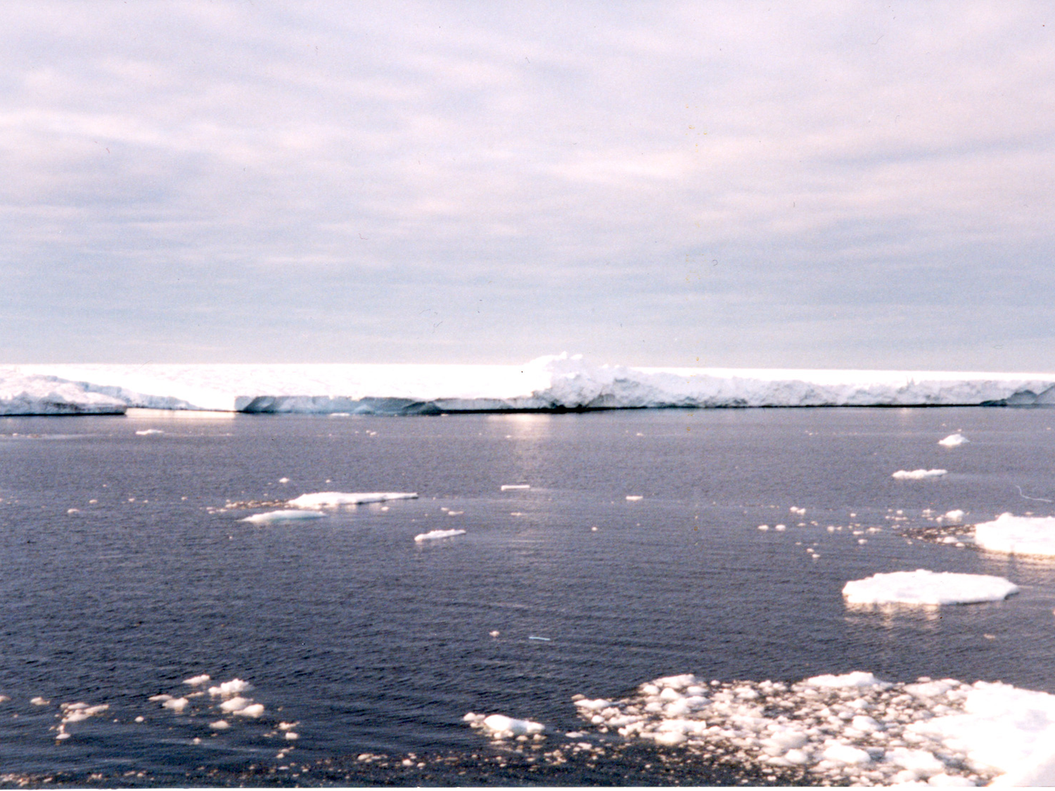
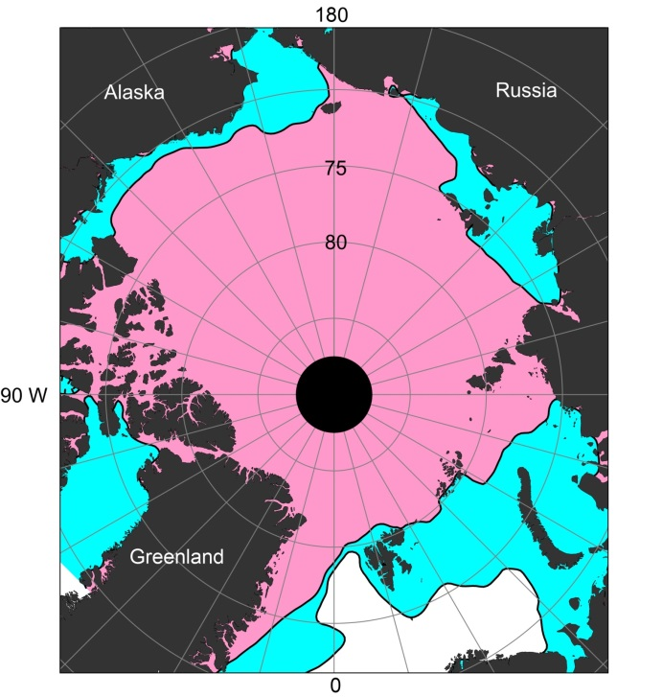
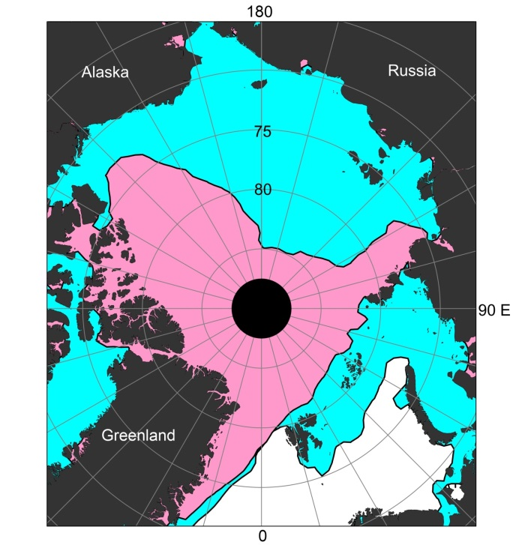
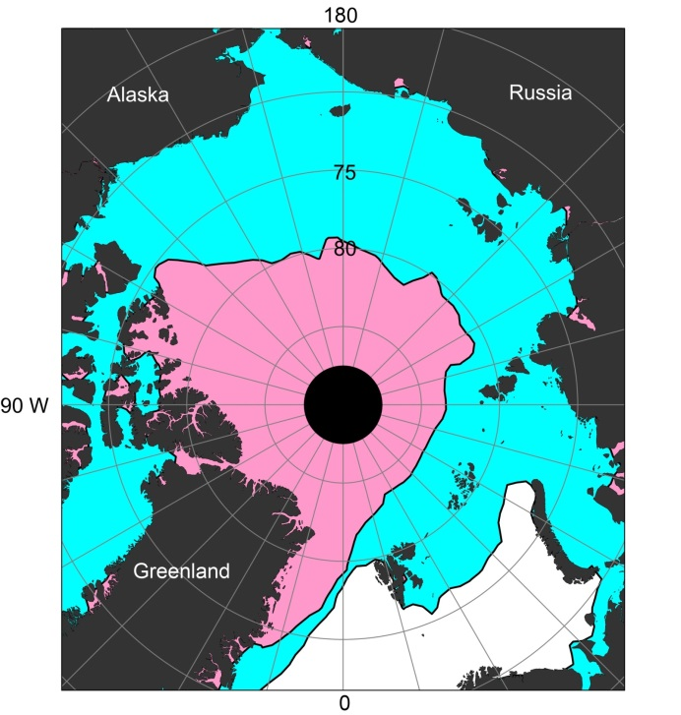
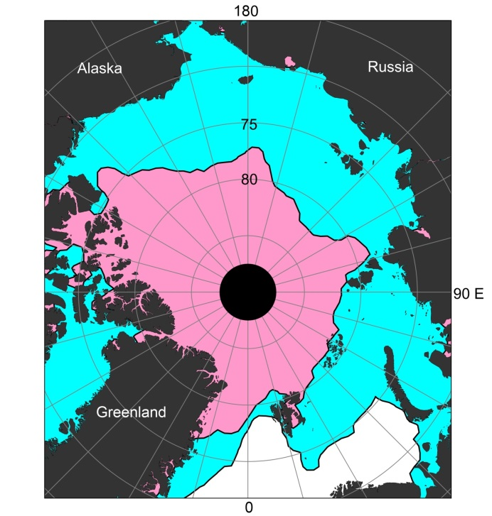
Seasonal changes of sea ice extent (15% sea ice concentration) in the Arctic Ocean
March – blue
September - pink
1979-2000
2007
2012
2016
(Ivanov et al., 2013)
AMSR-E and SSMIS data http://nsidc.org/data/nsidc-0051.html

Slide 11
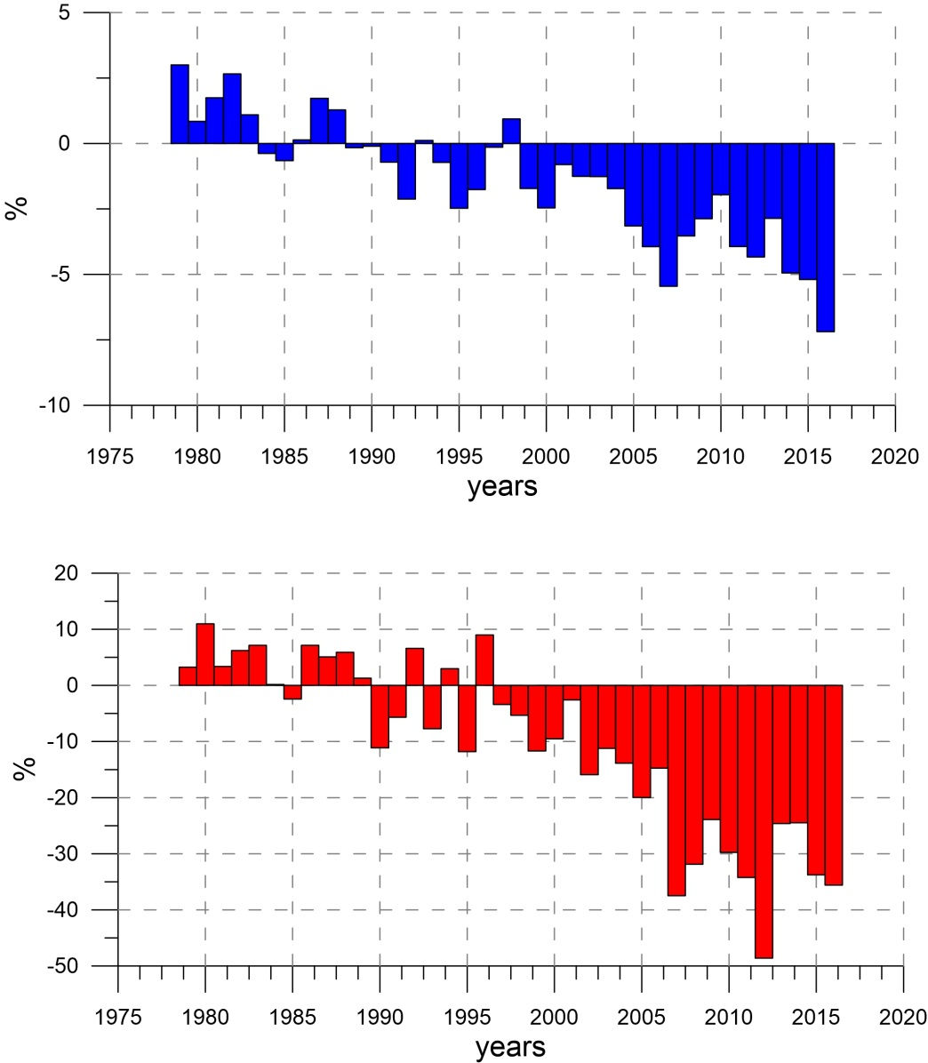
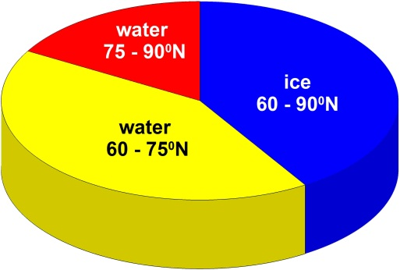
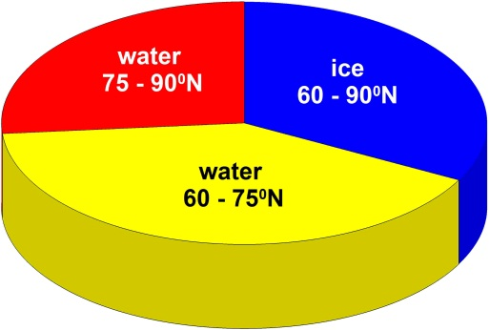
Anomalies of sea ice square
Squares of sea ice and open water
March
1979-2000
September
2007-2016
(Ivanov et al., 2013)
Data from: Nimbus-7 Scanning Multichannel Microwave Radiometer (SMMR) and the Defense Meteorological Satellite Program (DMSP) Special Sensor Microwave/Imager (SSM/I) Passive Microwave Data dataset. (http://nsidc.org/data/nsidc-0051.html)

Slide 12
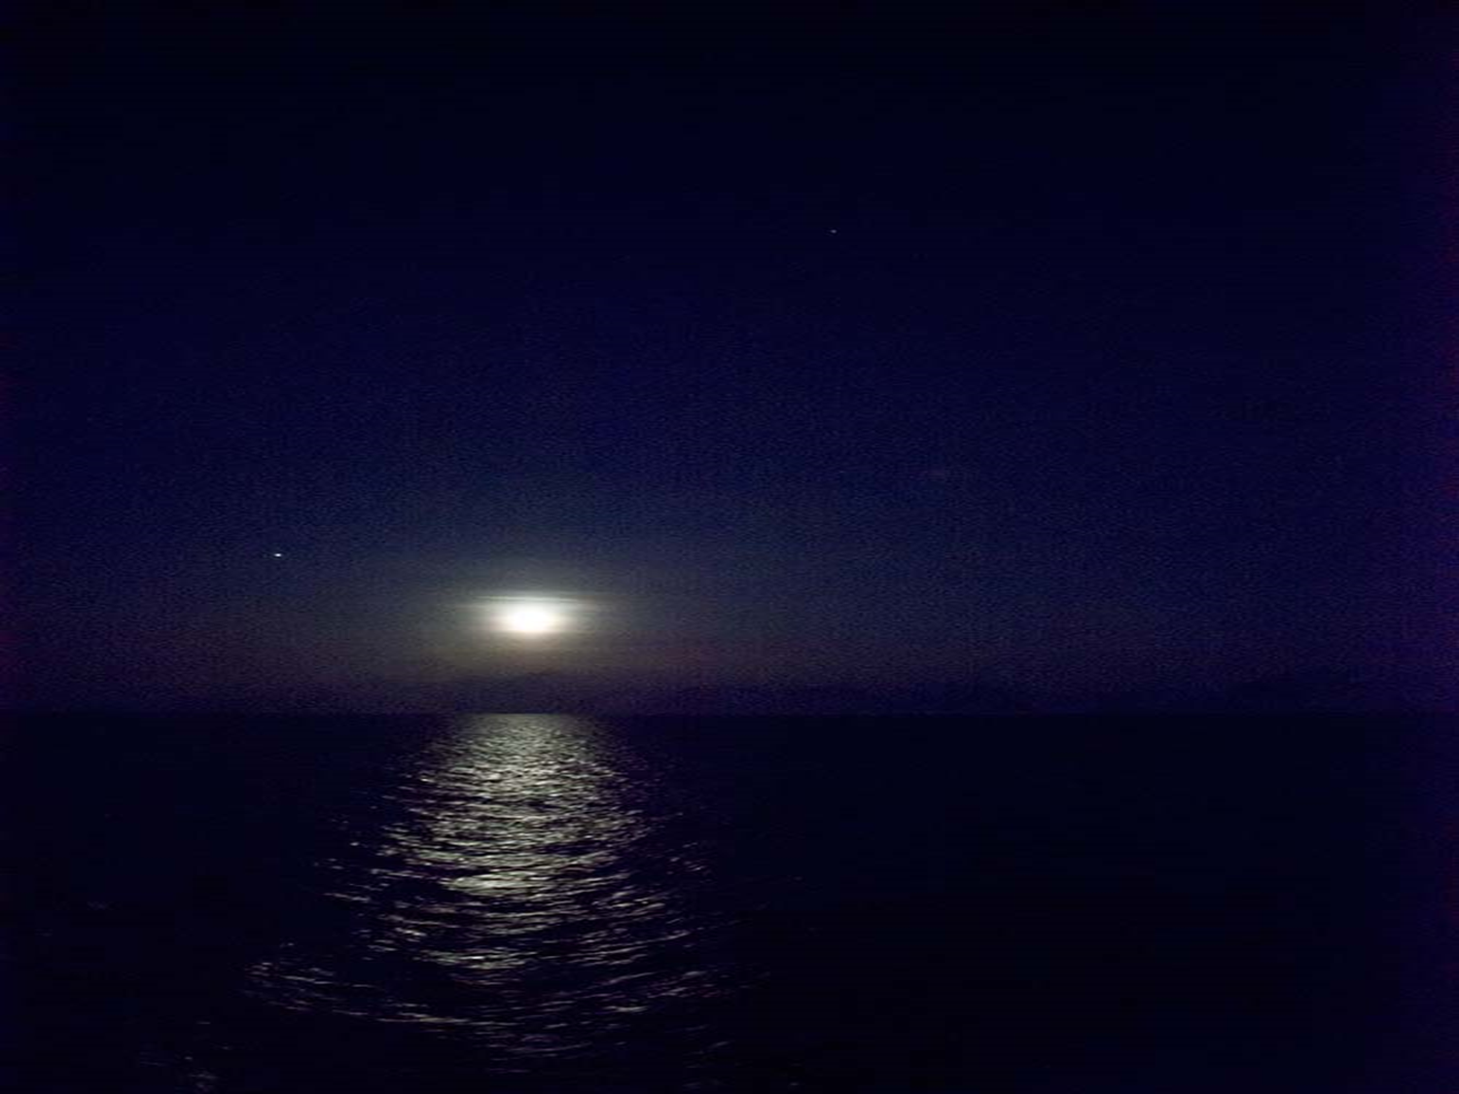
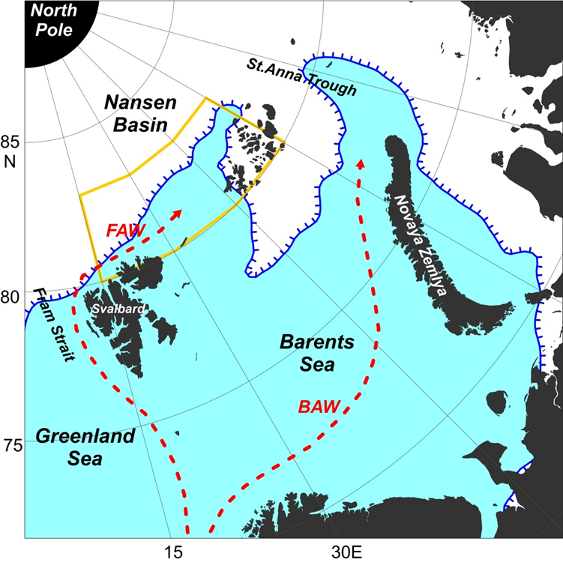
Atlantic Water effect on the ice cover
In mid-winter heat flux from the Atlantic Water in the Western Nansen Basin and in the Barents Sea slows down ice formation and provides ice removal over extended areas along the Atlantic Water pathways.
Nansen Basin, 82°N., 20°E., January, 14, 2014, Carbonbridge cruise on R/V “Helmar Hanssen”.
Mean edge of 50% concentration ice cover in February 1979-2000 (blue) and in February 2012-2014 (red)

Slide 13
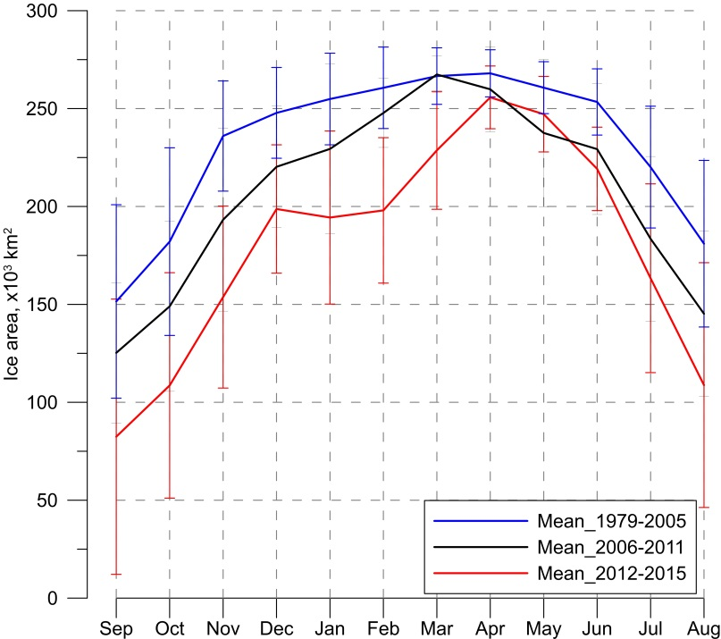
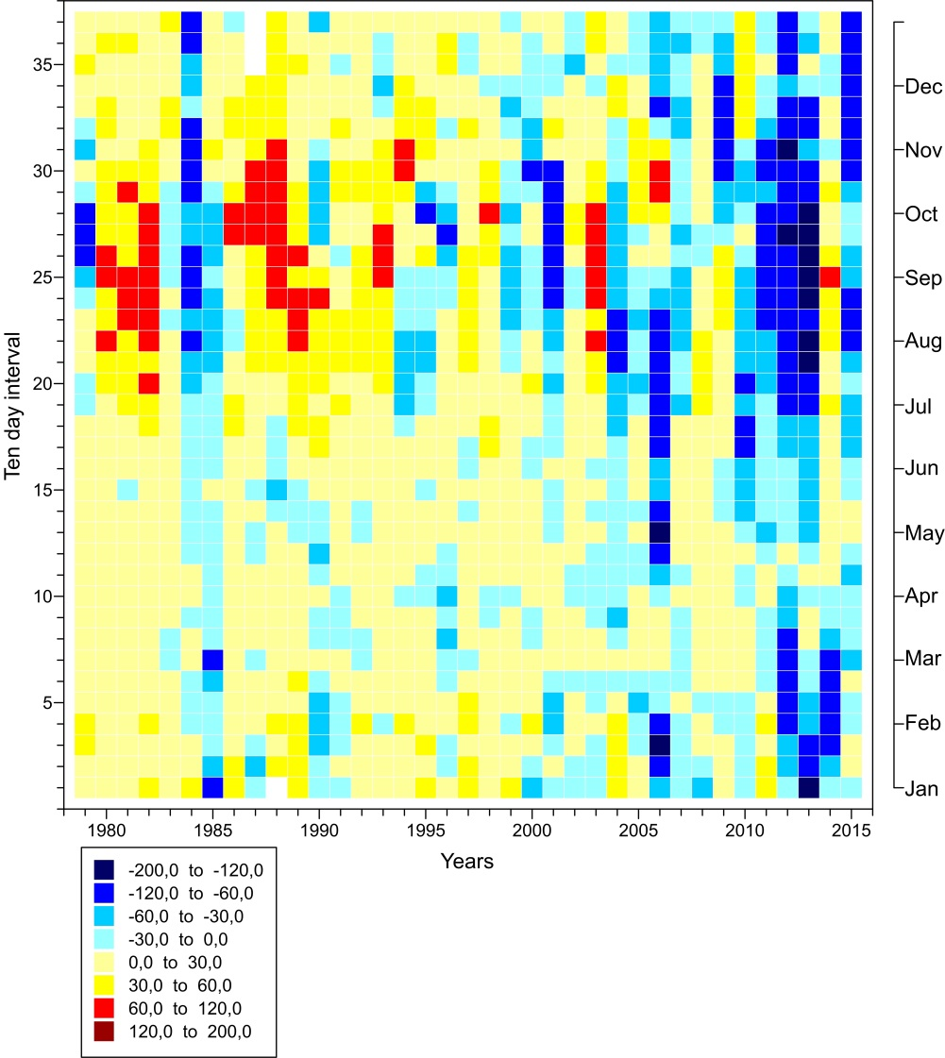
Seasonal and interannual variability in the Western Nansen Basin (80-83°N, 15-60°E)
Mean seasonal change of the sea ice area in the WNB (x10⁻³ km²) in 1979-2000 and in 2012-2015. Vertical bars show sample standard deviation.
Year to year distribution of ice area anomalies (x10⁻³ km²) for sequential decades.
[Ivanov et al., 2016]

Slide 14
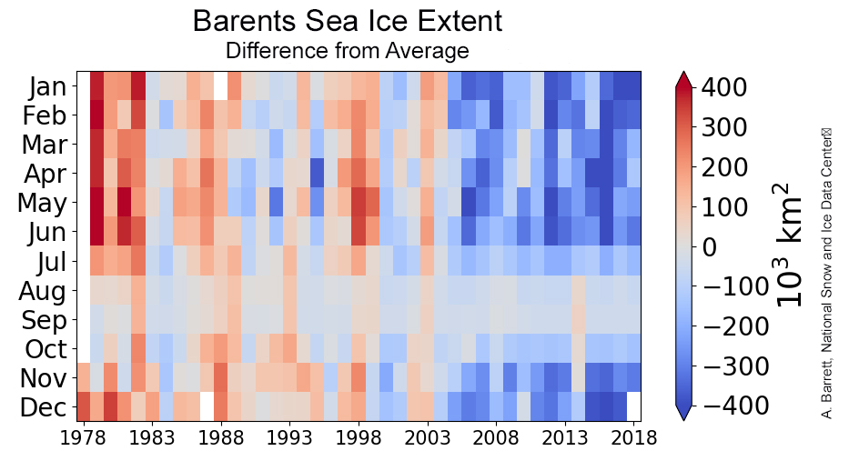
Web-site: Arctic sea ice news and analysis

Slide 15
Work hypothesis:
As a result of the reduction of sea ice cover, the influence of warm intermediate waters of Atlantic origin on the ice cover in the Atlantic sector Arctic of the Arctic Ocean in winter significantly increased?

Slide 16
OUTLINE
1. Definitions
2. Reduction of the Arctic sea ice in 2000-2010s
3. Atlantic Water (AW) impact on the ice cover
3.1. Features of Atlantic Water distribution in the Arctic Ocean
3.2. Winter thermohaline convection in the Atlantic sector of the Arctic Ocean
3.3. Significance of sea ice properties
3.4. Conclisions-1
4. Impact of sea ice reduction on the upper ocean layer
4.1. Change of thermohaline conditions in the upper ocean layer
4.2. Increasing role of ocean-air interaction under changed conditions at the surface
4.3. Intensification of seasonal signal?
4.4. Conclusions-2
5. Possible perspective

Slide 17
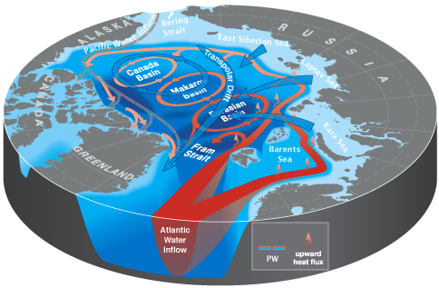
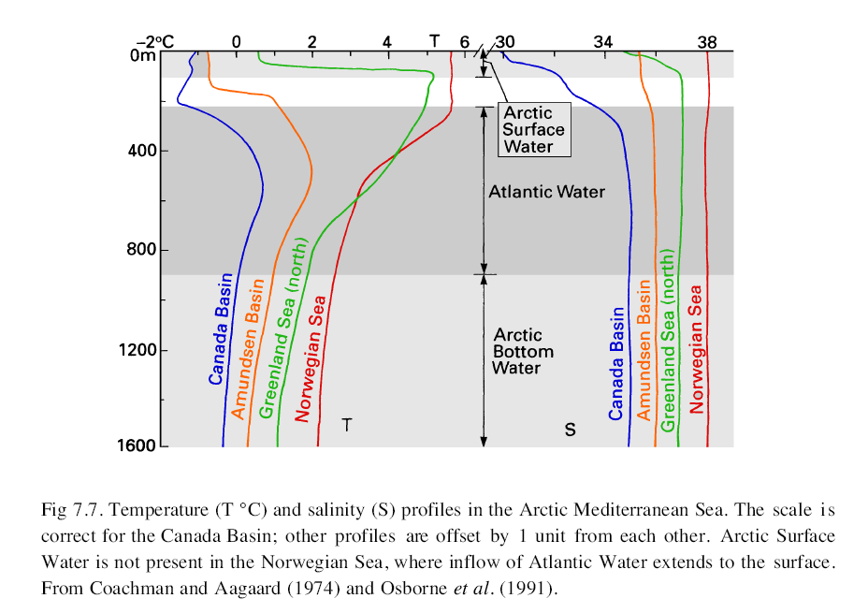
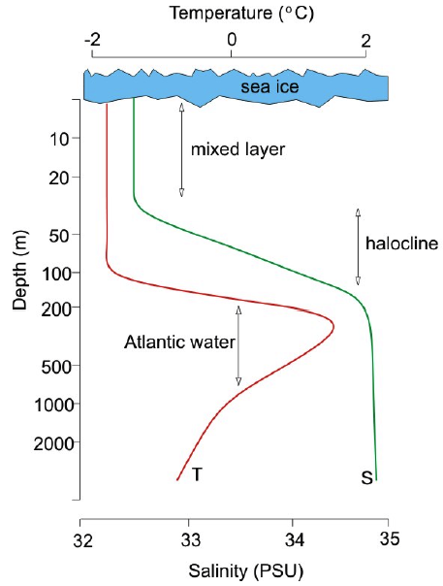
Scheme of T&S vertical distribution in the Arctic Ocean
Scheme of large scale transports in the Arctic Ocean

Slide 18
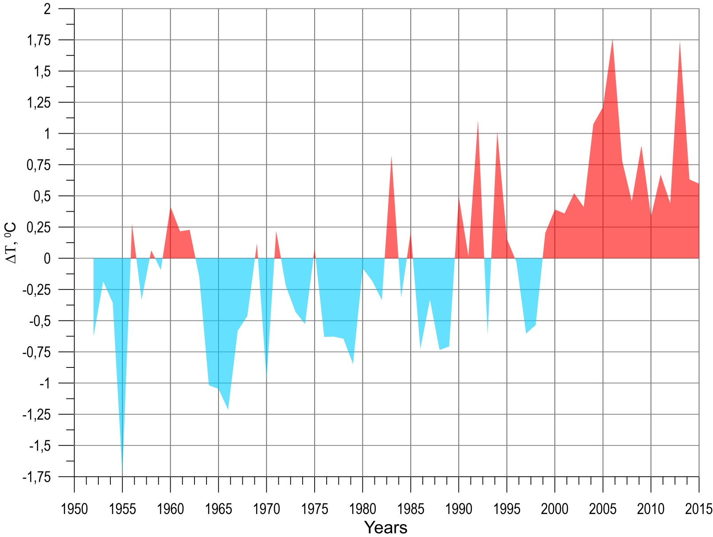
Temperature anomaly in 50-200 m layer in Fram Strait
5-10E, 78-80N
[AARI oceanographic database]

Slide 19
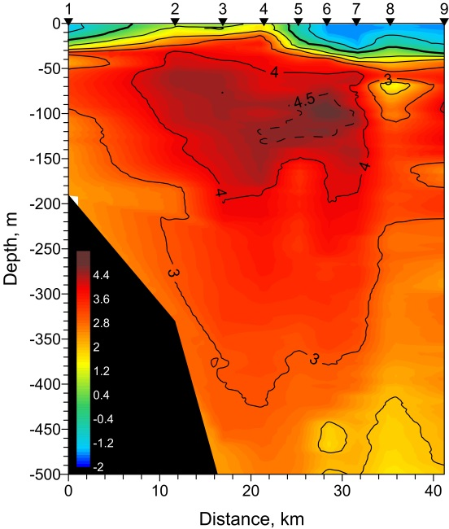
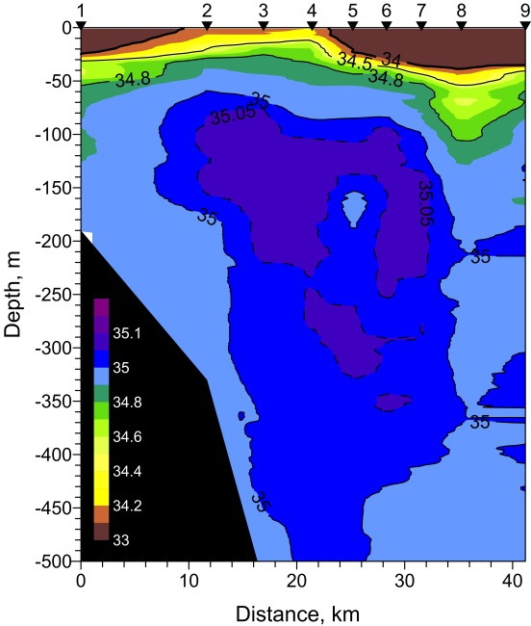
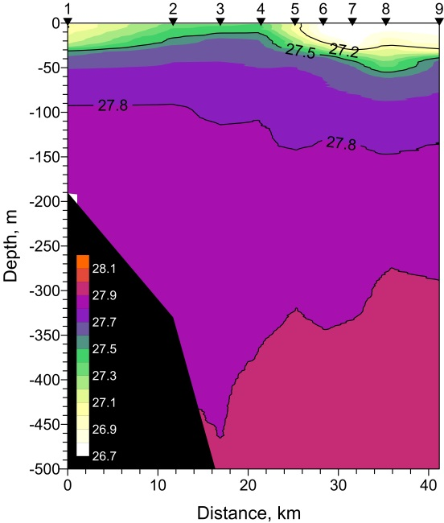
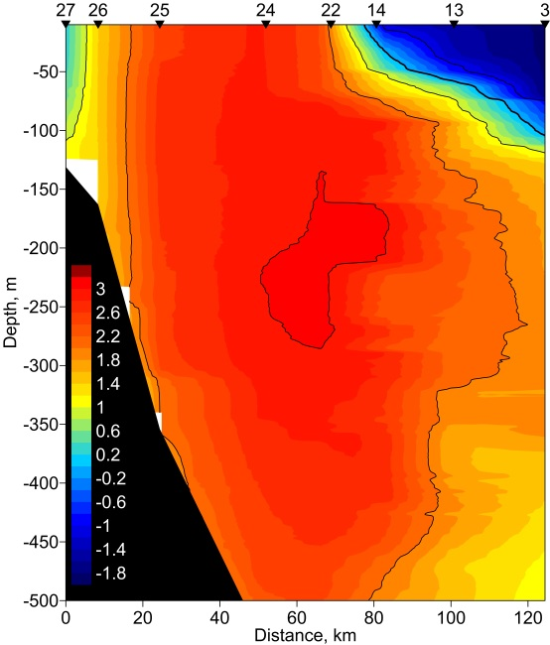
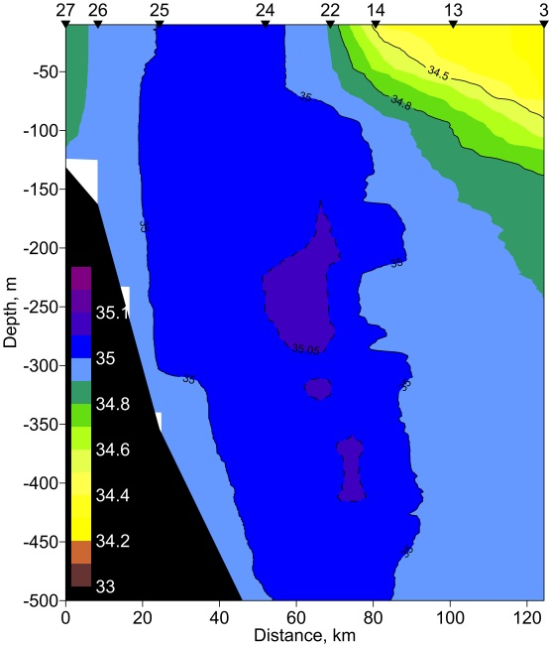
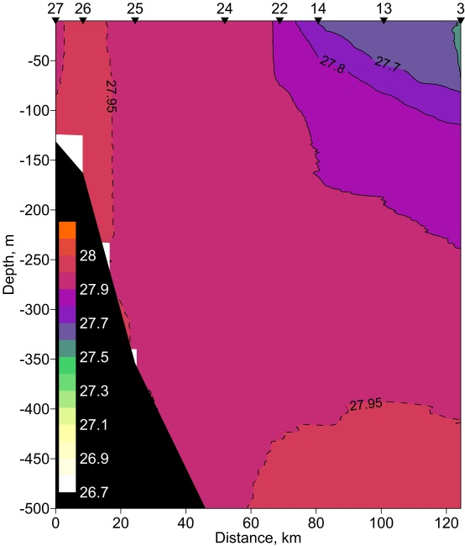
Cross-sections of temperature, salinity and potential density
October, 27, 2008: 31°E
[Ivanov et al., 2016]
T
S
σ_{t}
January, 15, 2014: 20°E
[Ivanov and Repina, 2019]
T
S
σ_{t}
Notes:
Иллюстрация достижения АВ поверхности в зимний сезон в районе к востоку от Шпицбергена. Более восточное проникновение АВ вблизи поверхности в 2010-е годы предположительно связано с сокращением ледяного покрова (меньше тепла расходуется на таяние льда)

Slide 20
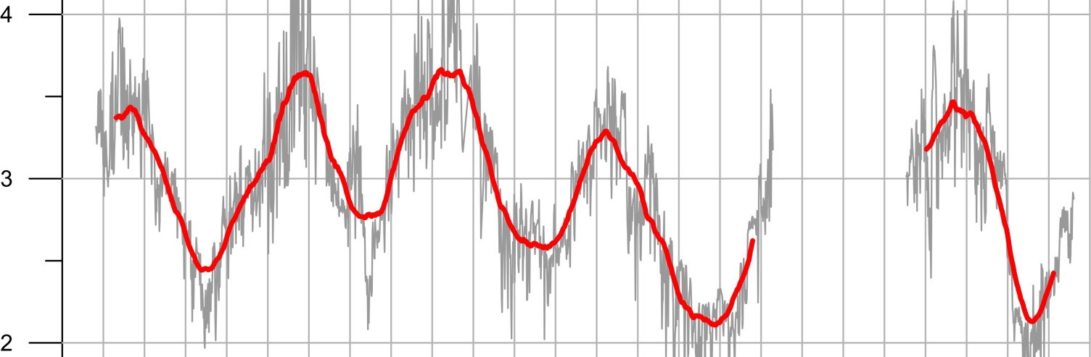
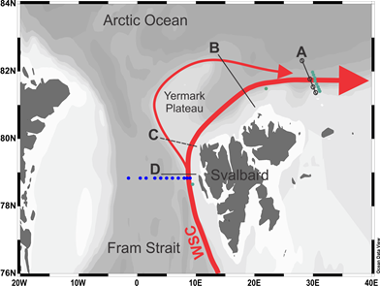
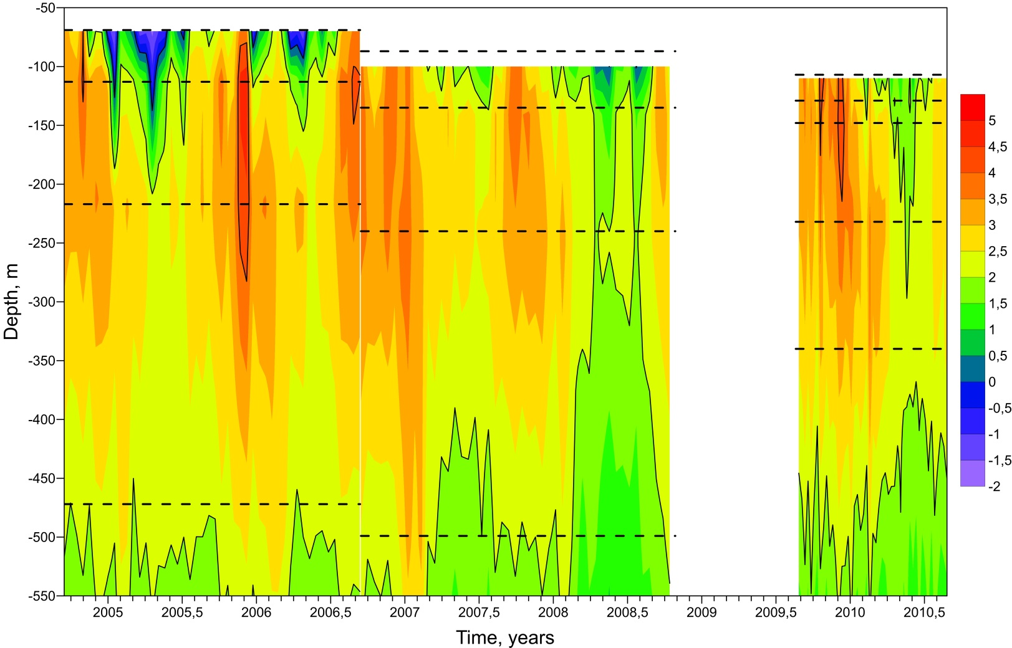
Seasonal variation of the AW temperature at 31 deg. E (A-trasect)
220 m
The range of seasonal cycling in the AW warm core is of about 1ºС with maximum temperature in winter

Slide 21
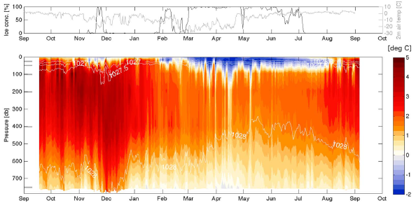
Long term monitoring in the Western Nansen Basin 81⁰N, 31⁰E
2012
2013
(Renner et al., 2018)

Slide 22
A possible mechanism of winter reduction of sea ice in the Atlantic sector of the Arctic Ocean in the 2010s:
Thermal impact from the ocean through thermal convection, raising warm salt water from the intermediate layer to the surface.

Slide 23
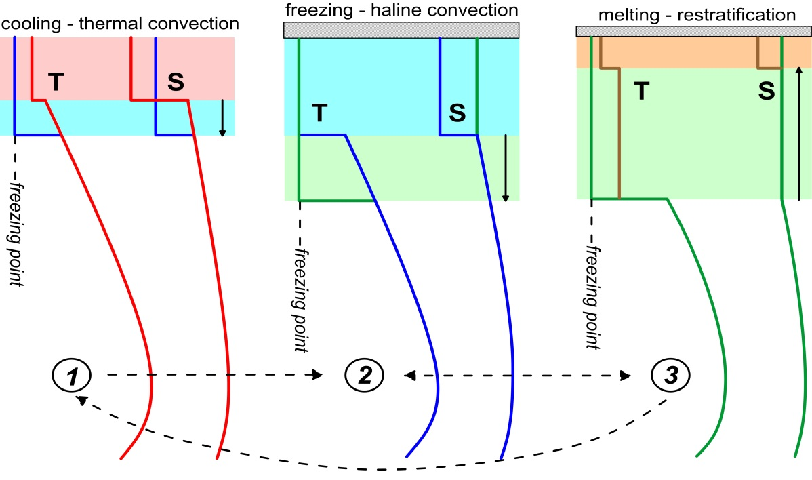
One-dimensional model of winter thermohaline convection
1
1. Cooling at the surface –> thermal convection –> mixed layer deepening
2. Ice formation –> brine ejection –> haline convection –> mixed layer deepening
3. Upwelling of warm waters –> ice melt –> mixed layer shallowing and re-stratification near the surface
2
3
(Ivanov et al., 2016)

Slide 24
Model calculations
Initial data:
October, 27, 2008: 31°E
T
S
σ_{t}
(Ivanov et al., 2016)
Notes:
Иллюстрация достижения АВ поверхности в зимний сезон в районе к востоку от Шпицбергена. Более восточное проникновение АВ вблизи поверхности в 2010-е годы предположительно связано с сокращением ледяного покрова (меньше тепла расходуется на таяние льда)

Slide 25
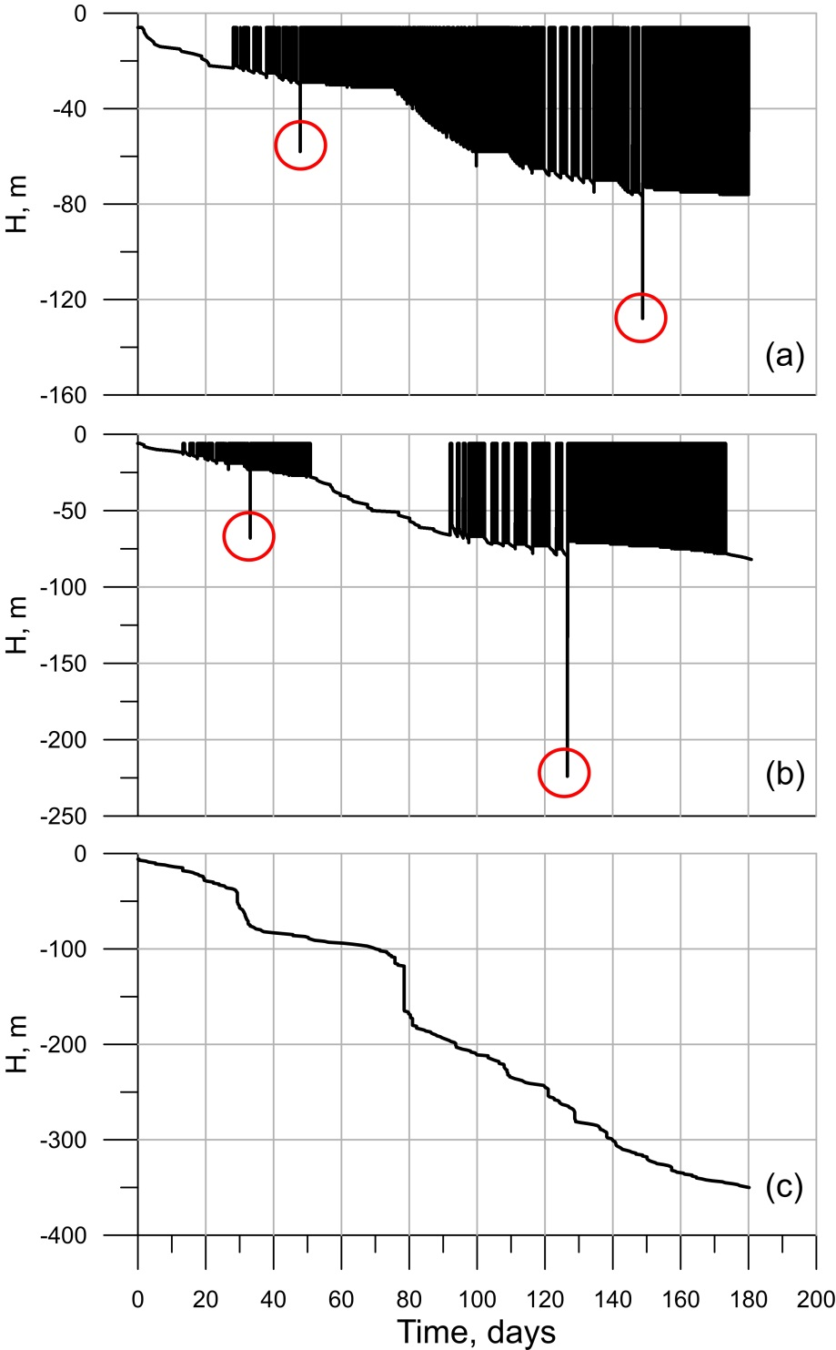
Model results
Temporal evolution of mixed layer depth, as obtained in model calculations with initial temperature and salinity distributions
shown at the previous slide at stations (a) 2, (b) 3, and (c) 4 with no ice, and the depth of the mixed layer equal to 5m at the beginning of calculations. Red circles indicate deep convection events.
For vertical thermohaline profile, as at station 4, no ice formation happens during the entire winter! Due to the deep penetration of convection, the heat flux from the ocean completely compensates heat transfer to the atmosphere.
(Ivanov et al., 2016)

Slide 26
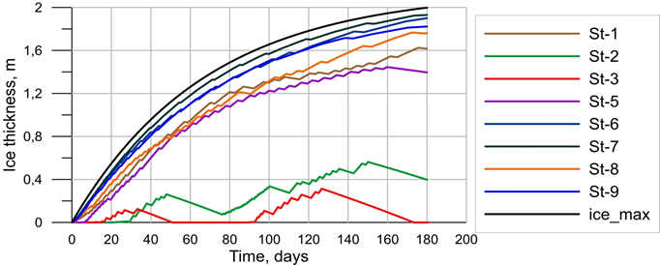
Time evolution of ice thickness
Initial depth of the mixed layer is equal to 5 meters The black line shows the evolution of ice thickness for the “ice-freezing” (without AW layer) ocean
(Ivanov et al., 2016)

Slide 27
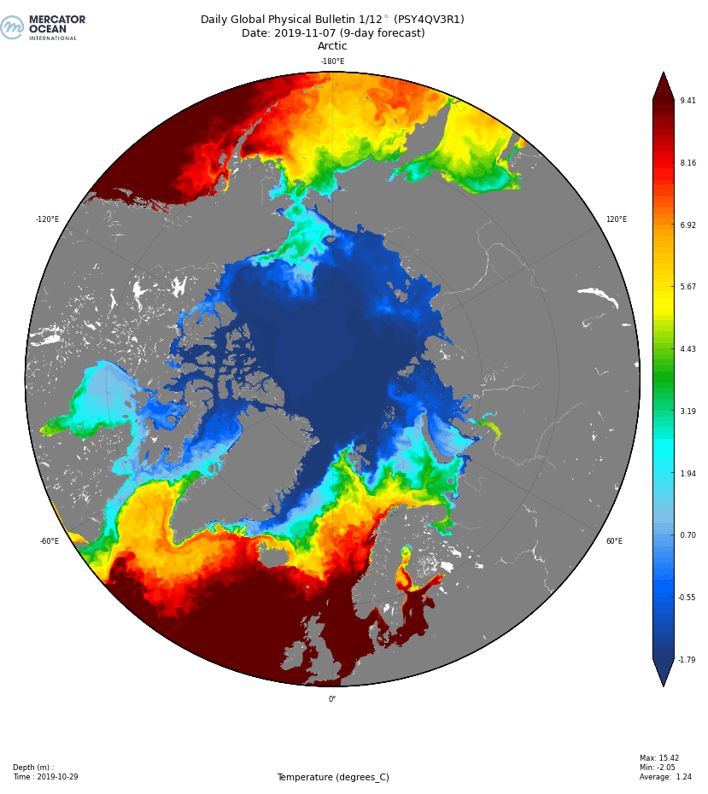
MERCATOR OCEAN: Ocean monitoring and Forecasting
Global Ocean reanalysis and forecast Daily Global Physical Bulletin at 1/12°

Slide 28
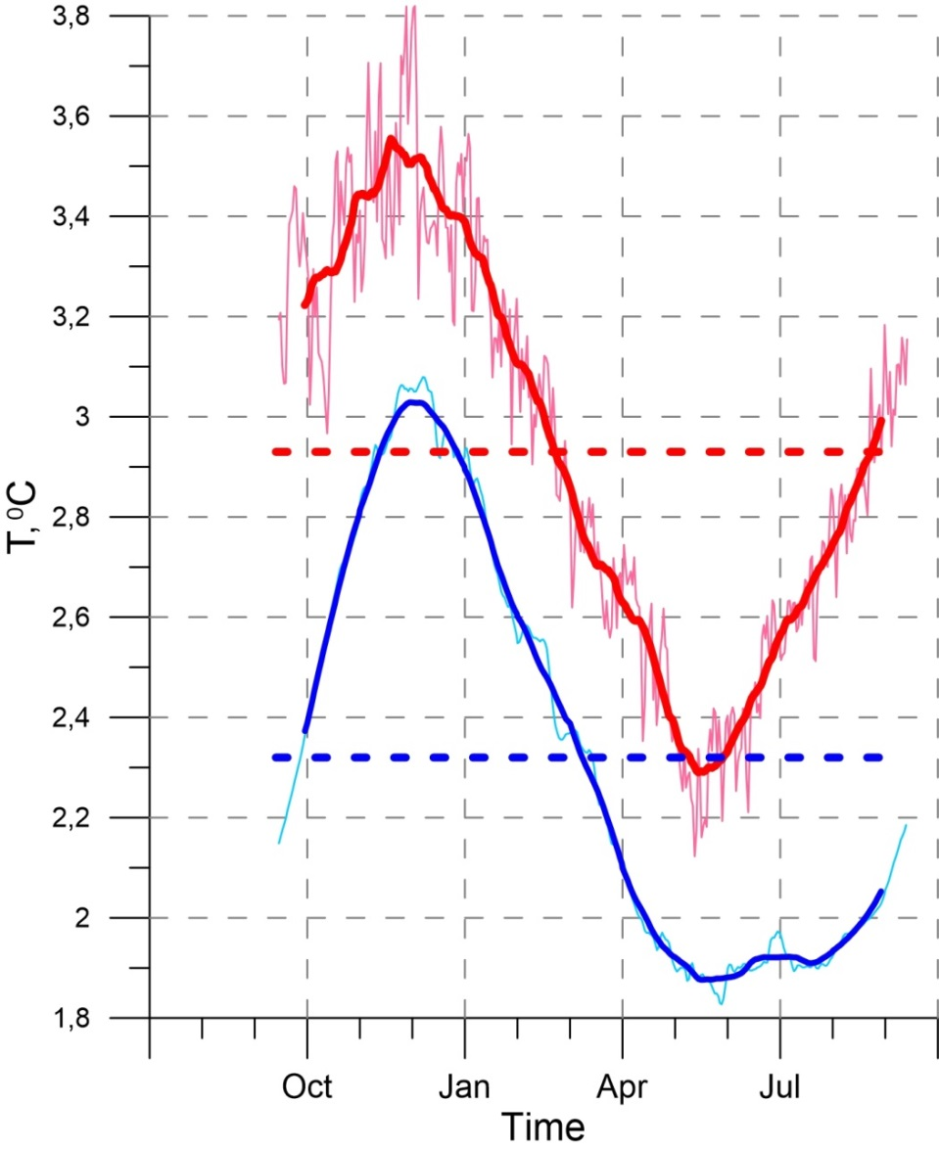
Comparison of MERCATOR reanalysis with observations
81⁰30’ N
31⁰00’E.
[Ivanov et al., 2018]
Mean seasonal oscillations of temperature in the AW «kernel» based on NABOS data (http://nabos.iarc.uaf.edu/) – red curve: 2004-2009; and MERCATOR reanalysis (https://www.mercator-ocean.fr/en/) - blue curve: 2007-2017. Daily data – thin lines; two-month running average - thick lines)

Slide 29
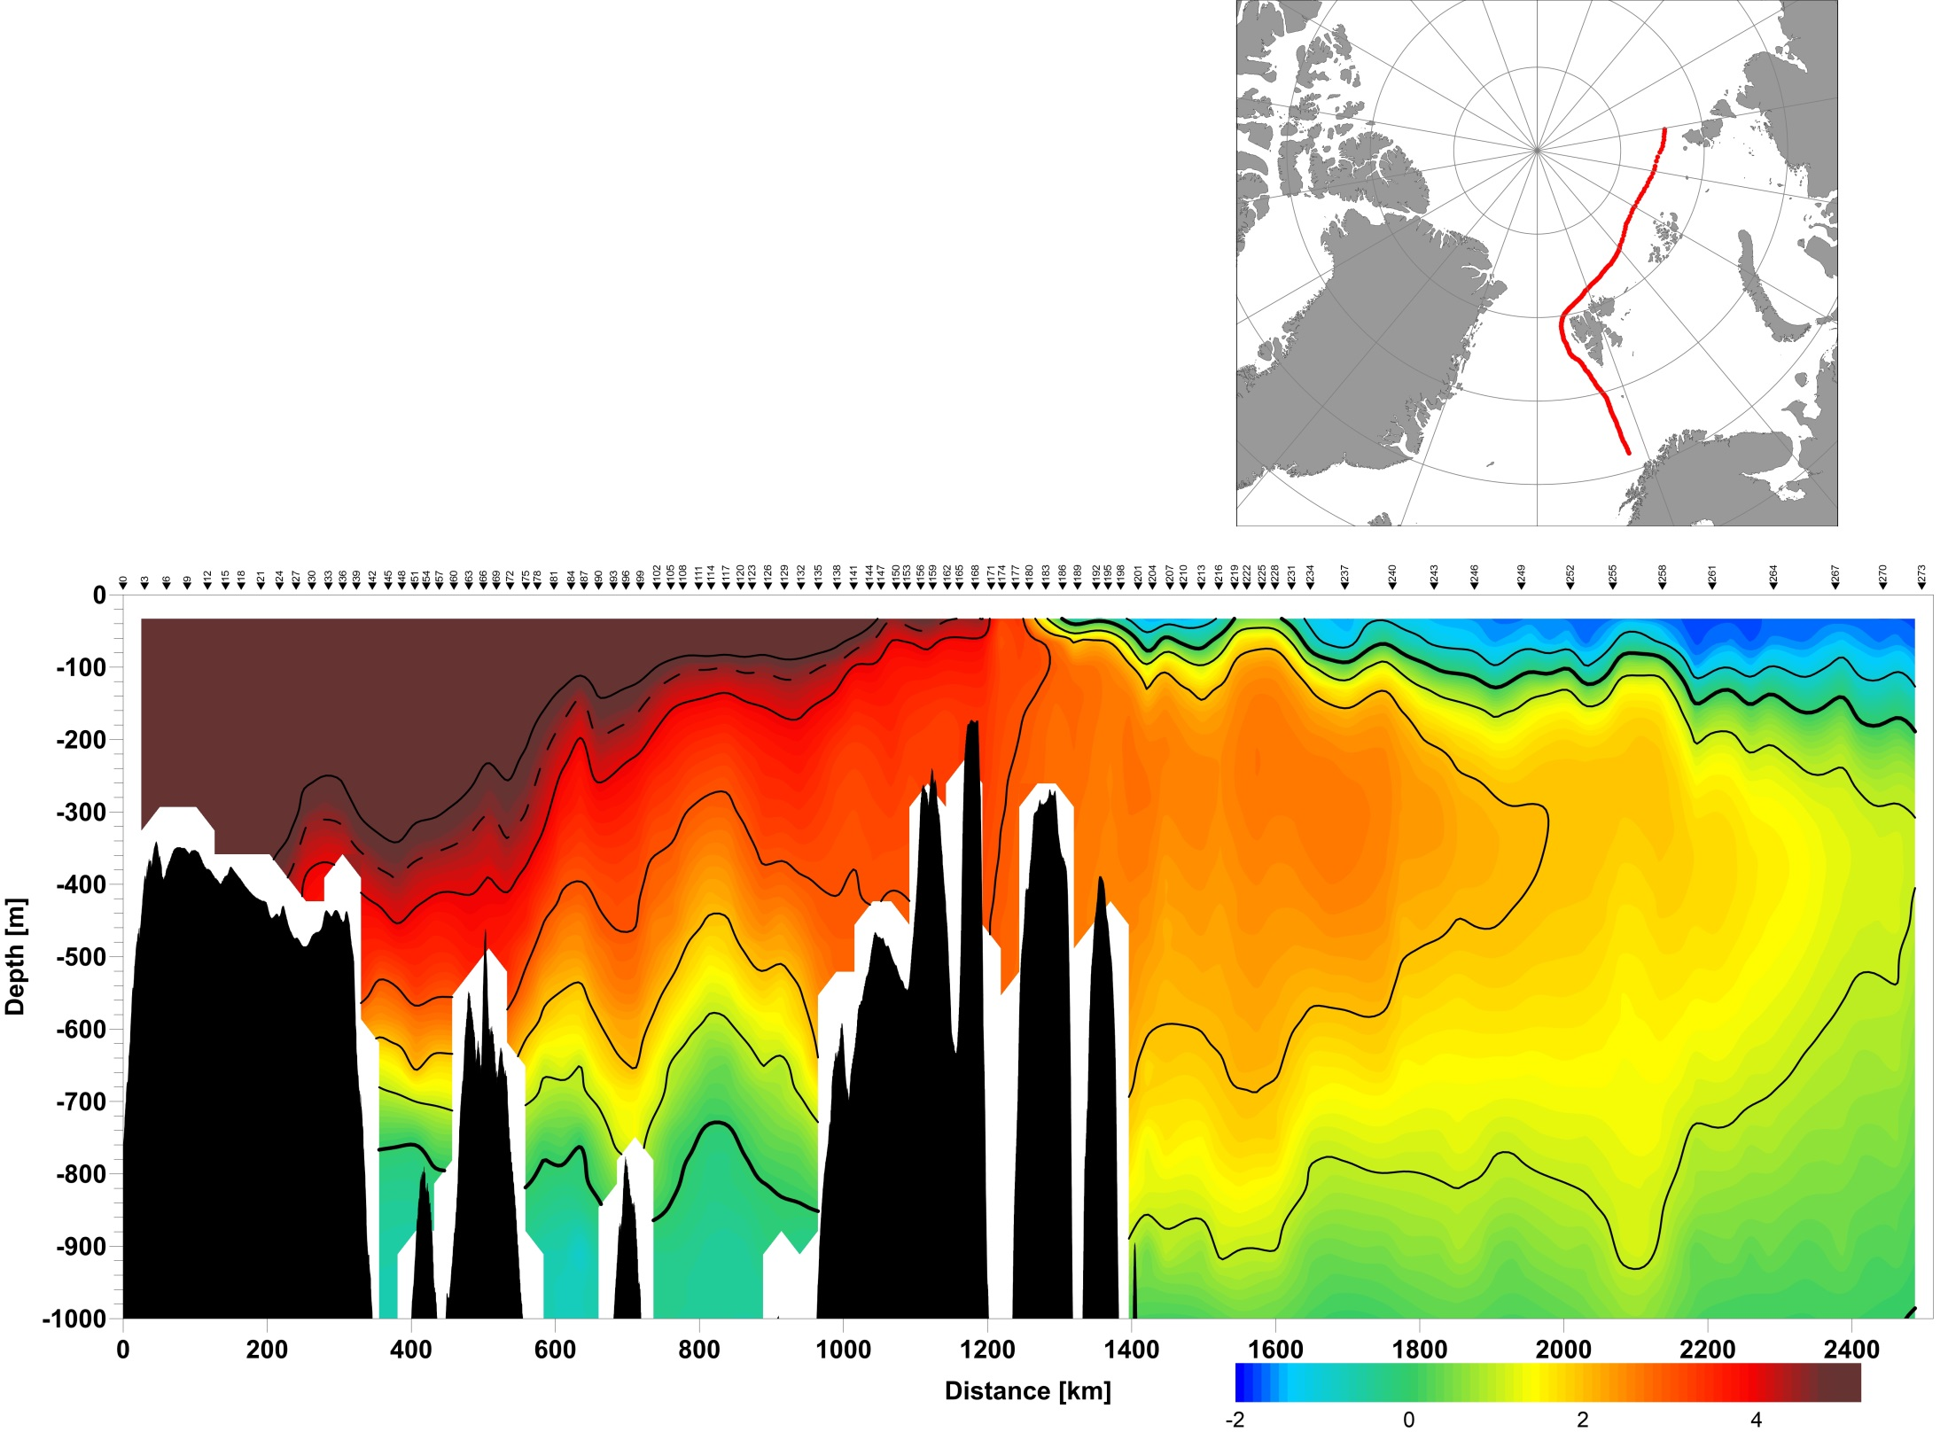
Atlantic Water inflow in the Arctic Basin according to MERCATOR reanalyss
Vertical distribution of temperature along the AW inflow pathway in the Nordic Seas and in the Nansen Basin (according to MERCATOR Ocean global operational system reanalysis NEMO, version 3.2 with data assimilation, https://www.mercator-ocean.fr/en/).
[Ivanov et al., 2018]

Slide 30
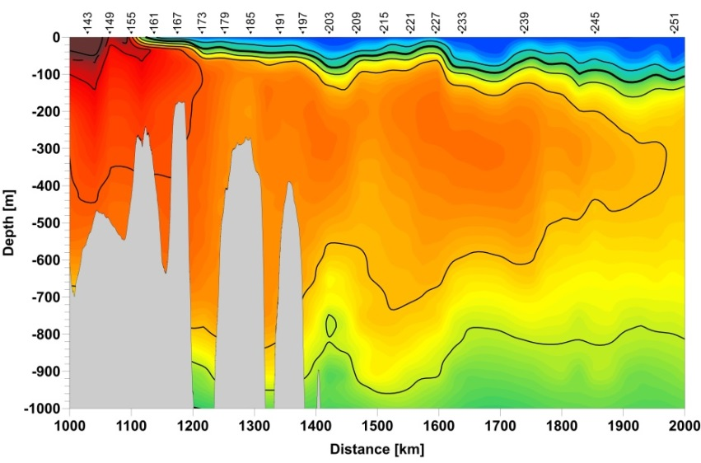
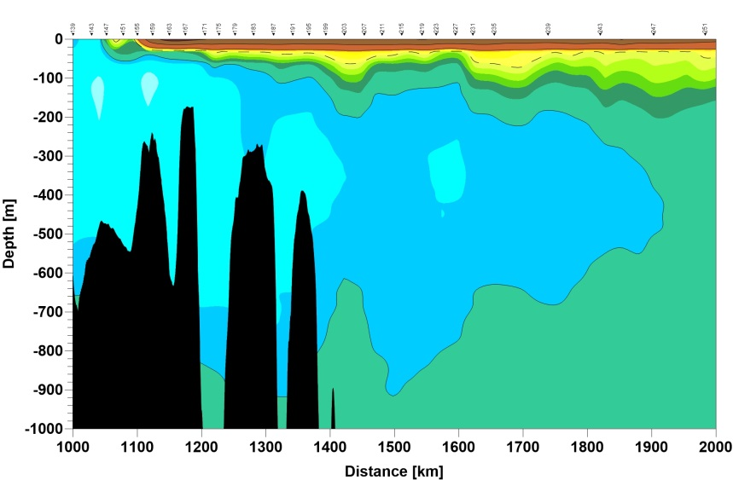
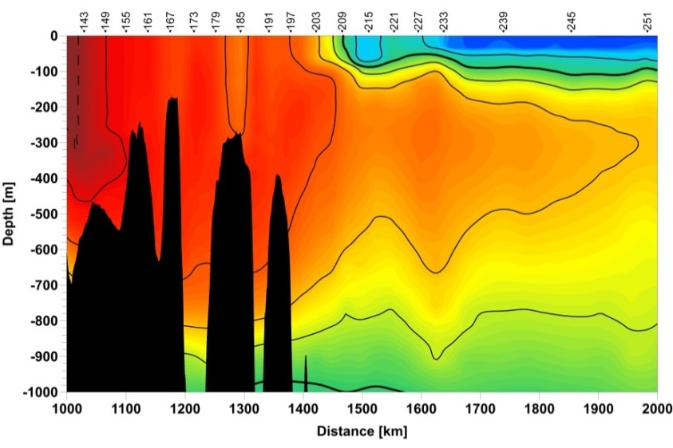
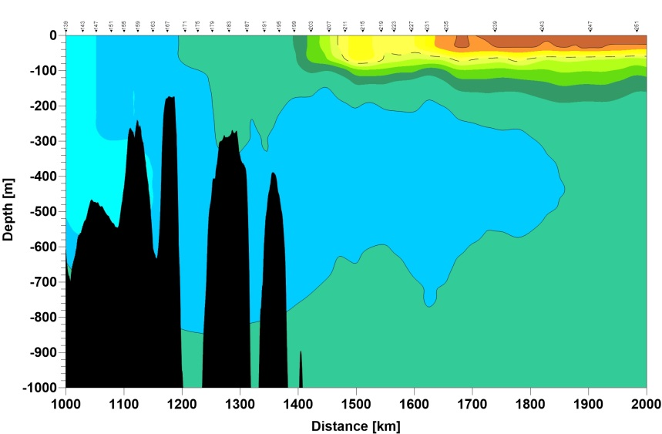
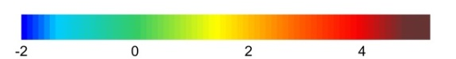
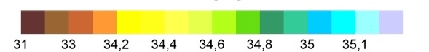
Application of MERATOR reanalysis : North-East of Svalbard
Temperature
Salinity
July-2015
July-2015
December-2015
December-2015
[Ivanov et al., 2018]
Seasonal Change of Thermohaline Structure in the WNB: July 2015 to February 2016

Slide 31
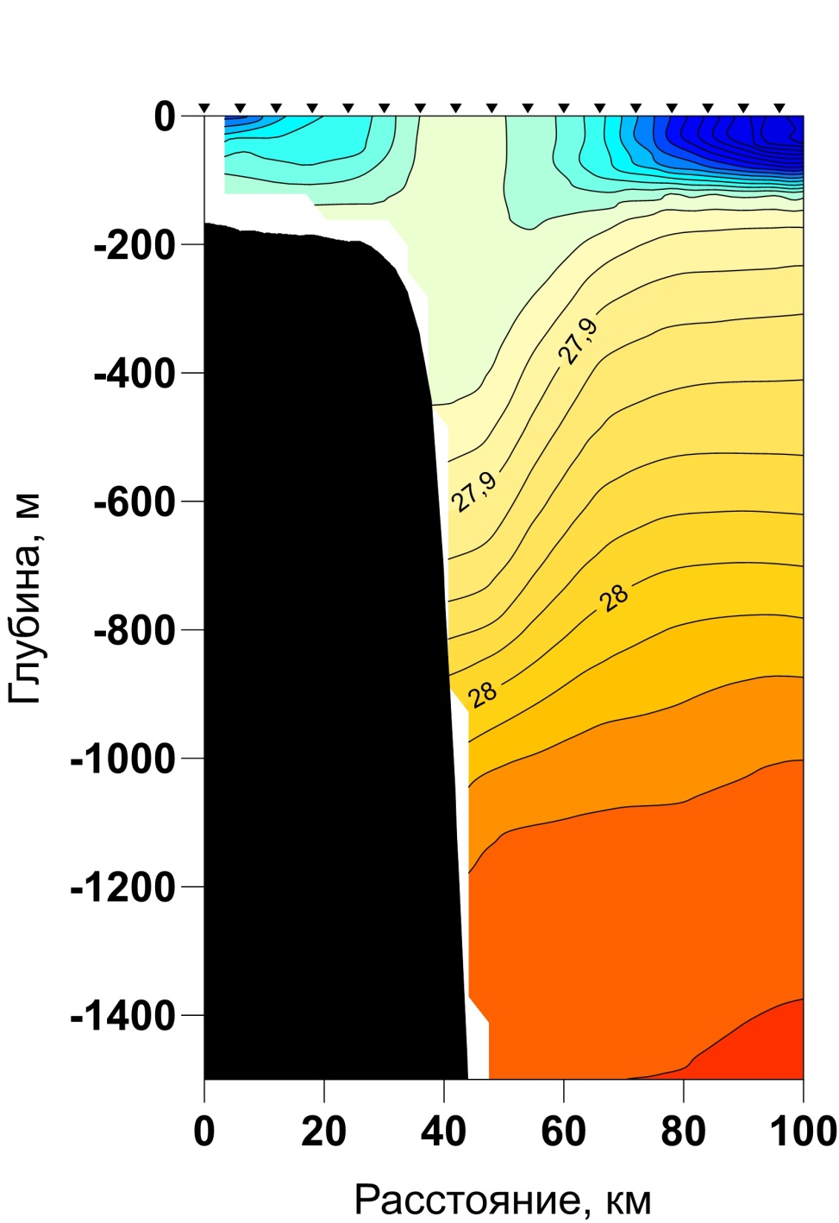
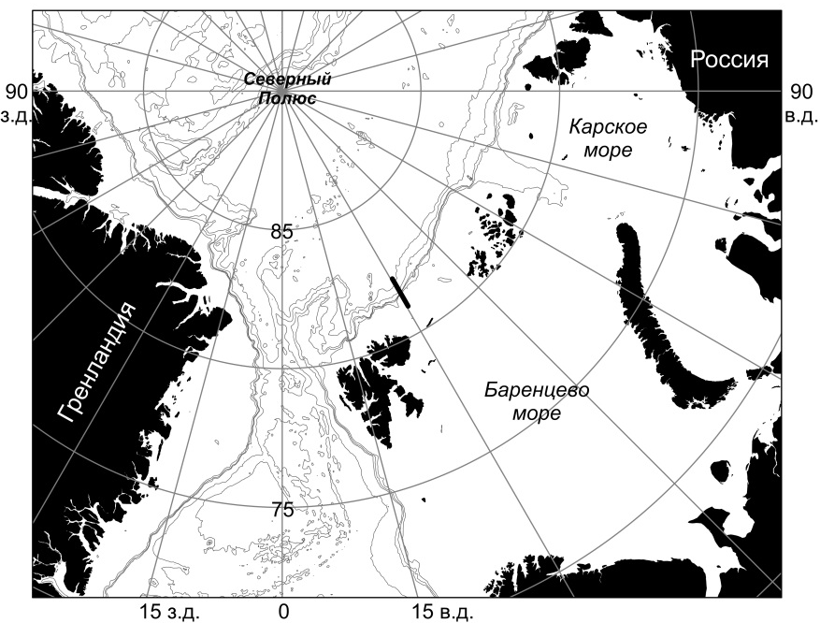
Winter convection as reproduced in reanalysis data
Vertical distribution of potential density anomaly (kg/m³) at the cross-slope transect (right panel) on December, 31 декабря, 2016 according o MERCATOR reanalysis.
(Aksenov and Ivanov, 2018)

Slide 32
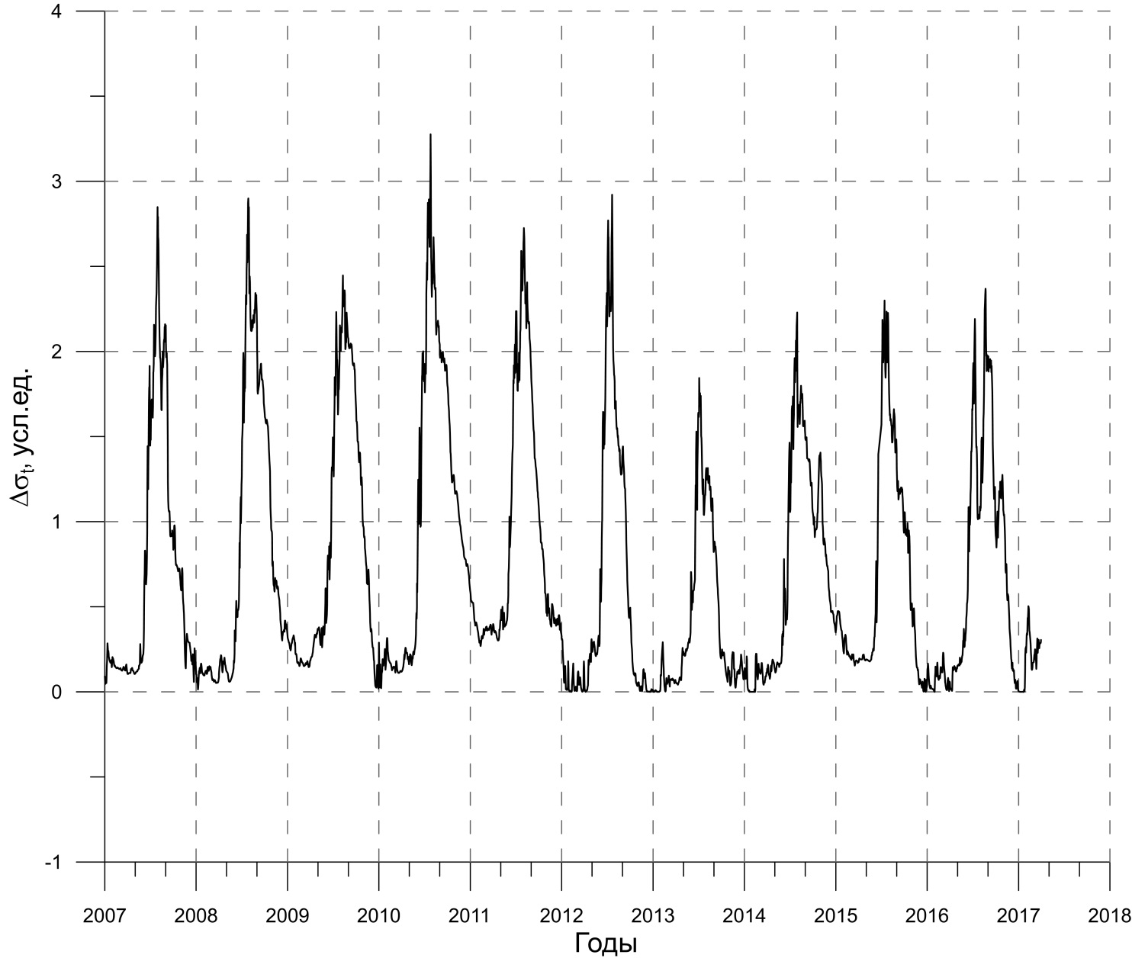
Time series of potential density anomaly (kg/m³) between 155m depth and the ocean surface inside 25 х 25 km area with center in the point 81°30’N, 31°E according to the MERCATOR data.

Slide 33

Estimates of the role of the initial ice thickness in a one-dimensional model
Temporal evolution of ice thickness, as obtained in the model calculations with initial temperature and salinity distributions at station 4 and different initial ice thickness. Temporal
evolution of the (b) mixed layer depth and (c) temperature of the mixed layer in the experiment with initial ice thickness equal to 75 cm. Red circle indicates a deep convection event.
(Ivanov et al., 2016)

Slide 34







Ice drift according to MERCATOR data
Ice thickness – color
Border of 50% concentration – white lines;
Drift speed – black arrows.
(а) January 2016
(б) February 2016
(в) March 2016
(г) January 2017
(д) February 2017
(е) March 2017
(а)
(г)
(б)
(д)
(в)
(е)
(Ivanov et al., 2018)

Slide 35

Conclusions-1
Formation of persistent and long-leaving anomalies of ice cover in winter north-east of Svalbard is probably linked with the increased seasonality of Arctic sea ice cover, enabling an enhanced influence of oceanic heat on sea ice, and in particular, heat transported by Atlantic Water.
When openings in ice cover form along the Atlantic Water pathway, weak density stratification at the mixed layer base supports the development of thermohaline convection, which further entrains warm and salty water from deeper layers.
Convection-induced upward heat flux from the Atlantic layer retards ice formation, either keeping ice thickness low or blocking ice formation entirely.
Influx of drifting ice in the favorable for convection region may retard or totally block convection development

Slide 36
OUTLINE
1. Definitions
2. Reduction of the Arctic sea ice in 2000-2010s
3. Atlantic Water (AW) impact on the ice cover
3.1. Features of Atlantic Water distribution in the Arctic Ocean
3.2. Winter thermohaline convection in the Atlantic sector of the Arctic Ocean
3.3. Significance of sea ice properties
3.4. Conclisions-1
4. Impact of sea ice reduction on the upper ocean layer
4.1. Change of thermohaline conditions in the upper ocean layer
4.2. Increasing role of ocean-air interaction under changed conditions at the surface
4.3. Intensification of seasonal signal?
4.4. Conclusions-2
5. Possible perspective

Slide 37

Location of regions with long-term observations in the Arctic Basin

Slide 38




Long-term changes of salinity in the Arctic Basin in the 5-20 m water layer
West
East-1
East-2
North Pole
Summer – red
Winter - blue

Slide 39




Long-term changes of temperature in the Arctic Basin in the 5-20 m water layer
West
East-1
East-2
North Pole
Summer – red
Winter - blue

Slide 40

Arctica-2018 cruise map

Slide 41


Slide 42




Upper ocean temperature anomalies
High temperatures (Tmax>3 ˚C) at M3 mooring in 2014
Tmax>3 ˚C
HC≈200 MJ/m² (Hice ≈ 70 cm )
Temperature, ˚C
Ice concentration (upper panel) and 2-year temperature record at M3 mooring (lower panel) Note: retaining positive temperature in the upper 50 m layer up to January, 2015.

Slide 43






Upper ocean temperature anomalies
August, 1996 , «Polarstern»
September, 2013, «Akademik Fedorov»
September 2015, «Akademik Tryoshnikov»
Ice concentration (upper panels) and temperature at transects across St.Anna Trough in summer in different years: intensive warming in the upper layer is evident in in 2013 and 2015, compared to 1996.
Notes:
Иллюстрация значительного потепления верхнего слоя в условиях сокращения летнего ледяного покрова.

Slide 44



Vertical thermohaline structure in the Laptev Sea
Water temperature: September 2018
A steady increase in water temperature in the summer season in the upper layer and decrease of depth of the upper AW boundary

Slide 45

Arctica-2018 cruise map

Slide 46

Mean sea ice extent (15% concentration) in September 2003, 2005, 2013 and 2015, represented by different colors. Position of the recurrent CTD station is shown by corresponding color squares. Bottom bathymetry is shown by thin black lines. Inset: the distance (km) from the position of the recurrent CTD station to the nearest ice edge.

Slide 47

Temperature and salinity vertical profiles at the recurrent CTD stations in different years. The first cast is shown by the blue line. The second cast is shown by the red line. Freezing point temperature profile is shown by the magenta line.

Slide 48

2003
2005
2013
2015
Time series of the heat balance components (color bars), total heat balance (solid lines) and wind speed (graph) at the recurrent CTD stations on the basis of the ERA-Interim reanalysis data. Black dotted lines indicate the timing of the recurrent casts. Blue dotted lines indicates the time of the open water emergence according to satellite observations (small dots) and according to the ERA-Interim data (big dots).

Slide 49

Scheme of positive feedback on seasonal time scale, illustrating accelerated ice melting under conditions of initial external impact [Stroeve et al., 2012].

Slide 50



The delay of total freezing of the Laptev Sea in 2018 was about 1 month!
Web-site: Arctic sea ice news and analysis

Slide 51




Change of the onset of ice formation in the Laptev Sea in recent several years
October, 29, 2016
October, 29, 2017
October, 29, 2018
October, 29, 2019
https://seaice.uni-bremen.de

Slide 52


Slide 53


Seasonal “signal”: relationship between the area of sea ice in the summer season and the subsequent winter season
Western Arctic
90-120°E, 65-80°N
Blue – winter (DJF)
Red – summer (ASO)
Time series of the sea ice extent anomalies (bars) and area (lines)
Eastern Arctic
150E-150°W, 65-80°N
Blue – winter (DJF)
Red – summer (ASO)

Slide 54






Horizontal distribution of the EOFs (1-3) for the mean ASO SLP: left panel and the time series of the corresponding principal component PC(1-3) (right panel) EOFs.

Slide 55

Conclusions-2
Progressive reduction of the Arctic sea ice cover alters processes of the ocean-air interaction. In the Arctic, ocean-air turbulent heat exchange is particularly significant in the fall when the short wave radiation balance at the ocean surface gets low and turbulent heat fluxes take over in the total heat balance.
Local ice formation in the open water commences only after the sea surface temperature drops to the freezing point. The required time for the freezing onset depends on the amount of heat accumulated in the UML throughout the summer, and the rate of this heat removal.
In the ‘icy’ years accumulation of heat in the UML is insignificant for the subsequent ice formation because the absorbed heat is mostly spent on the ice melt until the end of the summer. In the ‘ice-free’ years the ultimate heat storage in the UML depends on the duration of the open water, the distance of the point of interest to the nearest ice edge and on the synoptic weather patterns.
Significant ‘seasonal memory’, characterized by consistent change of the ice cover parameters in sequential seasons, was retrieved in the Eurasian segment between 2007 and 2017. Zonal flow at the northern periphery of the anticyclonic circulation carries warm and humid air from the Nordic Seas across the Siberian shelf seas up to the western margin of the East-Siberian Sea, thus slowing down surface water cooling in the fall.

Slide 56
OUTLINE
1. Definitions
2. Reduction of the Arctic sea ice in 2000-2010s
3. Atlantic Water (AW) impact on the ice cover
3.1. Features of Atlantic Water distribution in the Arctic Ocean
3.2. Winter thermohaline convection in the Atlantic sector of the Arctic Ocean
3.3. Significance of sea ice properties
3.4. Conclisions-1
4. Impact of sea ice reduction on the upper ocean layer
4.1. Change of thermohaline conditions in the upper ocean layer
4.2. Increasing role of ocean-air interaction under changed conditions at the surface
4.3. Intensification of seasonal signal?
4.4. Conclusions-2
5. Summary and possible perspective

Slide 57

Positive feedback in the “ice-ocean” system
Air temperature increase
Less ice in summer
Less ice in summer
Faster ice melt
Accumulation of heat
in the upper ocean
Thinner ice in spring
Atlantic Water
heating effect
Modified from scheme by
[Stroeve et al., 2012]

Slide 58
A possible cause of "atlantification" in the Western Nansen Basin and in the Barents Sea:
Activation of positive feedback in the “atmosphere – ice – ocean” system on a seasonal time scale

Slide 59
A possible reason for the advance of "Atlantification" to the east:
Change in the vertical mixing regime: from double diffusion, which is typical for the condition of year-round ice cover to wind-wave turbulence under depleted ice cover

Slide 60

Conceptual model of shift of the mixing regime in the eastern EB in recent years and associated suite of processes and state conditions including: 1) thinner, more mobile ice, 2) warmer surface mixed layer (SML), 3) weakening / retreat of cold halocline (HC) layer, 4) increased AW vertical heat flux (red arrows) and horizontal currents and their vertical shear (blue arrows), 5) shoaling of upper AW boundary, and 6) replacement of DD by shear instabilities as the fundamental mechanism of vertical flux. [Polyakov et al, submitted]

Slide 61

Scheme of gradual «atlantification» of the Arctic Ocean
Winter convection (WC) penetrated through the Cold Halocline Layer (CHL) in the eastern Eurasian Basin in recent years releasing AW heat upward.
This is similar to what was observed in early 2010s in the western Nansen Basin.
(Polyakov,… Ivanov et al., 2017)

Slide 62
Possible perspective...
With further decrease of summer ice cover, the AW flowing through the Fram Strait and through the Barents Sea will cool more slowly due to the fact that heat losses due to melting ice will noticeably decrease.
As a result, AW, as a surface water mass with a positive temperature, will be able to penetrate into the Arctic Basin at a much greater distance than that observed on average in the 20th century (“Atlantification of the Arctic Ocean”).
A more intense summer heating of the upper homogeneous layer due to decreased ice cover may at some stage lead to a situation when the incoming from the south AW merges with the warmed upper homogeneous layer (i.e., the seasonal thermocline will noticeably weaken or even change sign).
The consequence of this may be a sharp increase in the depth of winter convective mixing along the AW propagation path, which may result in a situation observed under climatic conditions of the 20th century in the Norwegian Sea and in the western part of the Barents Sea: a year-round ice-free regime supported by an intensive heat transfer from the ocean to the atmosphere.

Slide 63
Acknowledgements
Presented results were obtained with support of research projects:
ACCESS, NABOS,
РФФИ 15-29-06993, 17-05-00558, 18-05-60083
РНФ 14-37-00053, РНФ 19-17-00110

