Slide 1
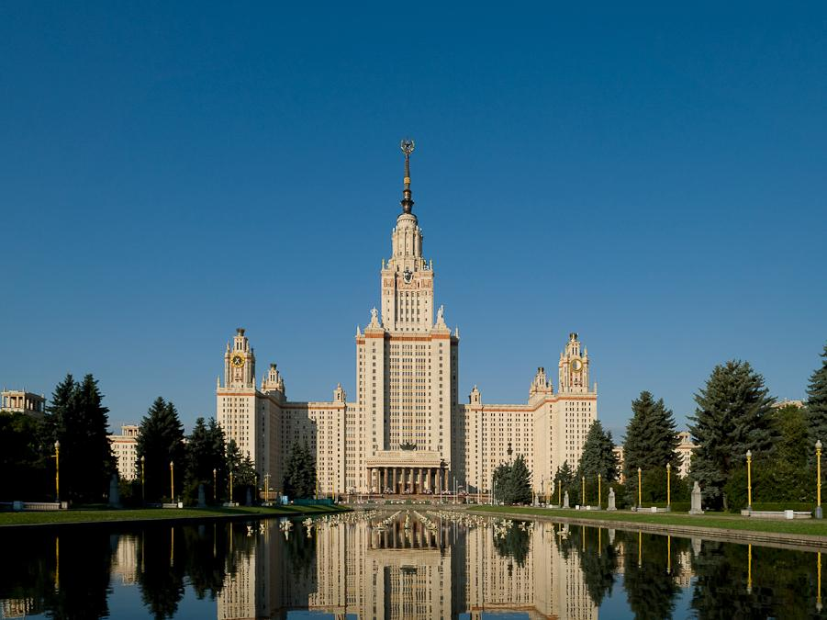
International conference
“Modern problems of computational mathematics and mathematical modeling”,
dedicated to the 90th anniversary of academician G.I.Marchuk
AlgoWiki: an Open Encyclopedia
of Parallel Algorithmic Features
Prof. Vladimir Voevodin
Deputy Director RCC MSU
Head of Department on Supercomputers and Quantum Informatics CMC MSU
voevodin@parallel.ru
June 10th , 2015, INM RAS, Moscow

Slide 2
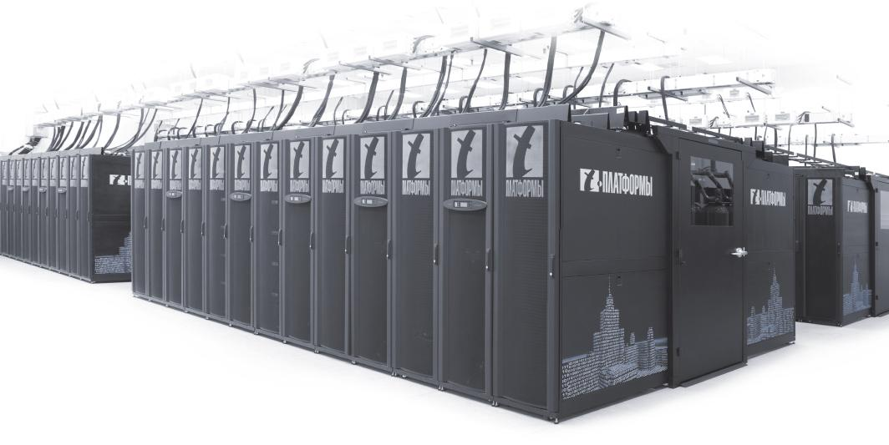
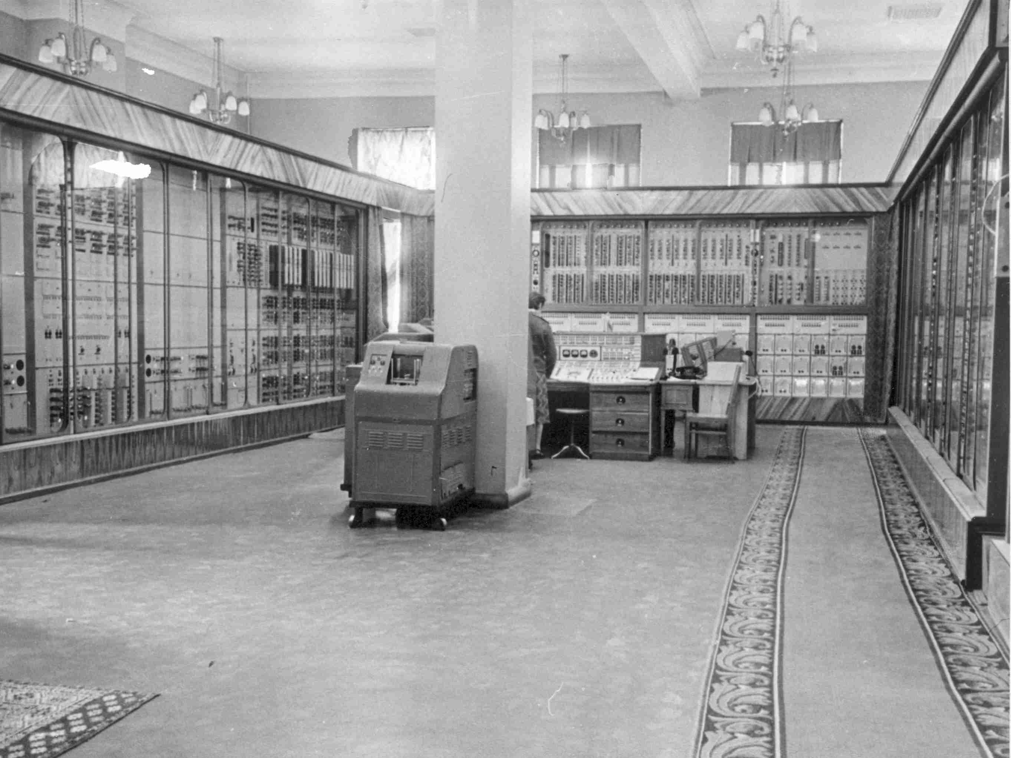
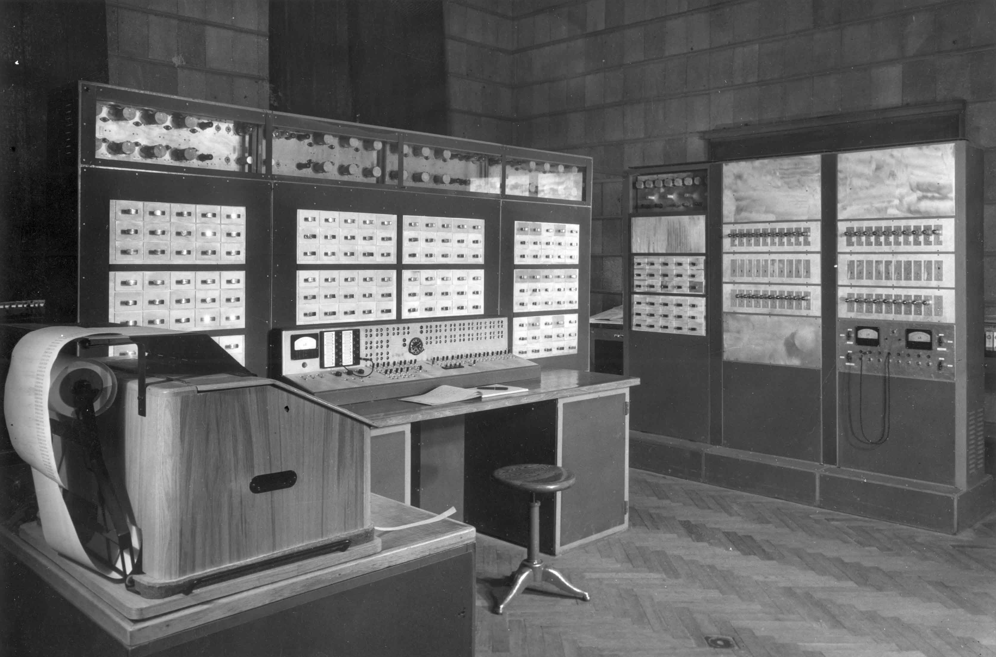
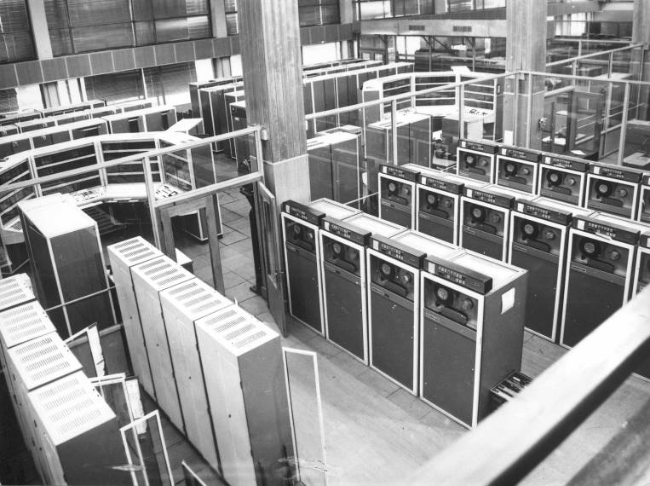
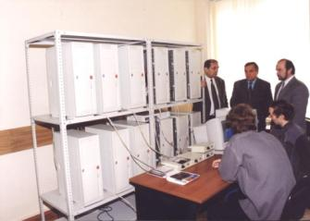
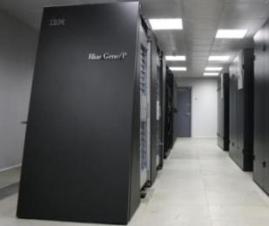
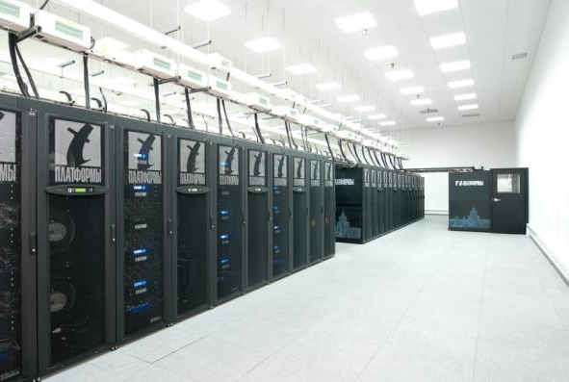
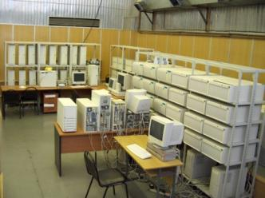
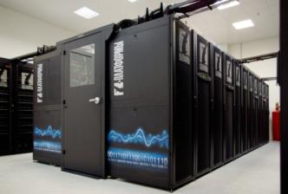
Computing Facilities of Moscow State University
(from 1956 up to now)
Strela
Setun
BESM-6
10³
10⁶
1956
1959
1967
BlueGene/P
“Lomonosov”
2000
2008
“Chebyshev”
10¹⁰
10¹⁵
2003
2008
2009

Slide 3
Research on Algorithm and Application Structures
(what are our algorithms?)
How often did we change programming paradigm?
(How many times did we have to rewrite our applications completely?)
70s - Loop Vectorization (innermost)
80s - Loop Parallelization (outer) + Vectorization (innermost)
90s - MPI
mid 90s - OpenMP
mid 2000s - MPI+OpenMP
2010s - CUDA, OpenCL, MPI+OpenMP+accelerators
…
Do you see the end of this rewriting process?

Slide 4
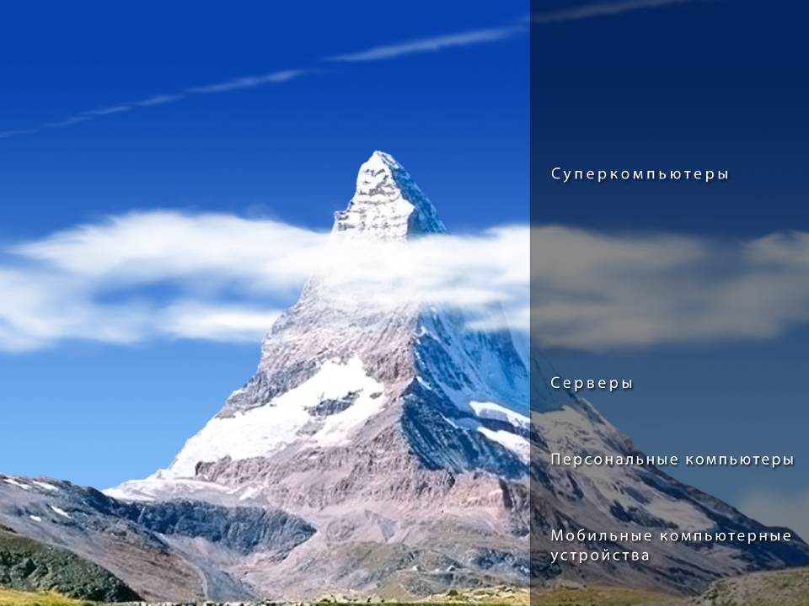
Supercomputers
Servers…
PCs, Laptops…
Tablets, Smartphones…

Slide 5
Degree of parallelism
2005
2015
2025
10⁴
10⁶
10⁹
Supercomputers
2-4
12-64
10⁴
Servers…
1
4-8
10³
PCs, Laptops…
1
1-4
10²
Tablets, Smartphones…

Slide 6
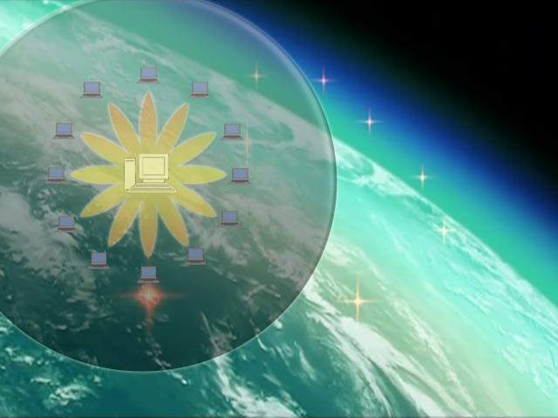
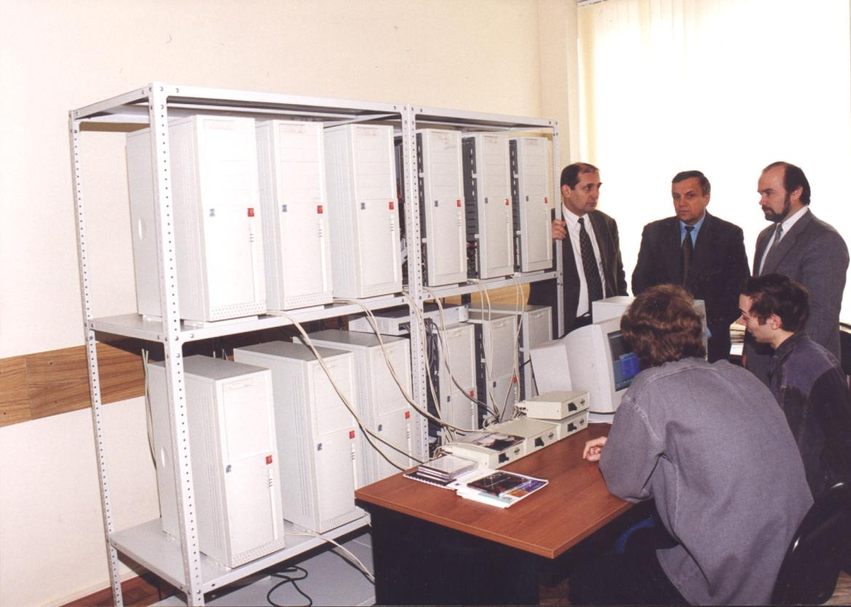
15 years ago …
(24 CPUs, Intel P-III/500 MHz, SCI network, 8 m² , 12 Gflops)

Slide 7
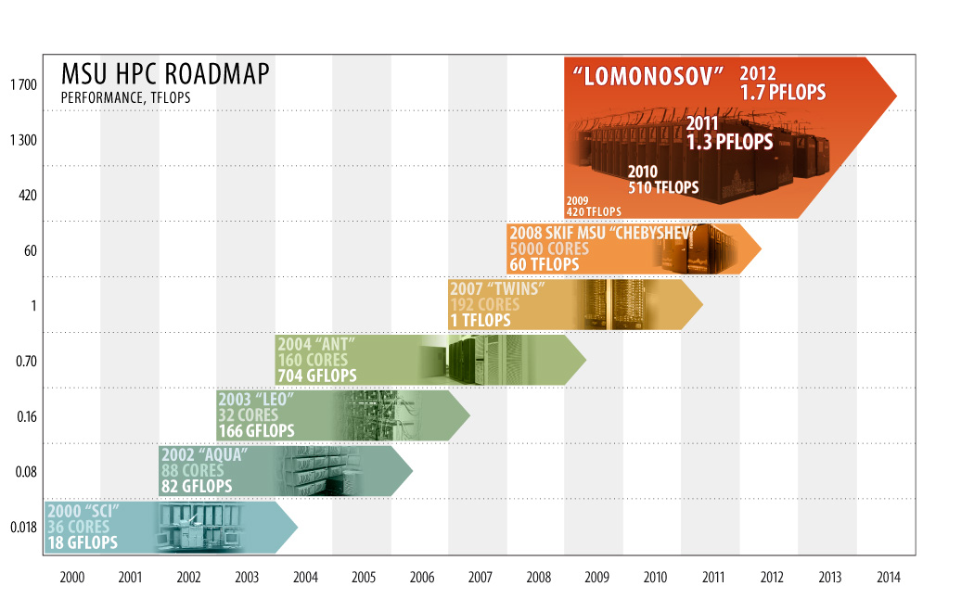
HPC Stages at MSU

Slide 8
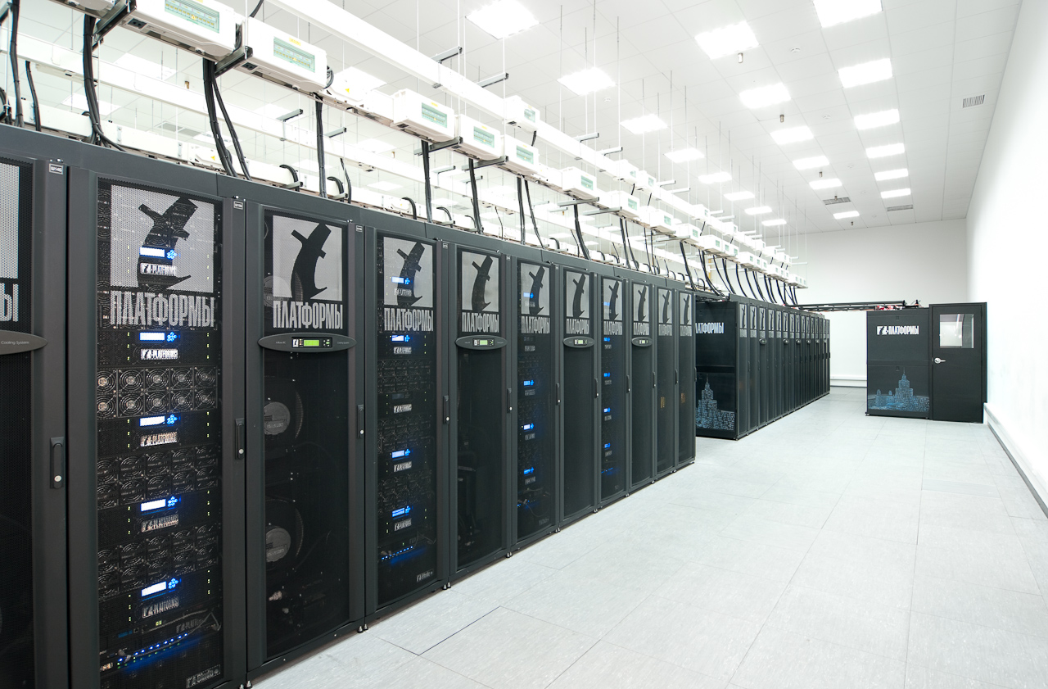
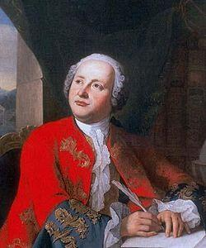

… and now
(52000+ Intel cores, 2065 NVIDIA GPUs, QDR IB, 1000 m² , 1.7 Pflops)
M.V.Lomonosov
1711 – 1765

Slide 9
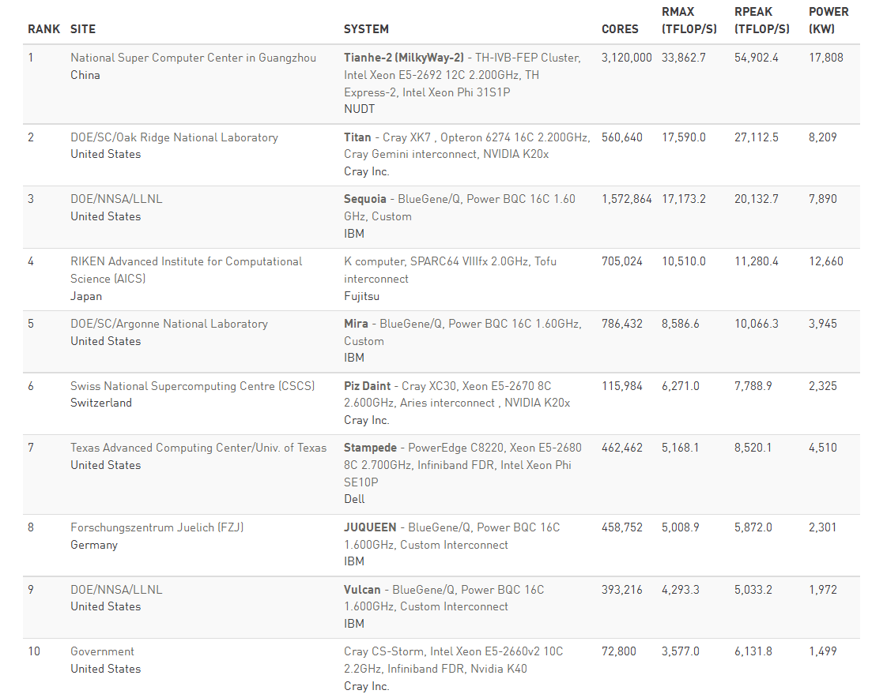
Top500 the most powerful computers…
(www.top500.org, November 2014)
Notes:
9

Slide 10
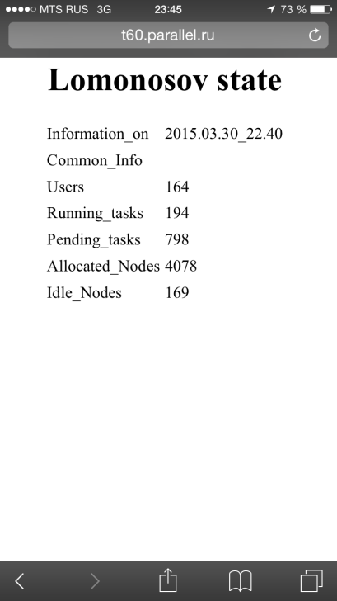
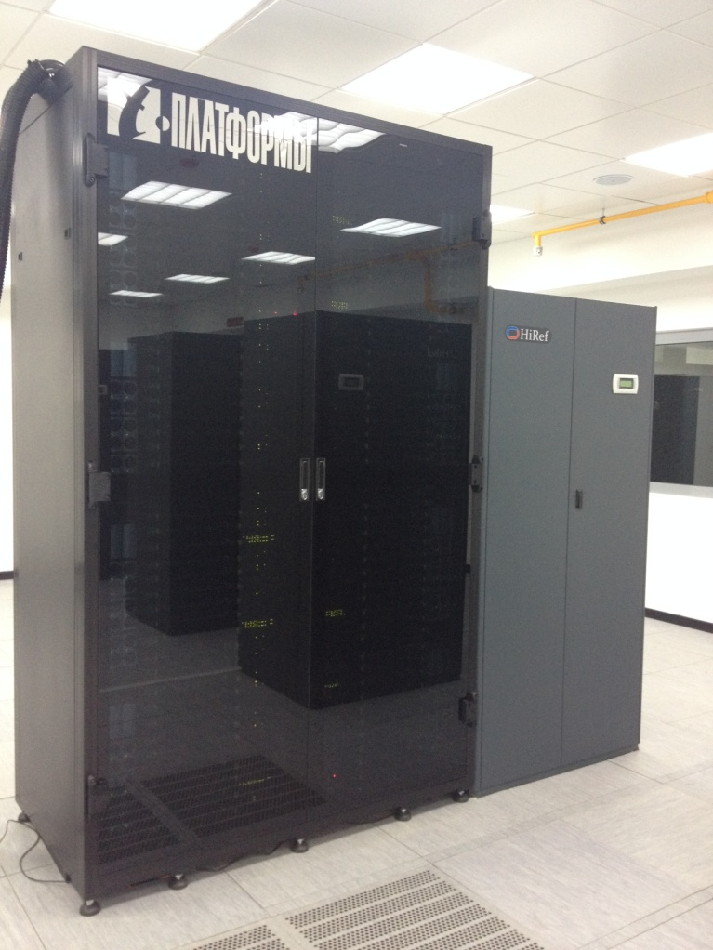
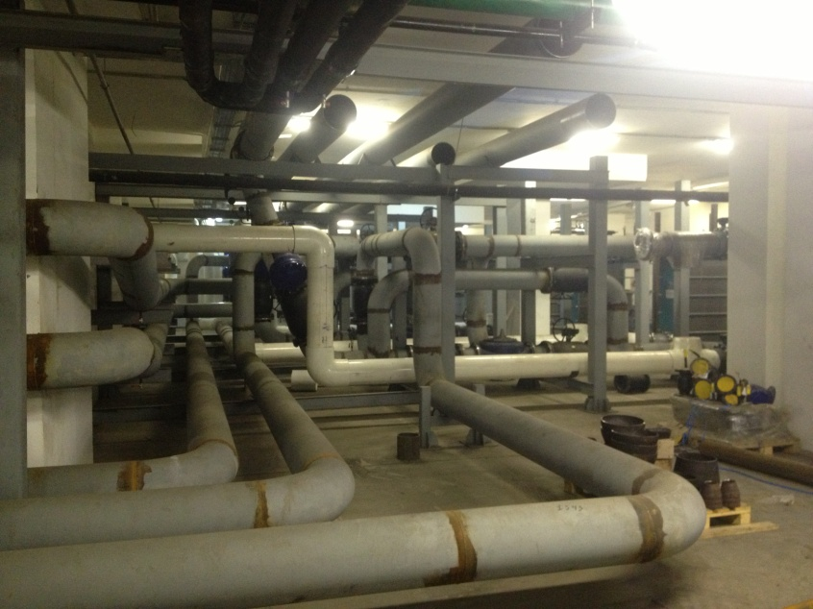
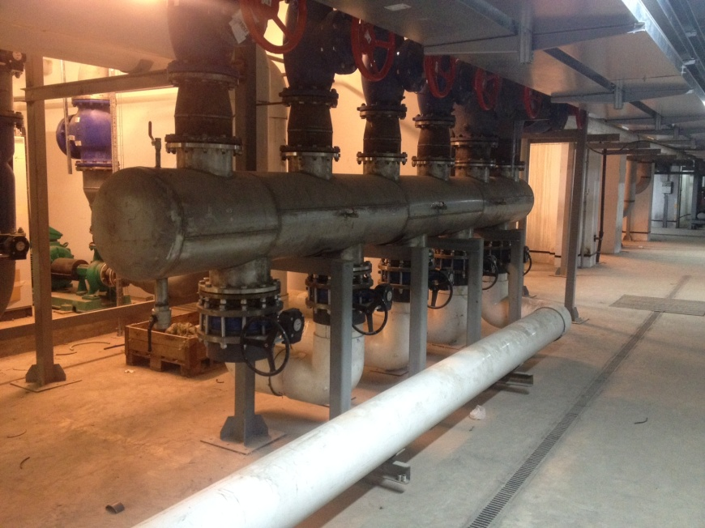
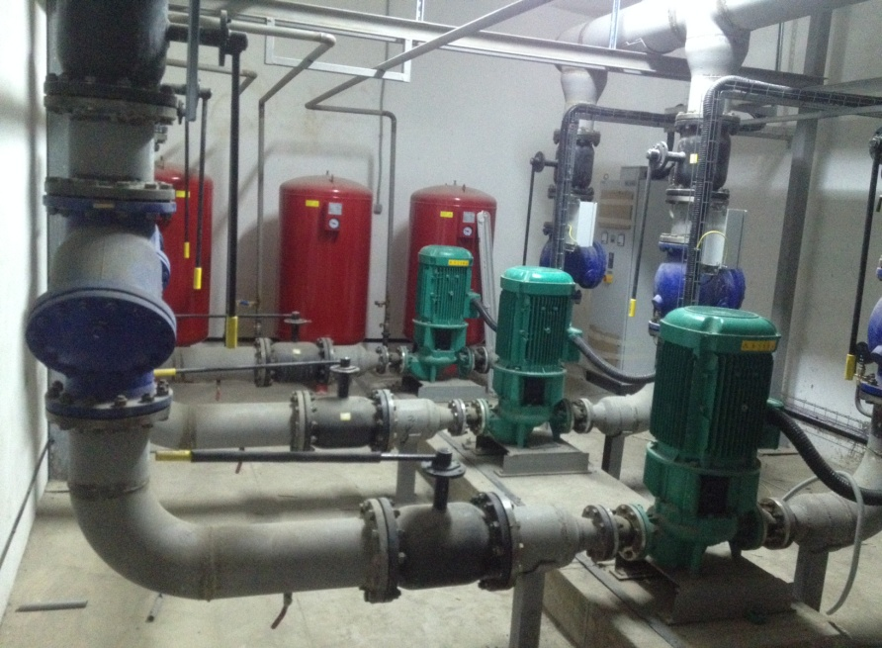
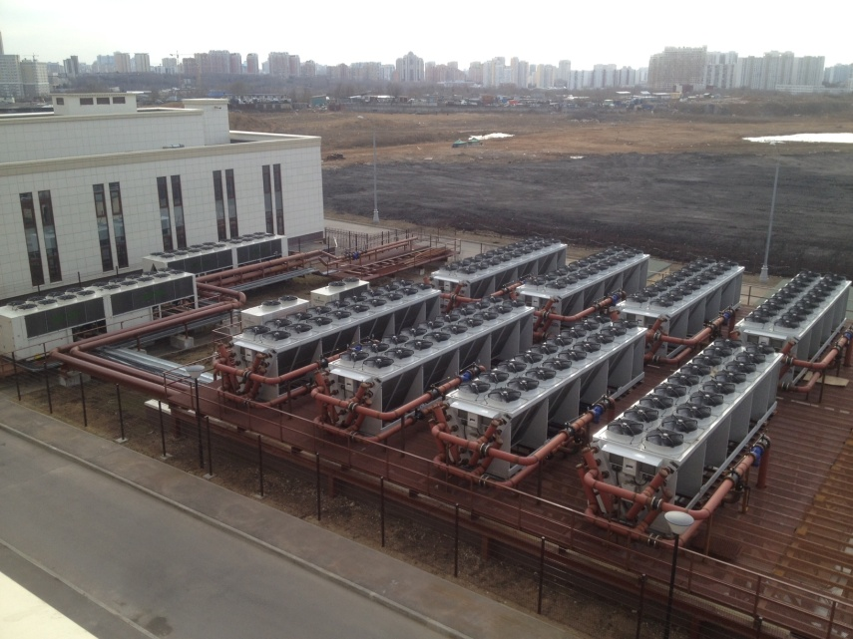
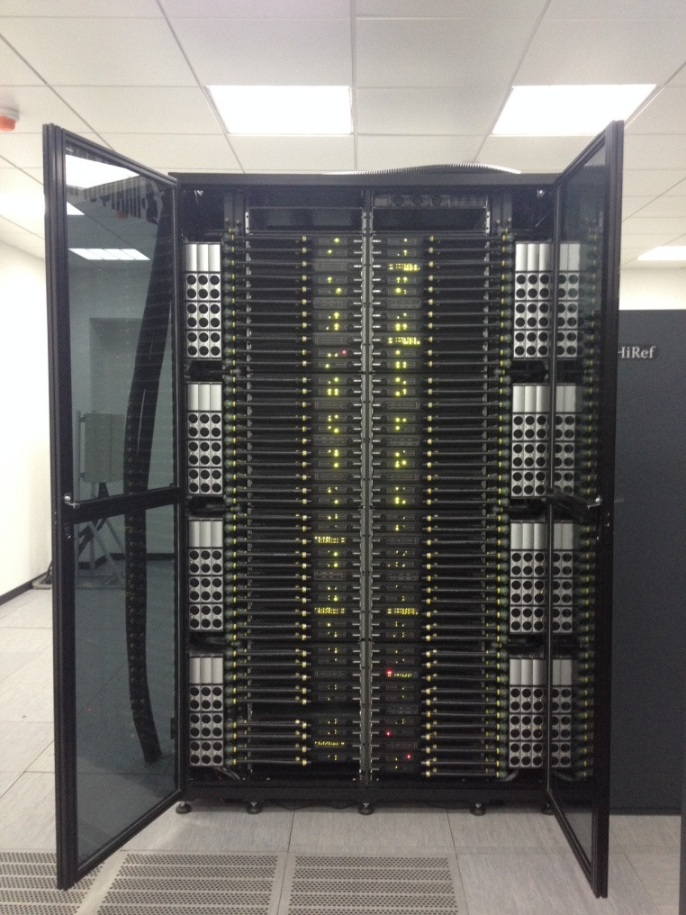
MSU Supercomputer “Lomonosov-2”
MSU Supercomputer Center:
Users: 2511
Projects: 1607
Organizations: 302
MSU Faculties/ Institutes : 20+
Computational science is everywhere…
1 rack = 256 nodes: Intel (14c) + NVIDIA = 515 Tflop/s
“Lomonosov-2” Supercomputer (5 racks) = 2.5 Pflop/s

Slide 11
What do we need to know to control efficiency of supercomputer centers ?
Is it difficult to control few components ?
A few ?..
Users
SysAdmins
Licenses
Organizations
Management
Projects
Partitions
Software
components
Hardware
components
Applications
Queues
Jobs
Statuses
Users
Quotas

Slide 12
A few? Info on MSU “Lomonosov” Supercomputer :
(1.7 Pflops, 6000 computing nodes, 12K CPUs, 2K GPUs…)
Users
SysAdmins
400
100
300
Projects
Licenses
Organizations
Management
15
100
25 000
600
Partitions
Software
components
Hardware
components
Applications
20
1000 per day
Queues
20
2500
30
Jobs
Statuses
Users
Quotas
Current trend: all these numbers grow extremely fast!

Slide 13
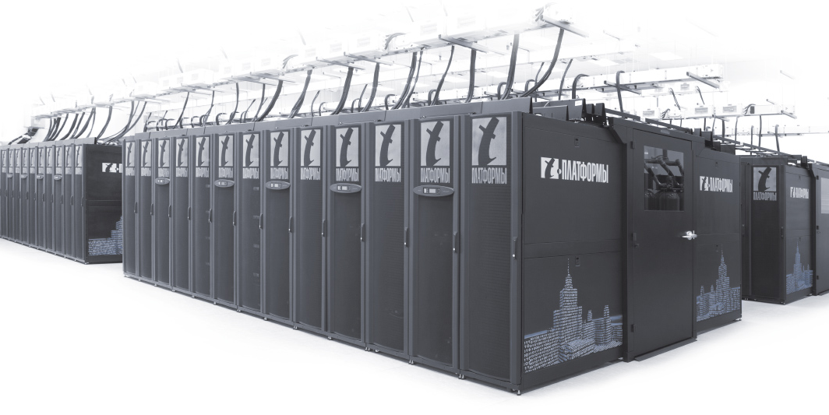
Software Infrastructure
of “Lomonosov” Supercomputer
(what about scalability?)
Software packages, systems, tools, libraries – 60+, and this number grows very fast:
Intel ICC/IFORT, GCC, PathScale, PGI, MPIs, Intel VTune Performance Analyzer, Intel Cluster Tools, RogueWave TotalView, RogueWave ThreadSpotter, Allinea DDT, ScaLAPACK, ATLAS, IMKL, AMCL, BLAS, LAPACK, FFTW, cuBLAS, cuFFT, MAGMA, cuSPARSE, CUSP, and cuRAND…
VASP, WIEN2k, CRYSTAL, Gaussian, MOLPRO, Turbomole,
Accelrys Material Studio, MesoProp, MOLCAS, Gromacs, FireFly, LAMMPS, NAMD, GAMESS, Quantum ESPRESSO, ABINIT, Autodock, CP2K, NWChem, PRIRODA, SIESTA, Amber, CPMD, DL POLY, VMD, GULP, Aztec, Geant, OpenFOAM, PARMETIS, FDMNES, GSL, METIS, Msieve, Octave, OpenMX, PETSc, SMEAGOL, VisIt, VTK, WRF…

Slide 14
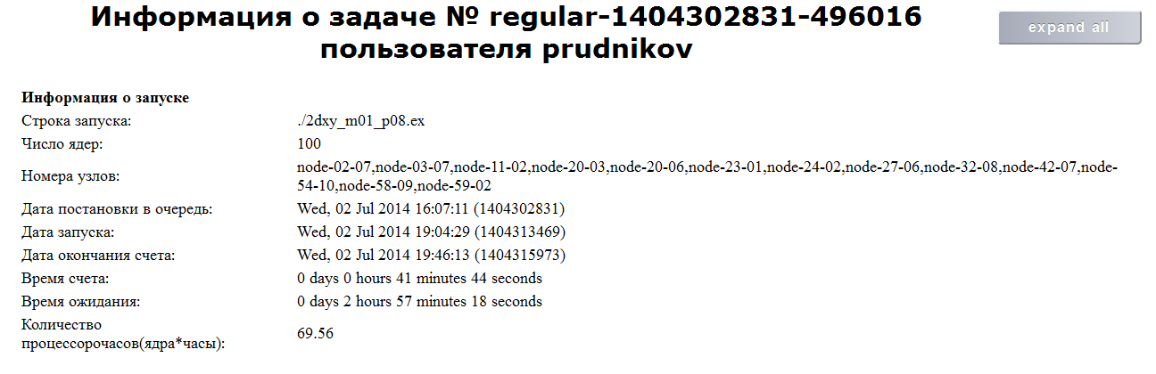
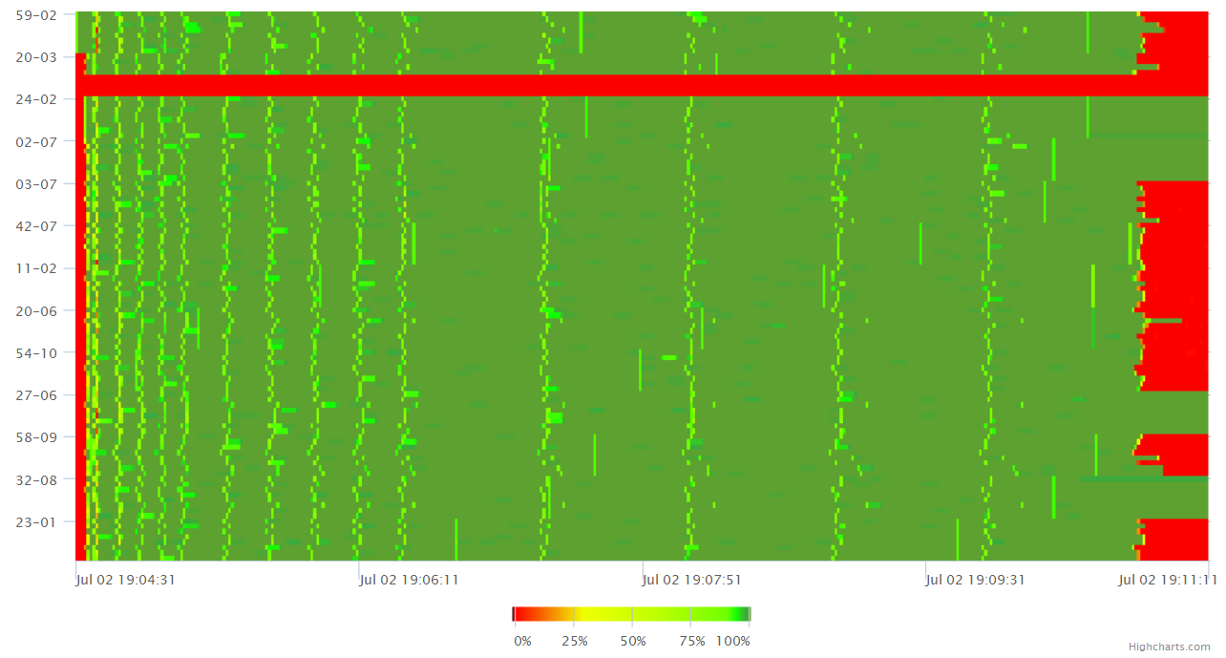
Fine analysis of supercomputing applications:
dynamic features
Notes:
14

Slide 15
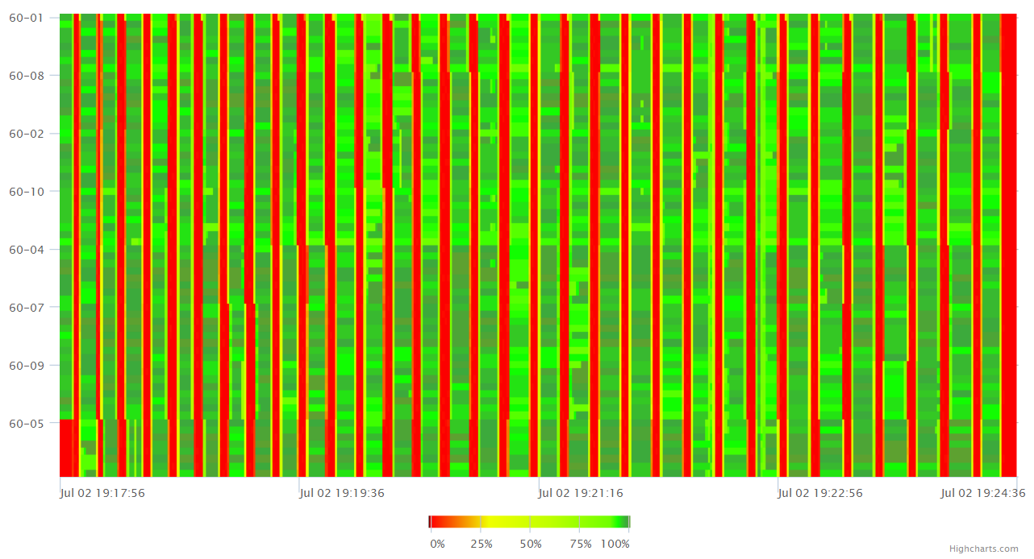
Fine analysis of supercomputing applications:
dynamic features
Notes:
15

Slide 16
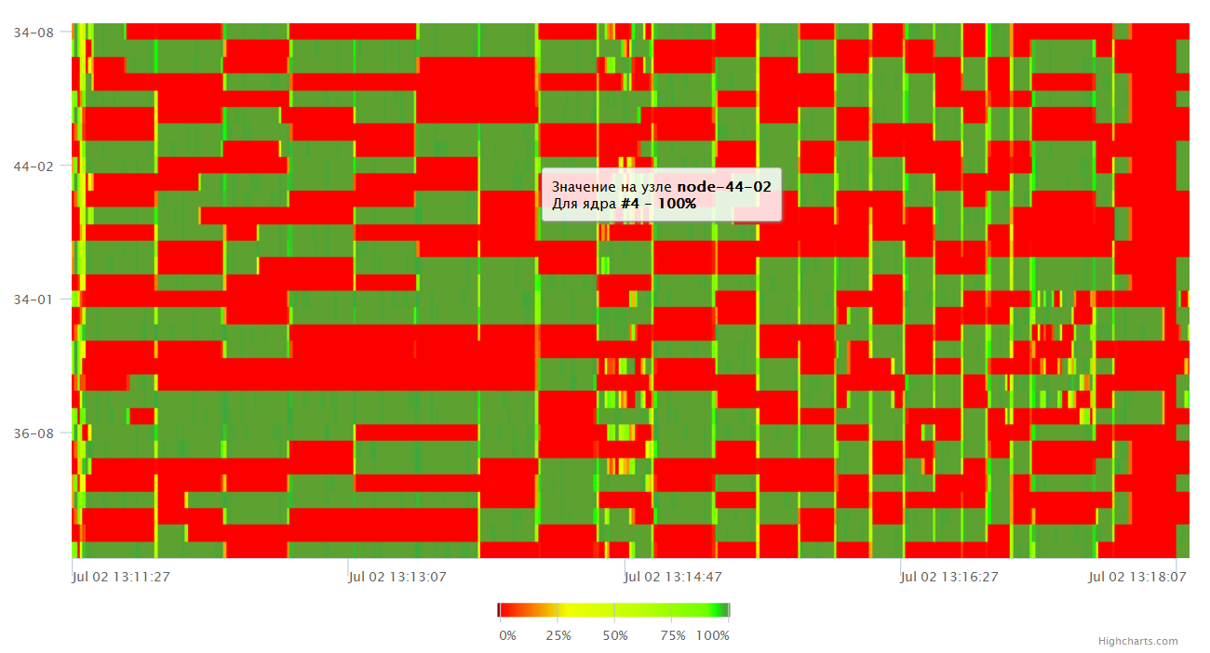
Fine analysis of supercomputing applications:
dynamic features
Notes:
16

Slide 17
Algorithms: description of properties and structures
(from mobile platforms to exascale supercomputers)
Description of properties and structures: theoretical part
  (machine-independent properties)
Description of properties and structures: implementation issues
(programming technologies, static and dynamic features, properties of computer architectures)
AlgoWiki
Notes:
17

Slide 18
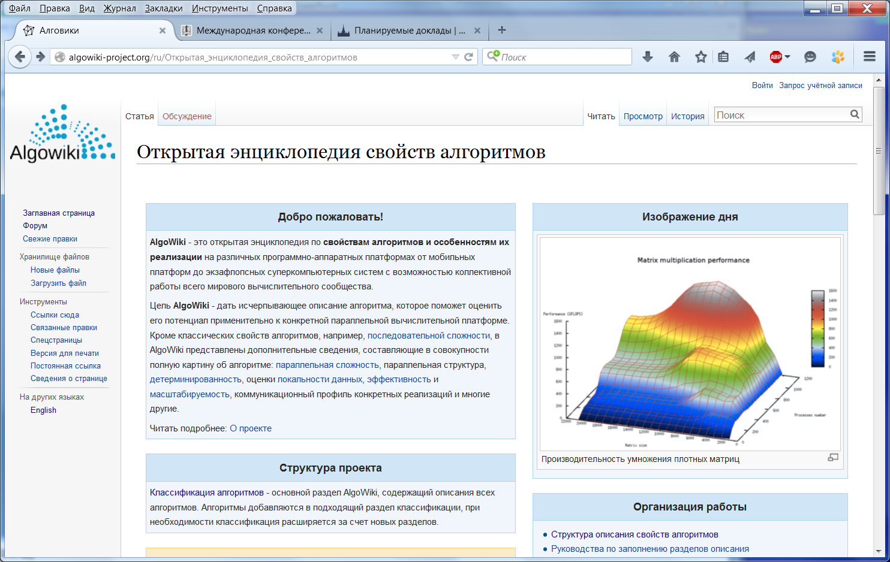
AlgoWiki
http://AlgoWiki-Project.org
Notes:
18

Slide 19
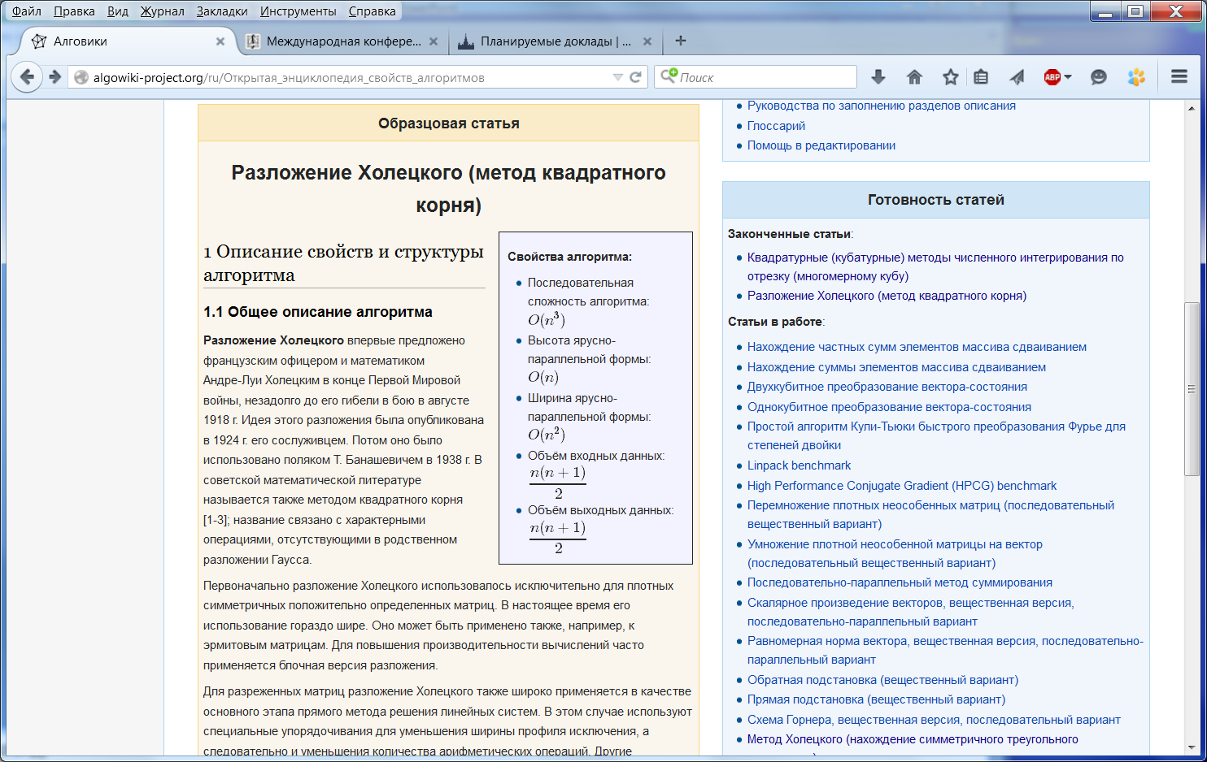
AlgoWiki
http://AlgoWiki-Project.org
Notes:
19

Slide 20
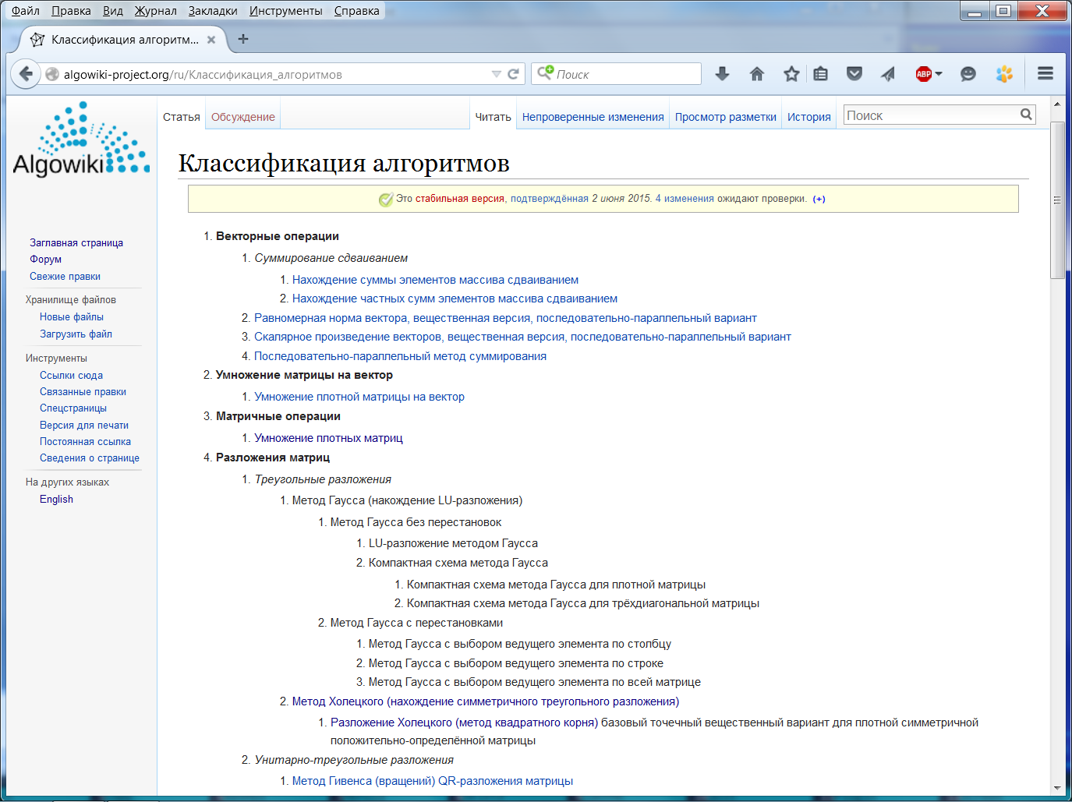
AlgoWiki
http://AlgoWiki-Project.org
Notes:
20

Slide 21
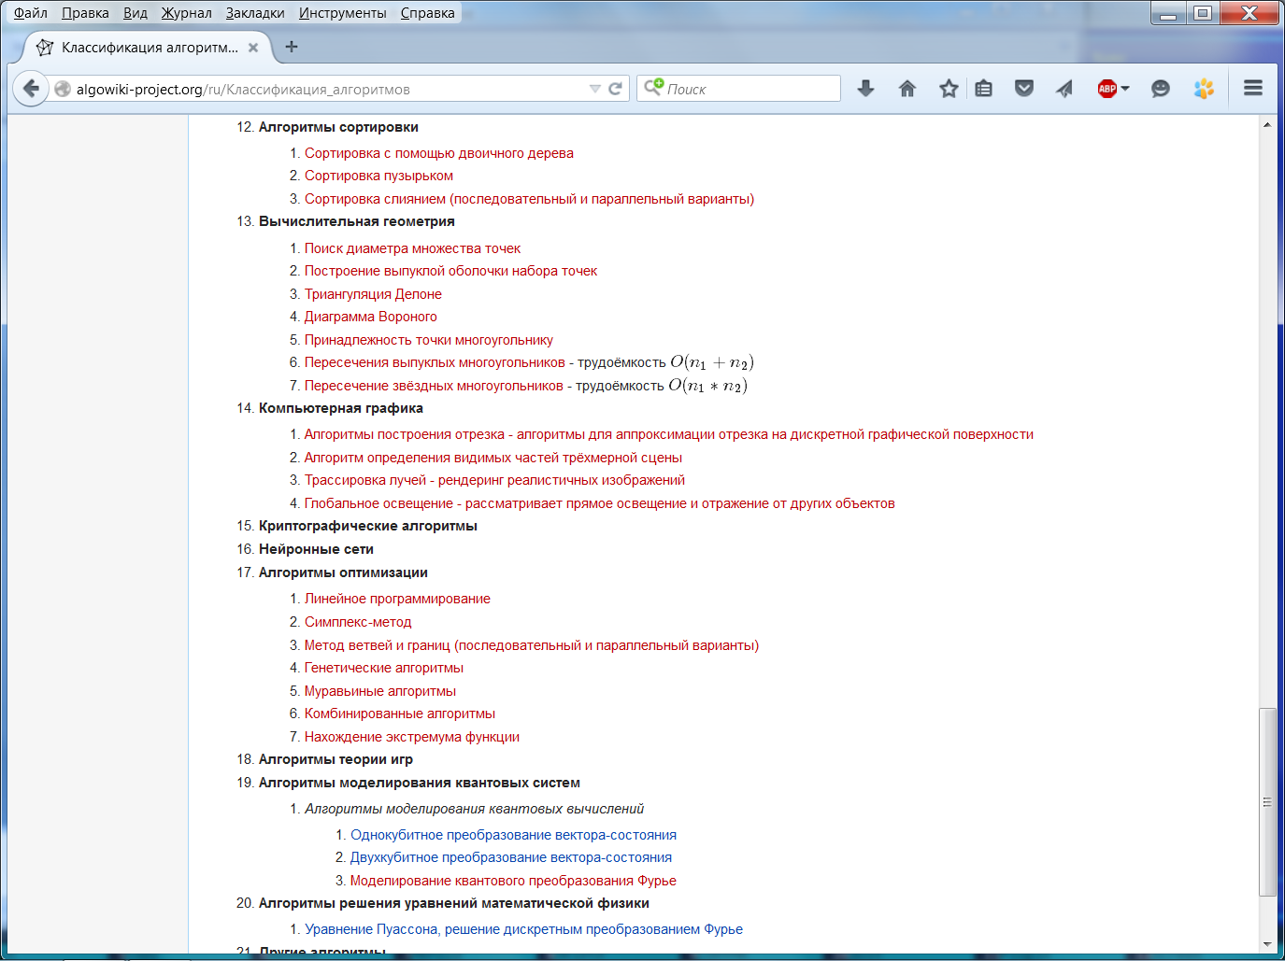
AlgoWiki
http://AlgoWiki-Project.org
Notes:
21

Slide 22
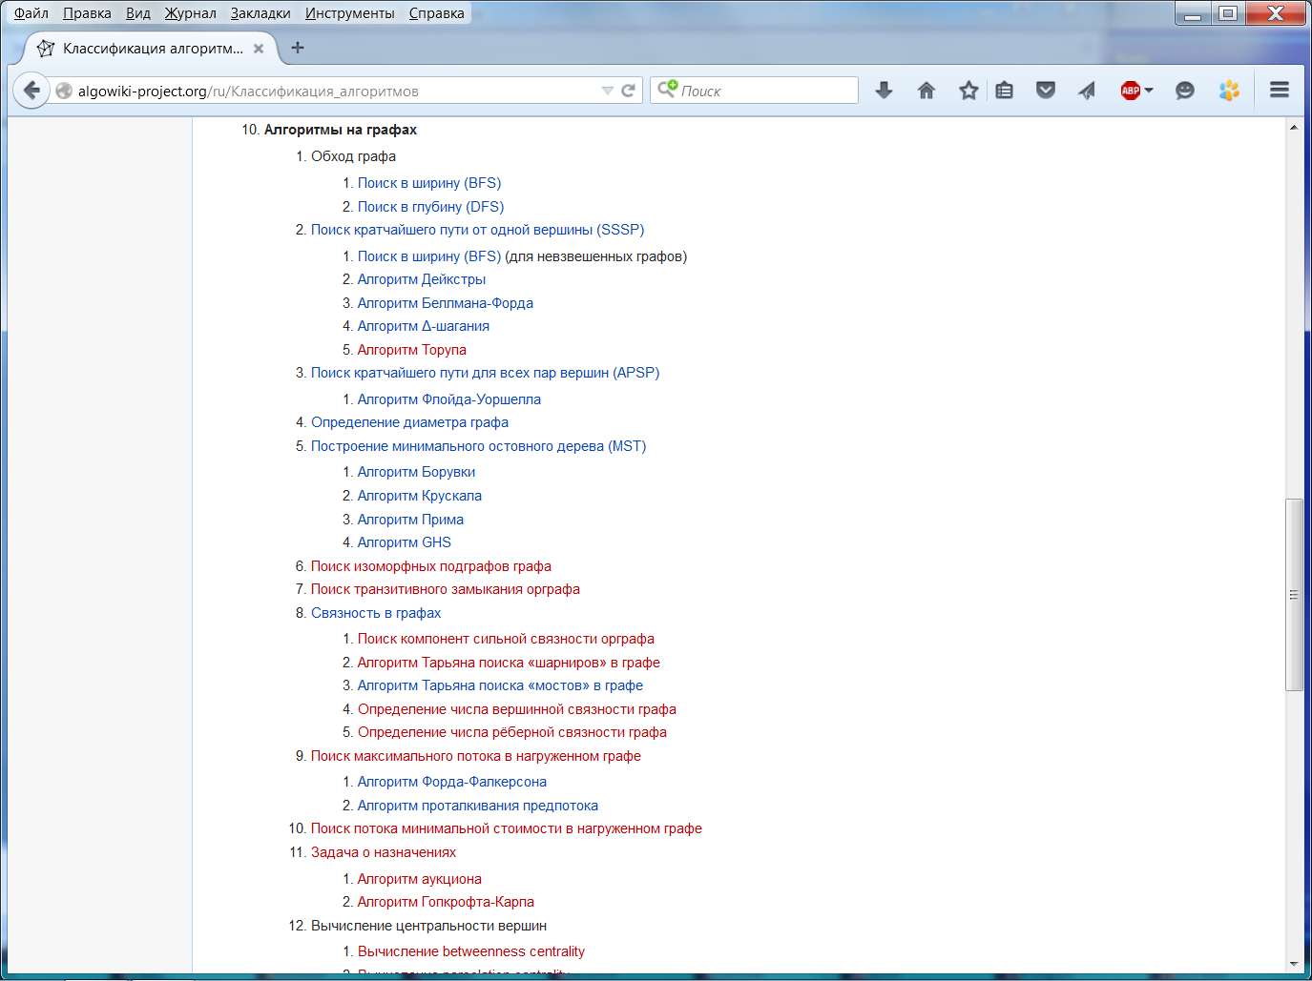
AlgoWiki
http://AlgoWiki-Project.org
Notes:
22

Slide 23
AlgoWiki
Algorithms: description of properties and structures
(from mobile platforms to exascale supercomputers)
I. Description of properties and structures: theoretical part
General description of algorithms
Mathematical description of algorithms
Computational kernel
Macro structure of algorithms
A description of algorithms’ serial implementation
Serial complexity of algorithms
Information graph
Describing the resource parallelism of algorithms
Input/output data description
Algorithm’s properties
…
http://AlgoWiki-Project.org
Notes:
23

Slide 24
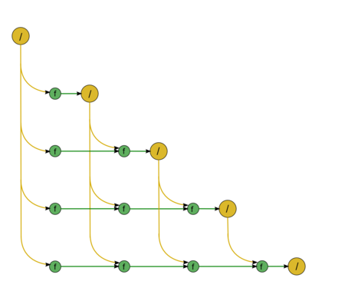
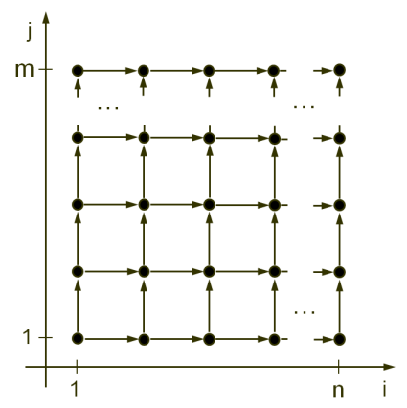
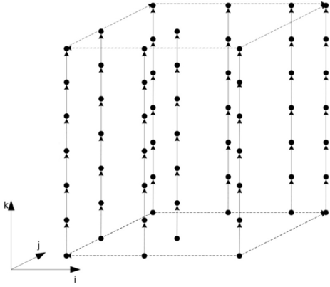
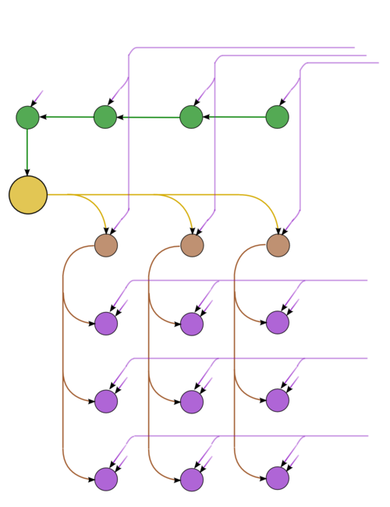
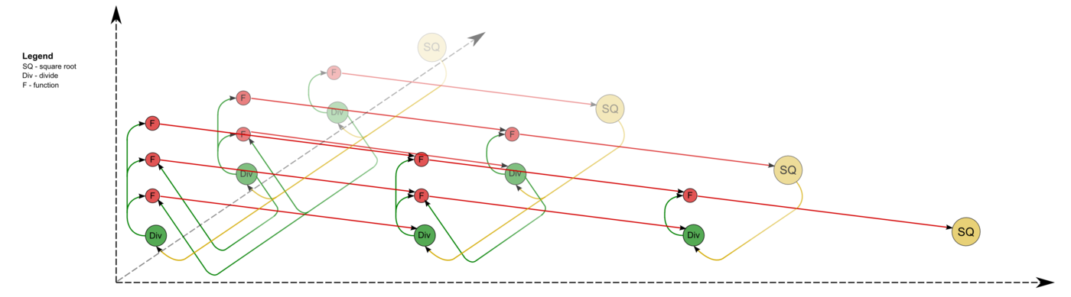
AlgoWiki
Algorithms: description of properties and structures
(information graph)
Notes:
24

Slide 25
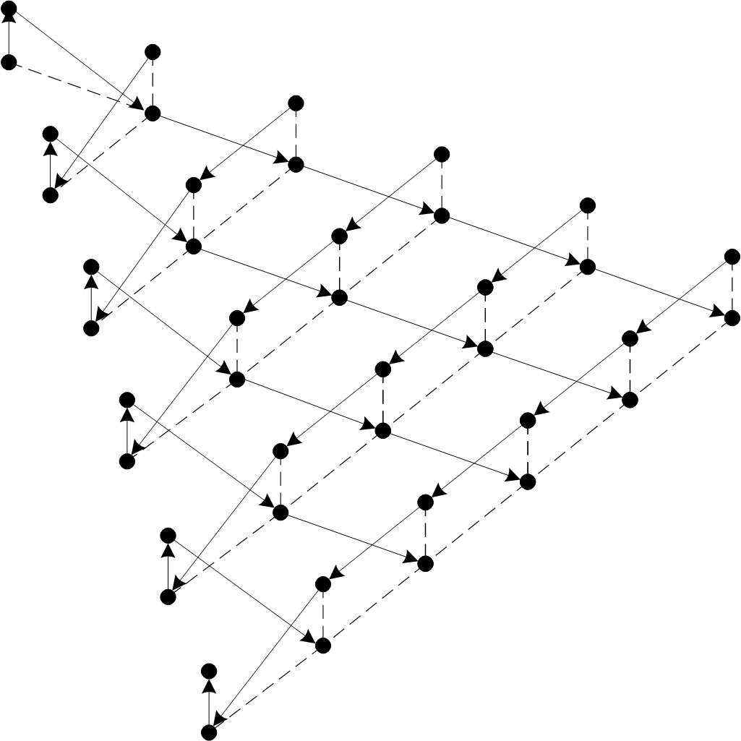
AlgoWiki
Algorithms: description of properties and structures
(information graph)
http://AlgoWiki-Project.org
Notes:
25

Slide 26
AlgoWiki
Algorithms: description of properties and structures
(information graph)
http://AlgoWiki-Project.org
Notes:
26

Slide 27
AlgoWiki
Algorithms: description of properties and structures
(information graph)
http://AlgoWiki-Project.org
Notes:
27

Slide 28
AlgoWiki
Algorithms: description of properties and structures
(information graph)
http://AlgoWiki-Project.org
Notes:
28

Slide 29
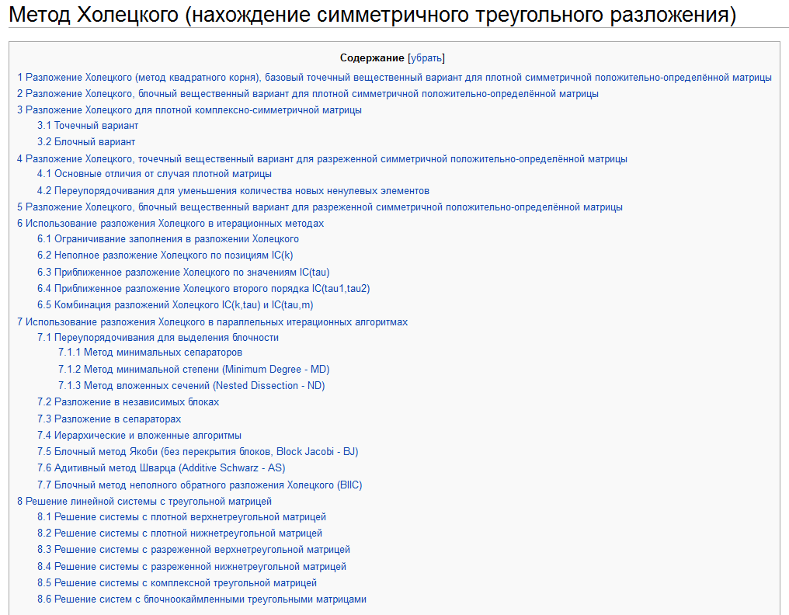
AlgoWiki
Algorithms: description of properties and structures
http://AlgoWiki-Project.org
Notes:
29

Slide 30
AlgoWiki
Algorithms: description of properties and structures
(from mobile platforms to exascale supercomputers)
I. Description of properties and structures: theoretical part
General description of algorithms
Mathematical description of algorithms
Computational kernel
Macro structure of algorithms
A description of algorithms’ serial implementation
Serial complexity of algorithms
Information graph
Describing the resource parallelism of algorithms
Input/output data description
Algorithm’s properties
…
http://AlgoWiki-Project.org
Notes:
30

Slide 31
AlgoWiki
Algorithms: description of properties and structures
(algorithm’s properties)
Serial and parallel complexity ratio for the algorithm;
computational intensity of an algorithm (ratio of a number of arithmetic operations to amount of data);
balance of different types of operations;
determinacy of the algorithm:
  number of iterations,
  data structures (e.g., the structure of sparse matrices),
  use of random number generators,
  use of associative operations: the effect of round-off errors.
“long” edges in the information graph and other similar features of families of edges;
intensity of data usage;
known compact representations of the information graph;
…
http://AlgoWiki-Project.org
Notes:
31

Slide 32
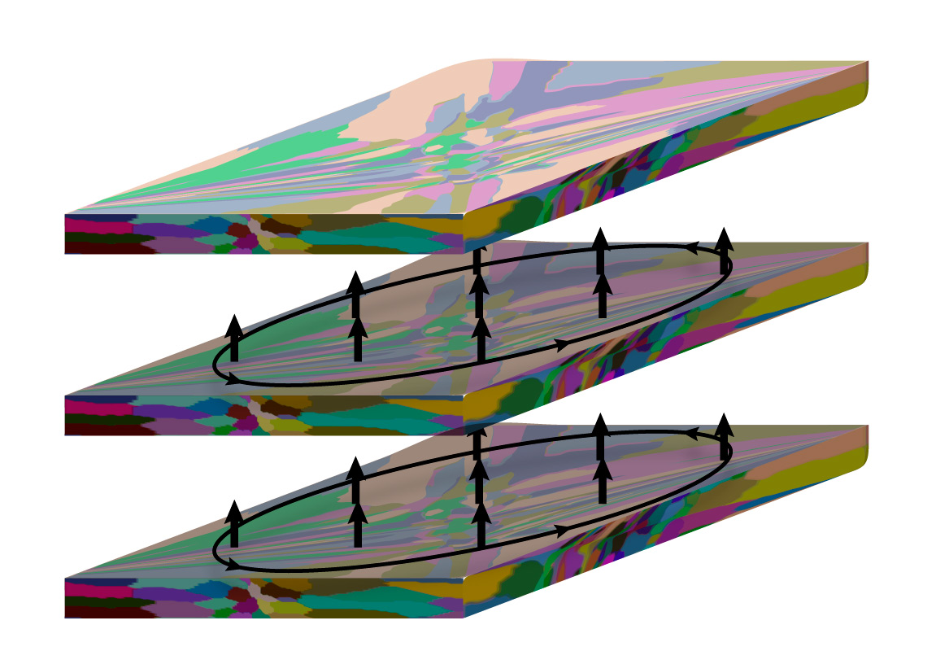
AlgoWiki
Algorithms: description of properties and structures
(determinacy of algorithms: collective operations)
MPI_Reduce( buf, …)
MPI_Reduce( buf, …)
MPI_Reduce( buf, …)
http://AlgoWiki-Project.org
Notes:
32

Slide 33
AlgoWiki
Algorithms: description of properties and structures
(from mobile platforms to exascale supercomputers)
II. Description of properties and structures: implementation issues
Peculiarities of implementations of the serial algorithm;
Description of data and computation locality;
Possible methods and considerations for parallel implementation of the algorithm;
Scalability of the algorithm and its implementations;
Dynamic characteristics and efficiency of algorithm implementations;
Conclusions for different classes of computer architectures;
Existing implementations of the algorithm;
…
http://AlgoWiki-Project.org
Notes:
33

Slide 34
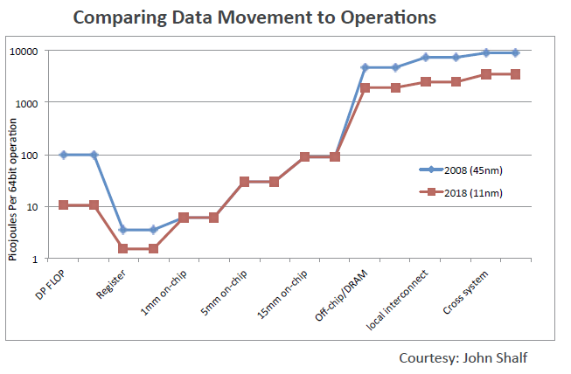
AlgoWiki
Description of data locality
Canonical analysis of algorithms: ops = time
Make algorithm faster = minimize ops, compares…
http://AlgoWiki-Project.org
Notes:
34

Slide 35
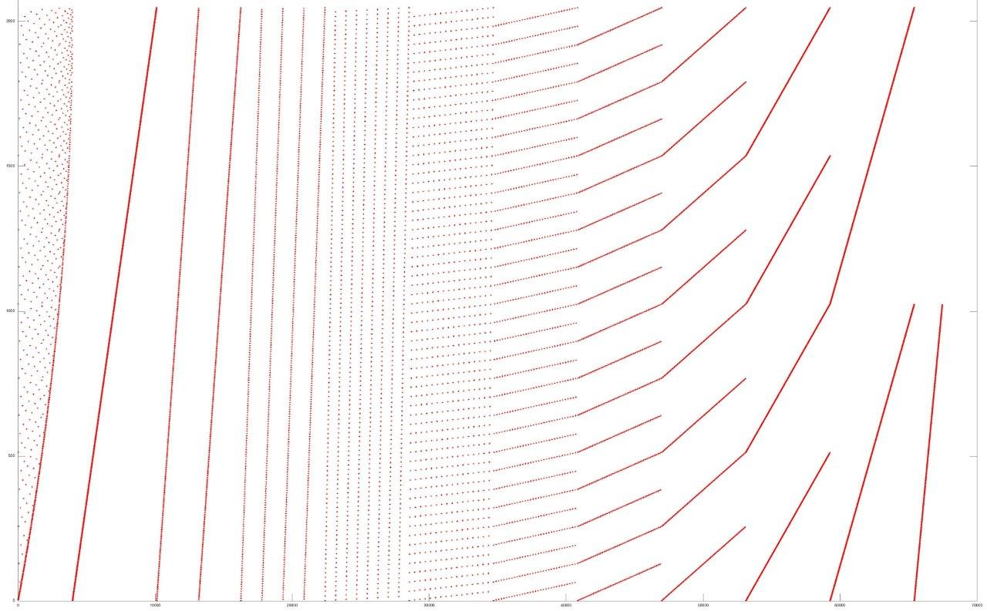
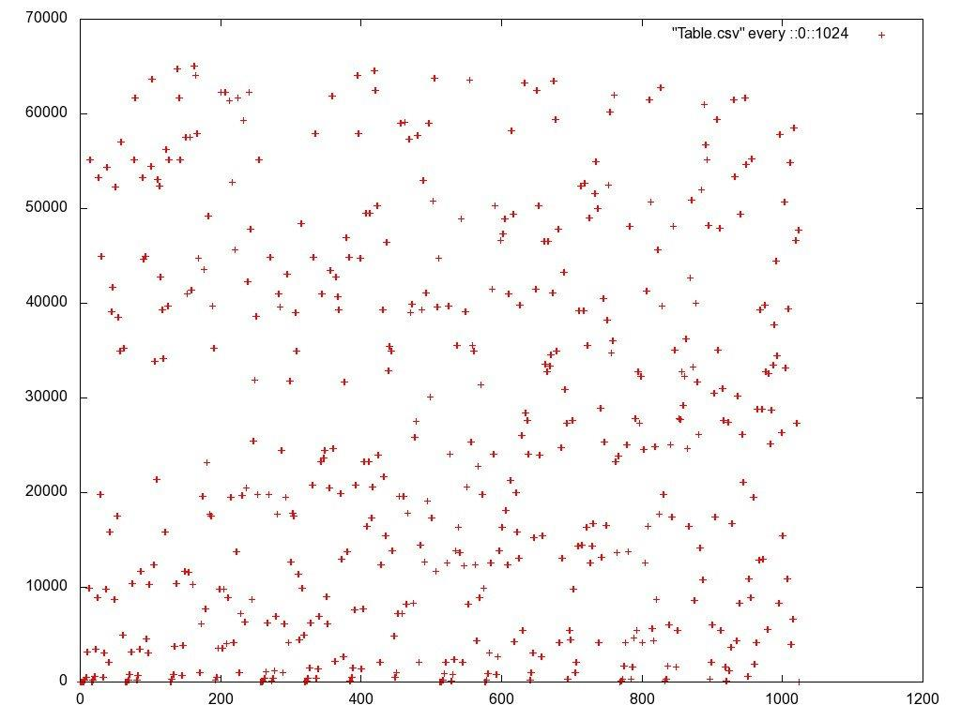
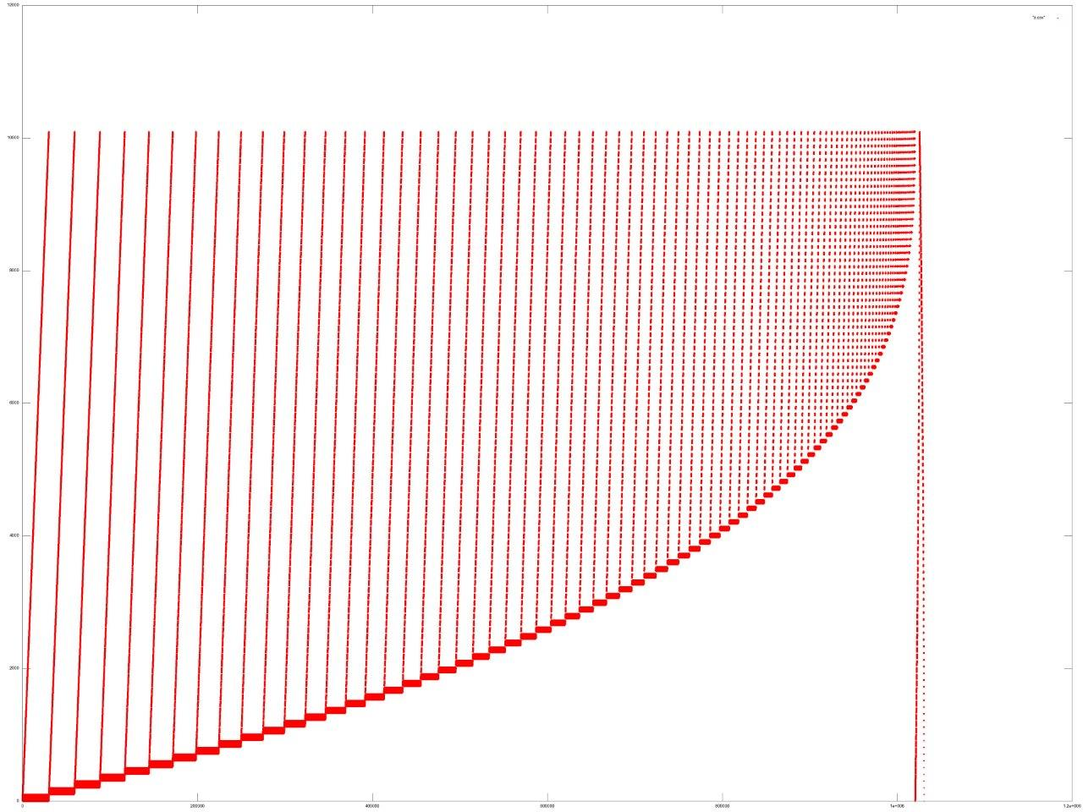
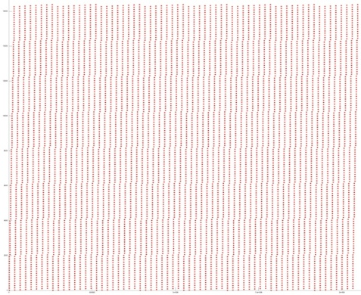
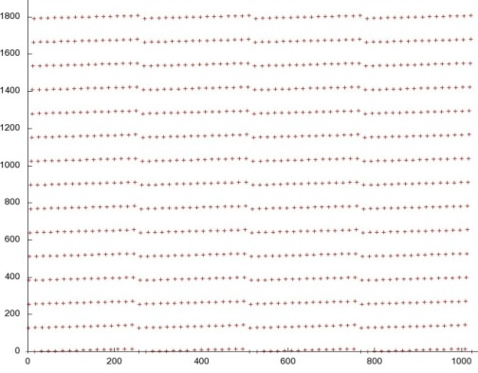
AlgoWiki
Algorithms: description of properties and structures
(description of data locality)
FFT
Random Access
Linpack
http://AlgoWiki-Project.org
Courtesy of Vad.Voevodin, MSU
Notes:
35

Slide 36
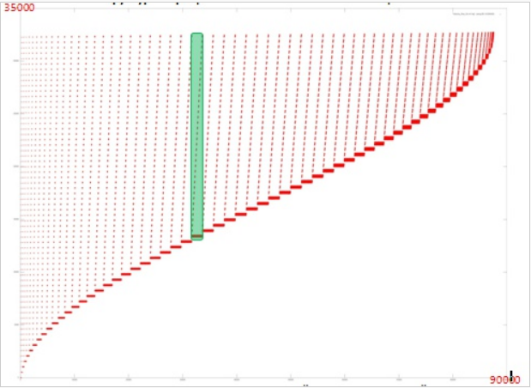
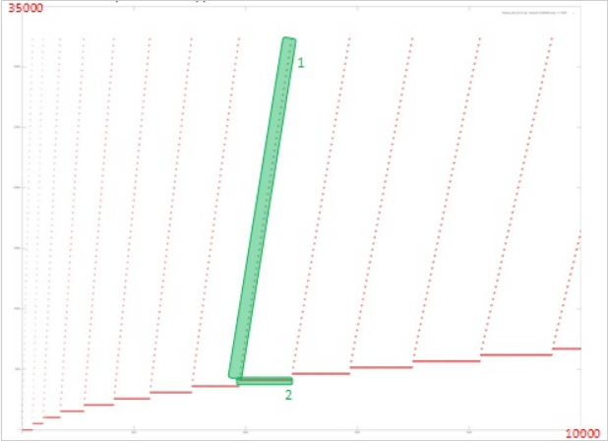

AlgoWiki
Algorithms: description of properties and structures
(data locality of Cholesky factorization)
http://AlgoWiki-Project.org
Courtesy of Vad.Voevodin, MSU
Notes:
36

Slide 37


AlgoWiki
Algorithms: description of properties and structures
(scalability of algorithms: performance)
AlgoWiki and Top500:
Top500 = “Linpack + performance + computers”.
“Algorithms + performance + computers” is an element
of the Part II of AlgoWiki.
http://AlgoWiki-Project.org
Courtesy of A.Teplov, MSU
Notes:
37

Slide 38


AlgoWiki
Algorithms: description of properties and structures
(scalability of algorithms: efficiency)
http://AlgoWiki-Project.org
Courtesy of A.Teplov, MSU
Notes:
38

Slide 39



AlgoWiki
Algorithms: description of properties and structures
(dynamic features)
http://AlgoWiki-Project.org
Courtesy of A.Teplov, MSU
Notes:
39

Slide 40









Проведение анализа масштабируемости программ
Performance (Gflops)
Performance of 1 core
L1 cache misses (mln/s)
Number of Load ops (bln/s)
Number of Store ops (mln/s)
L3 cache-misses (mln/s)
Data transfer rate (MB/s)
Average data transfer rate (MB/s)
Data transfer rate (thousands packets/s)
Courtesy of A.Teplov, MSU
Notes:
В рамках использования технологий кодизайна проанализируем как в тех же координатах менятся других характеристики, для определения что стало причиной сильного снижения эффективности.
Видим что скорость передачи данных по Infiniband показывает аномальную активность. Проанализируем более детально при фиксированном размере задаичи.

Slide 41
AlgoWiki
AlgoWiki is a project for the entire computing community !
http://AlgoWiki-Project.org
Notes:
41

Slide 42
International conference
“Modern problems of computational mathematics and mathematical modeling”,
dedicated to the 90th anniversary of academician G.I.Marchuk
Thank you !
June 10th, 2015, INM RAS, Moscow

