Slide 1
A Defence of Some Low Observational Estimates of
Effective Climate Sensitivity
J. Ray Bates
Meteorology and Climate Centre,
University College Dublin, Ireland
Conference Dedicated to the
90th Anniversary of G.I. Marchuk,
Moscow, June 2015.

Slide 2
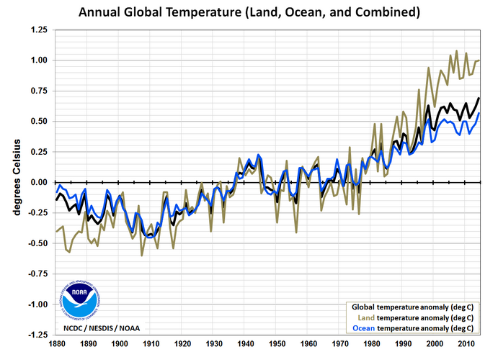
Notes:
http://www.ncdc.noaa.gov/sotc/ [For comments, see NOAA temp graph 1880-2014 in EFC]
The annual mean temperature for every year in the period 1880-2014 (135 years) is shown (anomalies relative to the 20th century average).

Slide 4
Equilibrium Climate Sensitivity and
Effective Climate Sensitivity
(IPCC Definitions)
Equilibrium Climate Sensitivity (EqCS, units: °C) is the equilibrium change in the annual global-mean surface temperature (ΔT) following a CO₂ doubling.
We cannot do an experiment with the real climate system, but EqCS can be estimated by running a GCM to equilibrium (with a mixed layer ocean or a dynamic ocean).
Effective climate sensitivity (EfCS, units: °C) is an estimate of EqCS evaluated from GCM output or observations for evolv­ing non-equilibrium conditions.
Its evaluation involves the use of simple energy balance models.

Slide 5
Energy Balance Models Used in Evaluating EfCS Involve Radiative Response Coefficients

Slide 7
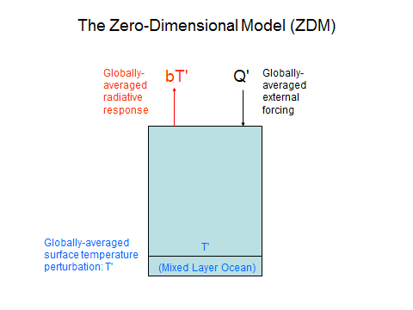

Slide 8
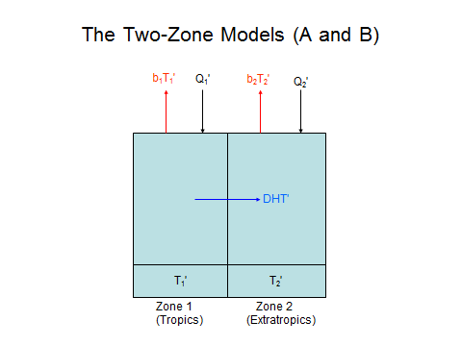

Slide 9
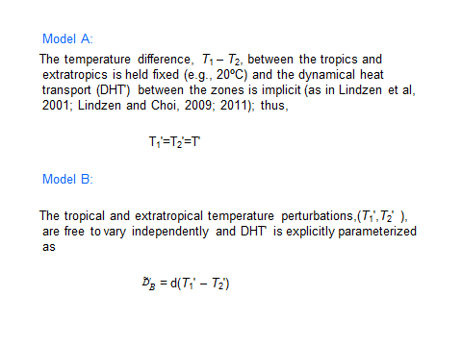

Slide 10
Expressions for Effective Climate Sensitivity (EfCS) in the ZDM, Model A and Model B

Slide 21
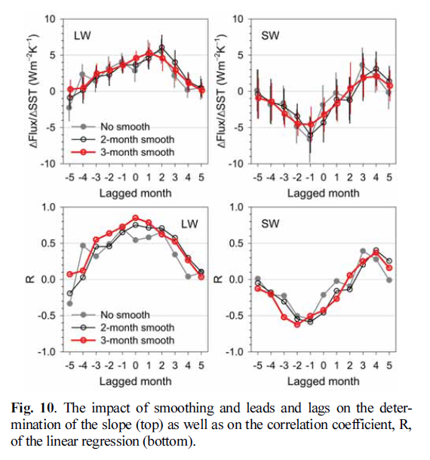

Slide 24
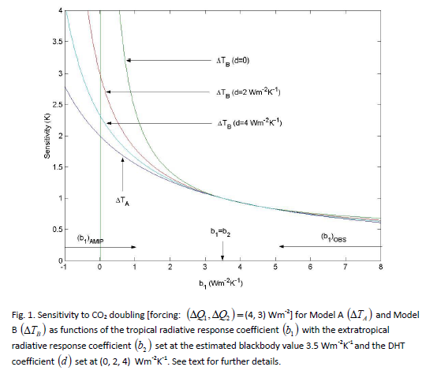

Slide 27
The End

Slide 28
