Slide 1
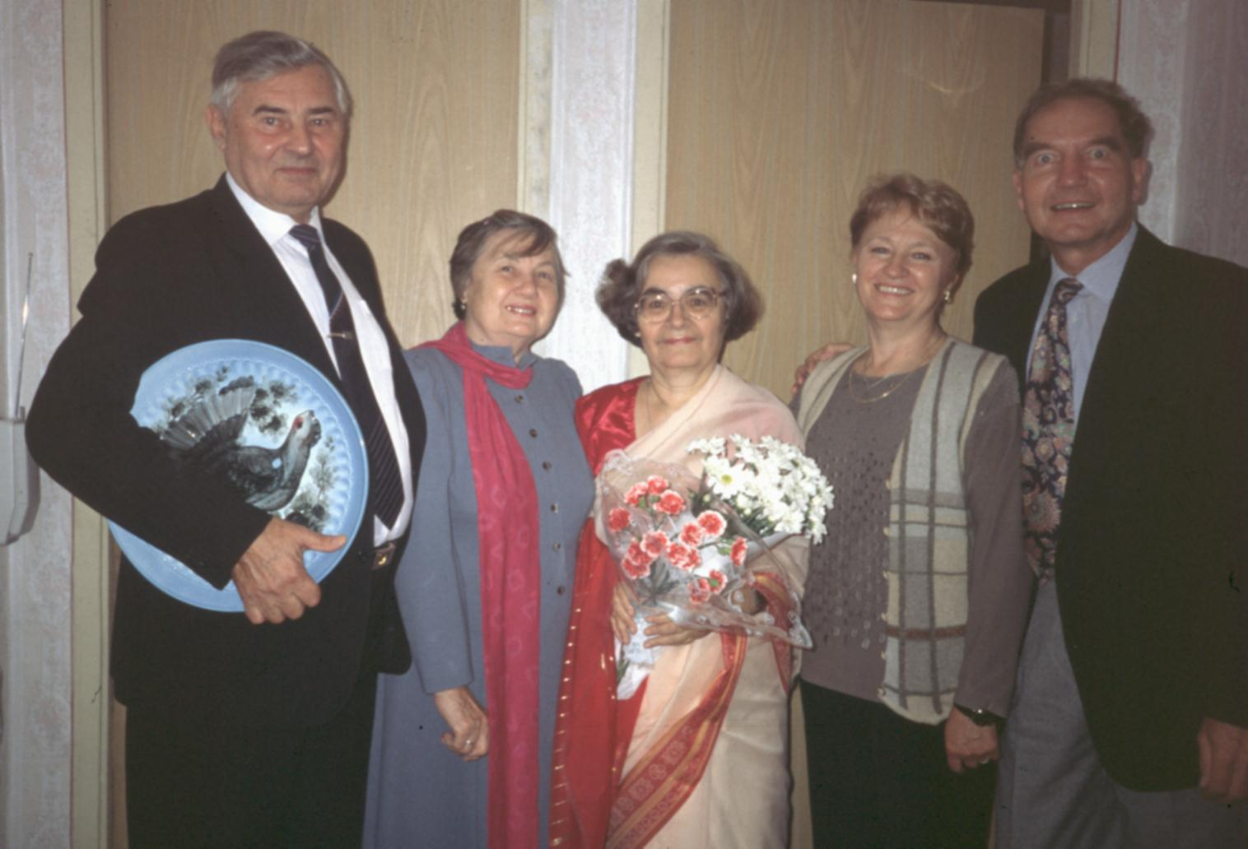
Cooperation depends on persons –
highlights of a German-Russian cooperation

Slide 2
Brief history of cooperation I
2nd Oceanographic World Congress in Moscow
January – March
Sabbatical in Academgorodok:
Computing Center (Marchuk, Kochergin)
Hydrodynamics (Vasiliev)
Visits at Shirshov Institute of Oceanology
in Moscow (Monin, Sarkisyan)
and Leningrad (Zilitinkevich, Kagan)
June 16
Signing of the first Agreement of Cooperation in
Novosibirsk by G.I. Marchuk and J. Sündermann

Slide 3
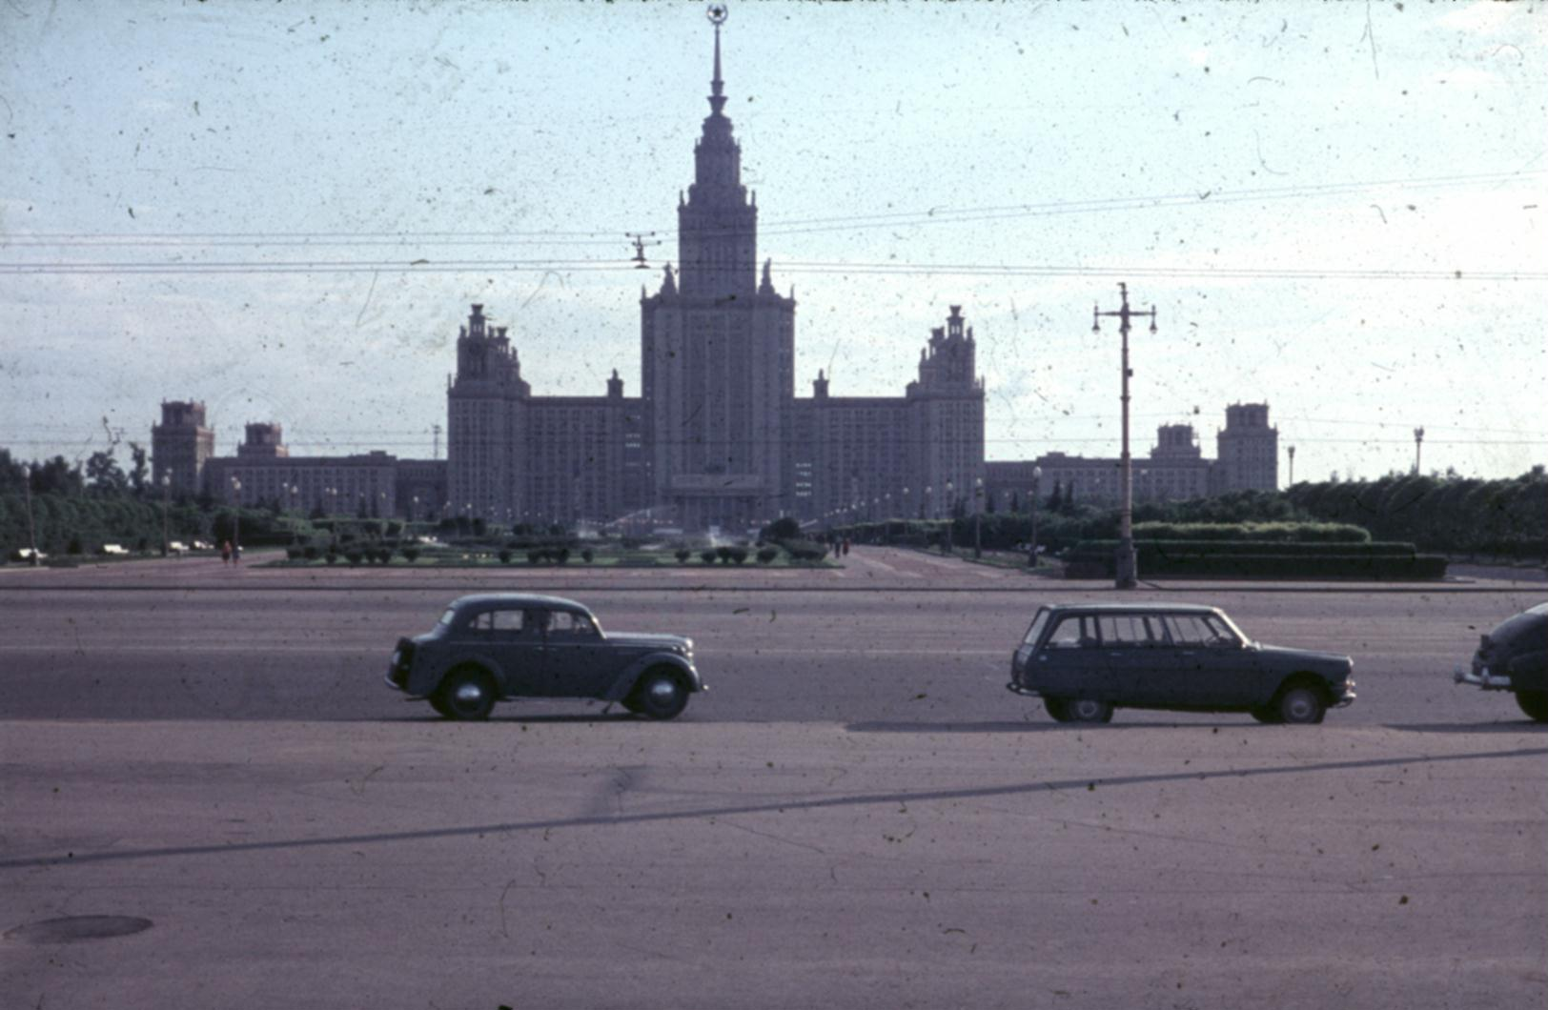
Moscow, May 1965 Lomonosov University
2nd Oceanographic World Congress

Slide 4
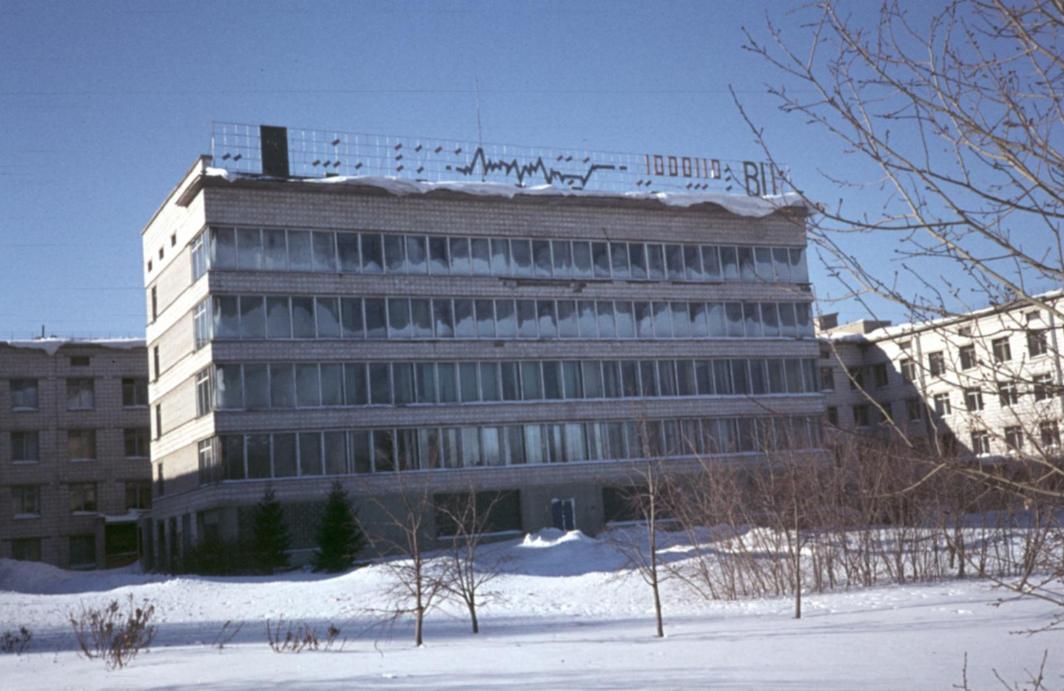
Computing Center Novosibirsk, January 1977

Slide 5
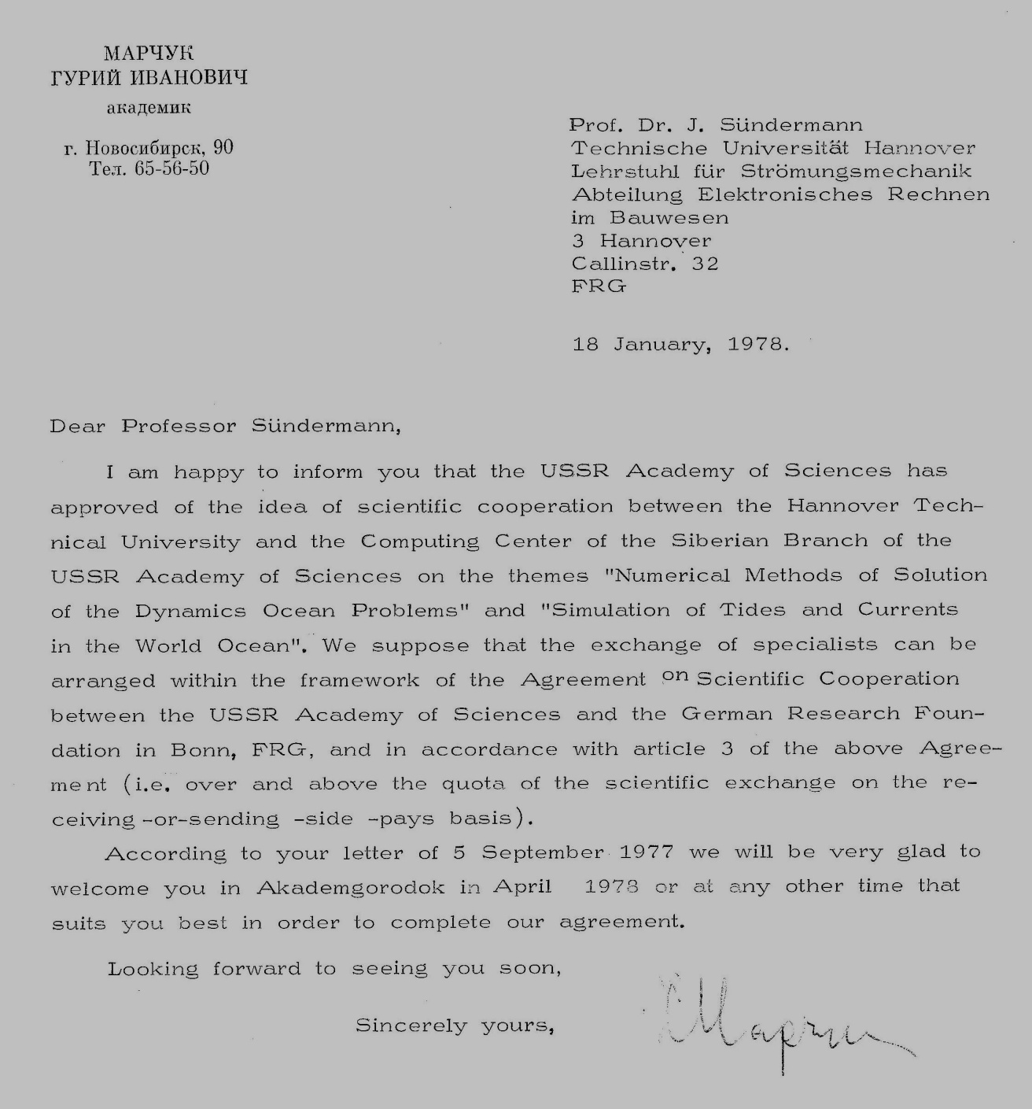
Letter of
approval of
scientific
cooperation
by G.I.
Marchuk
dated
January 18,
1978

Slide 6
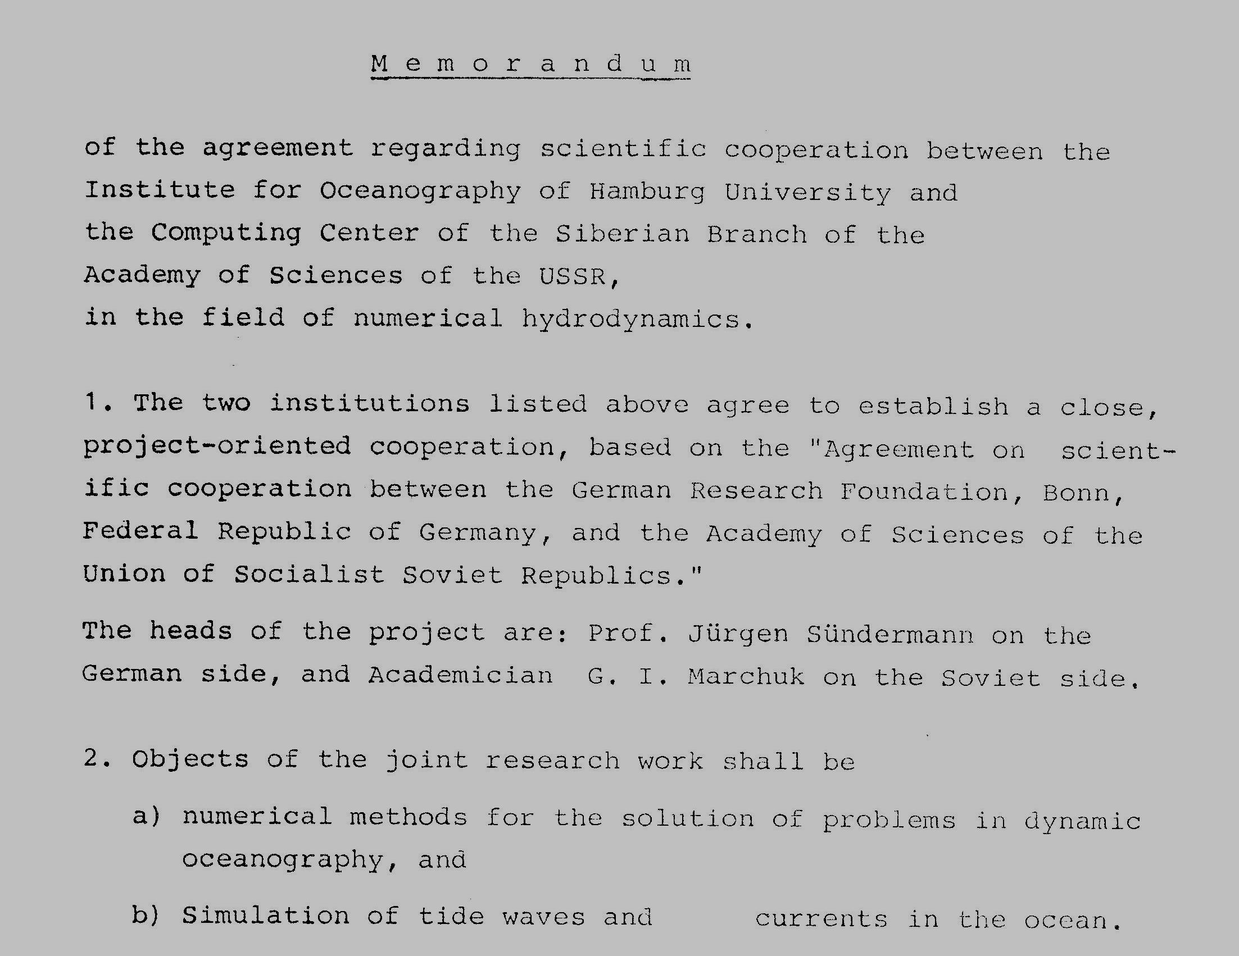
First agreement on scientific cooperation

Slide 7
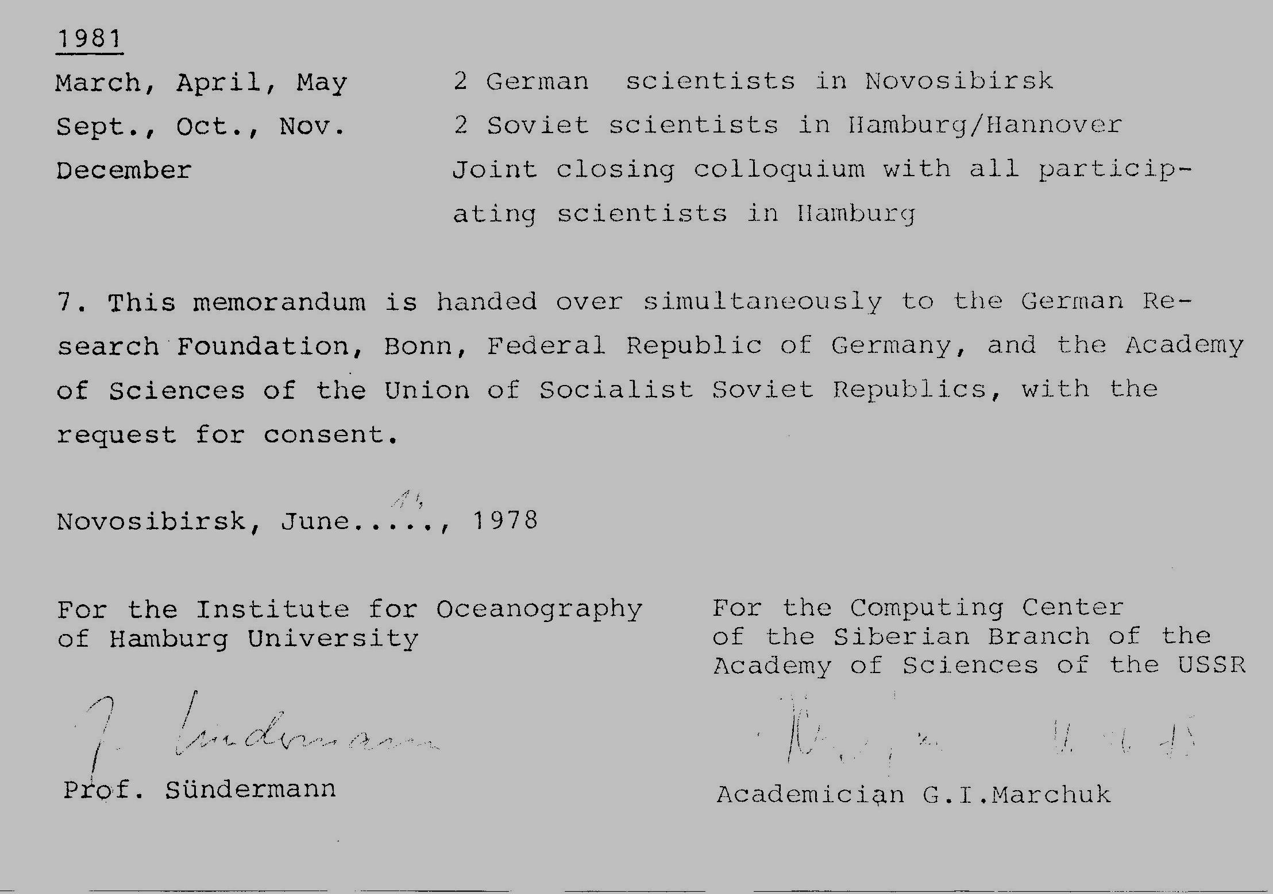
Novosibirsk, June 16, 1978

Slide 8
Brief history of cooperation II
From 1979
Regular exchange of scientists, meetings of
project heads, joint seminars in Hamburg and
Moscow
Joint projects, joint publications
Guest professors in Hamburg:
G. Marchuk, A. Sarkisyan, V. Kamenkovich, S. Voyt,
S. Zilitinkevich, V. Kuzin, B. Kagan, A. Aitsam

Slide 9
Brief history of cooperation III
From 1983
Participation of further institutes
Moscow: Oceanology, Atmospheric Physics
Leningrad: Oceanology
Tallinn, Frunze, Sevastopol: Oceanology
Hamburg: Max Planck Meteorology
Kiel, Bremerhaven: Oceanography
Hannover: Fluid Mechanics

Slide 10
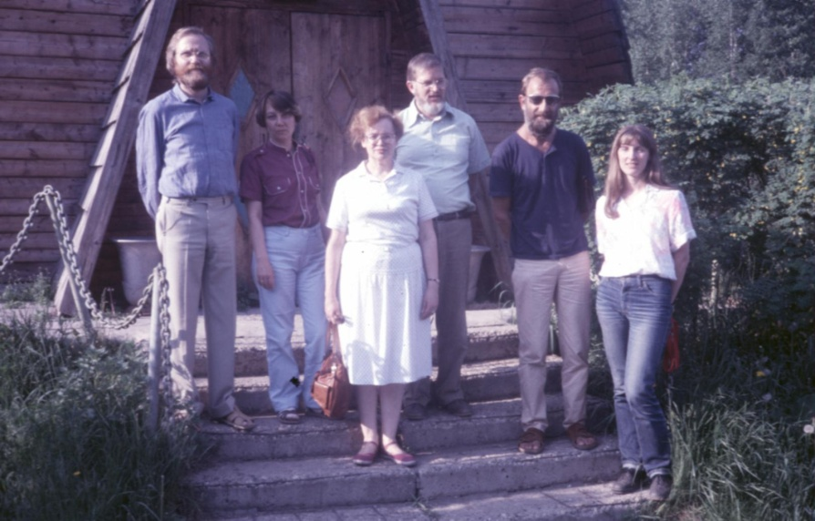
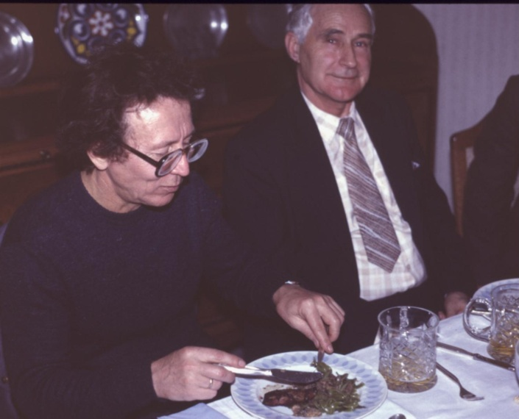
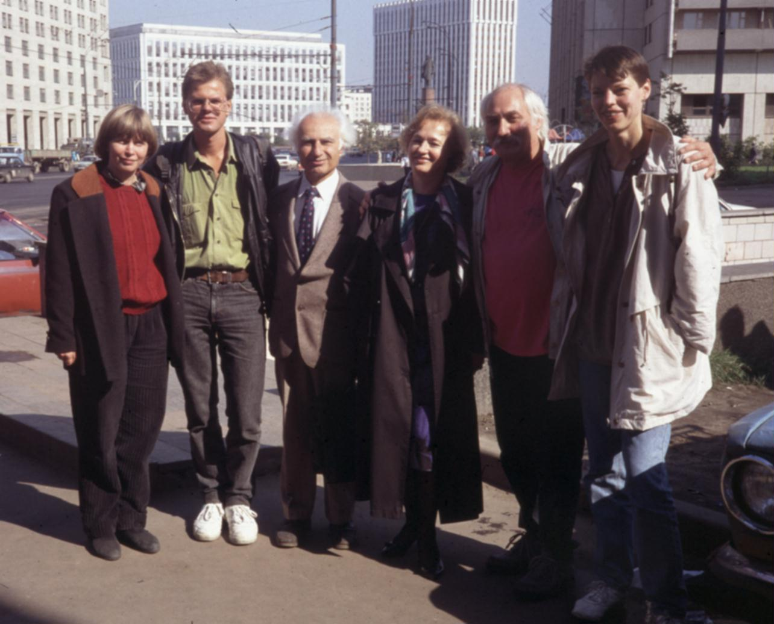
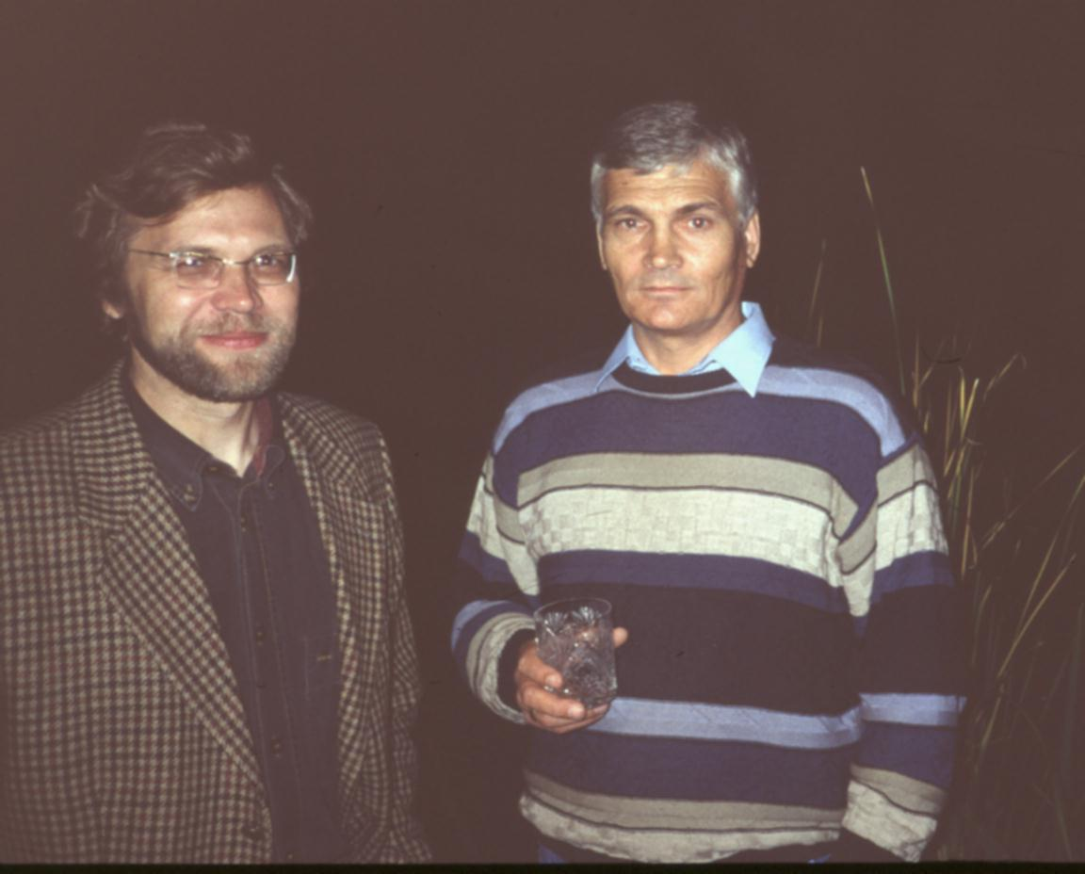
Moscow 1985
Hamburg 1990
Moscow 1991
Hamburg 1994

Slide 11
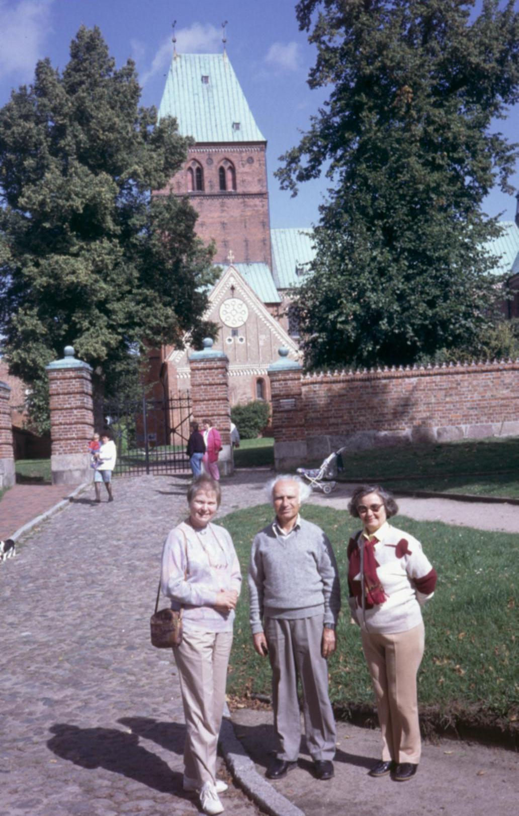
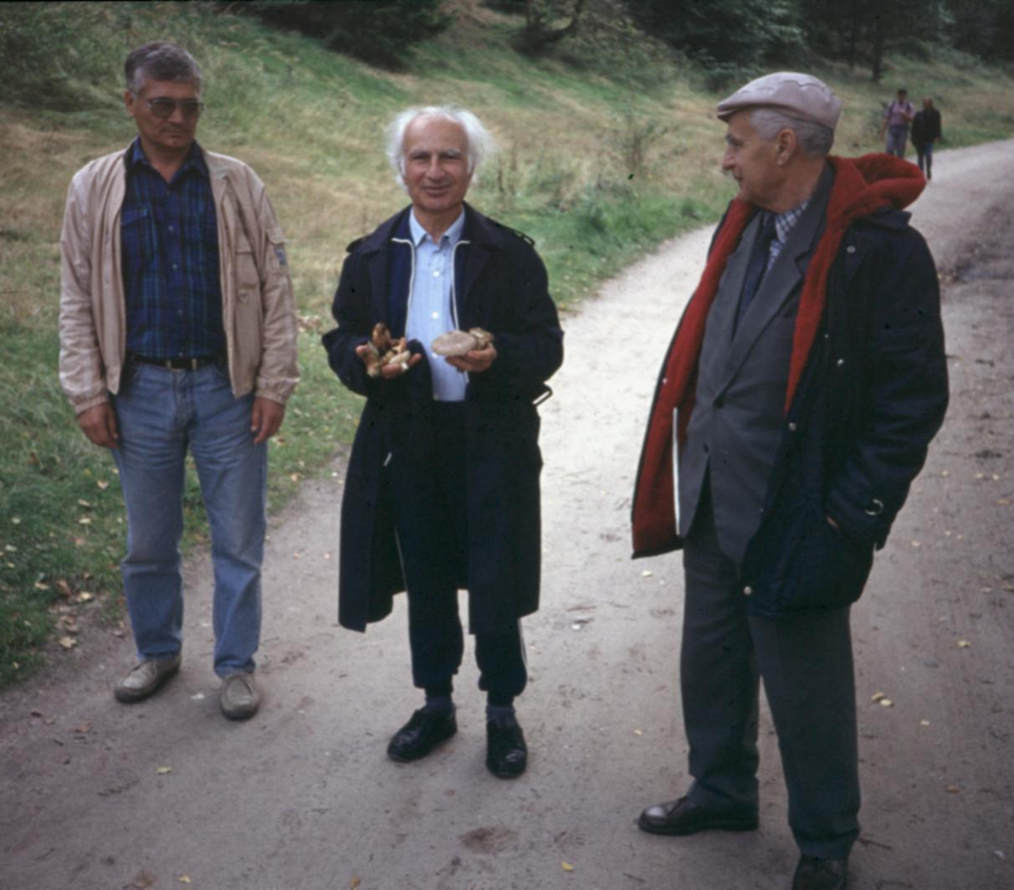
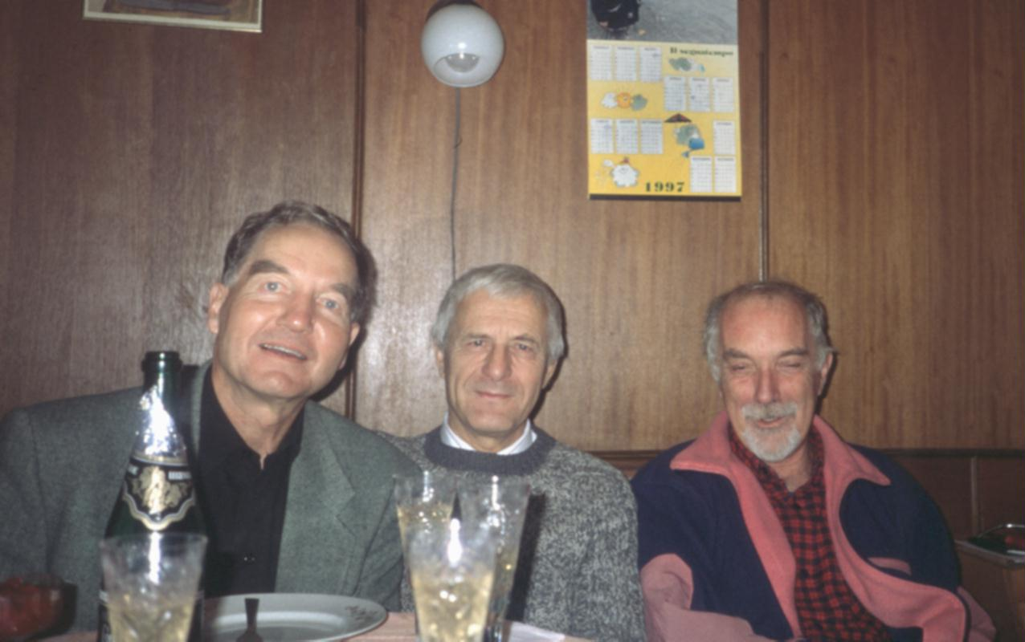
Beyond working…

Slide 12
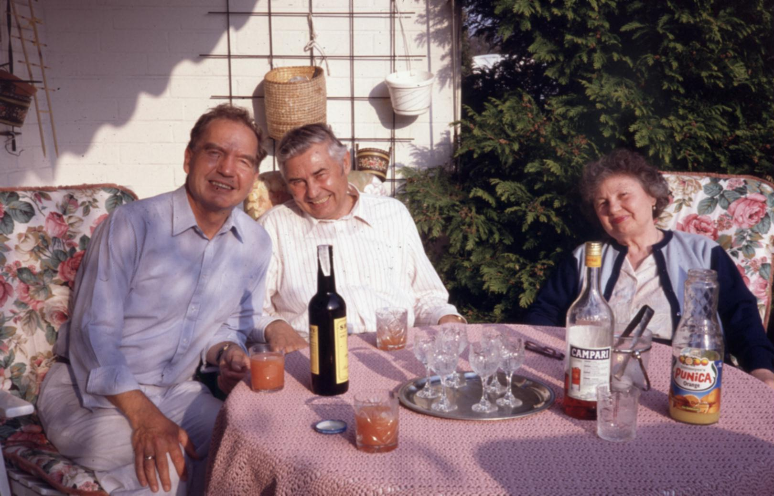
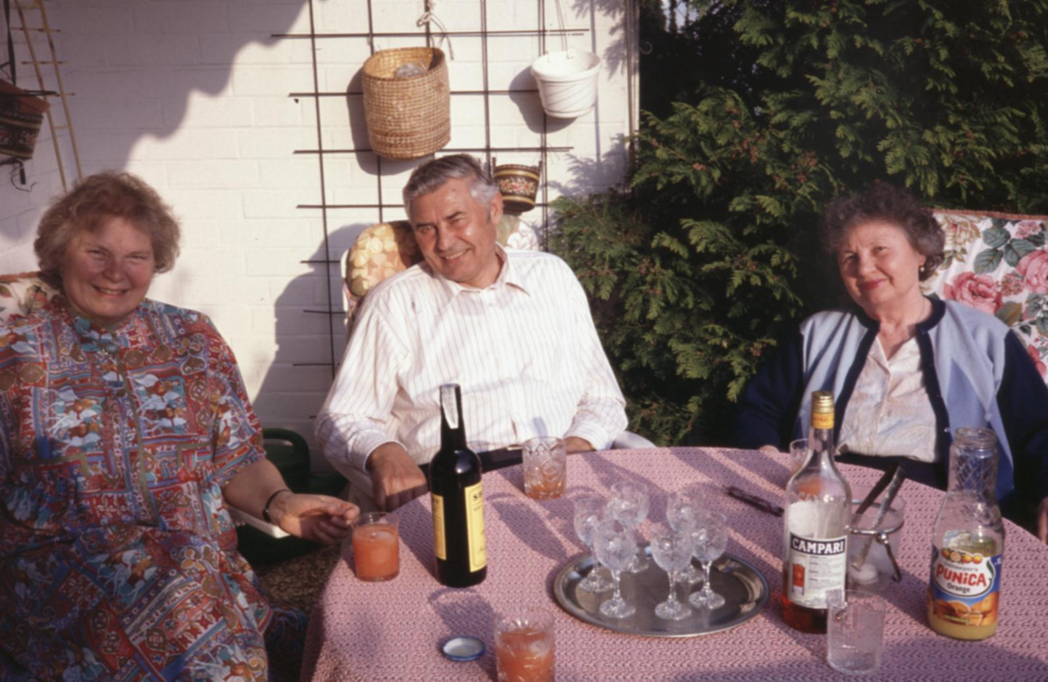
May 1994
Three weeks visit
of Guri and Olga
Marchuk in Hamburg
invited by the
Toepfer Foundation

Slide 13
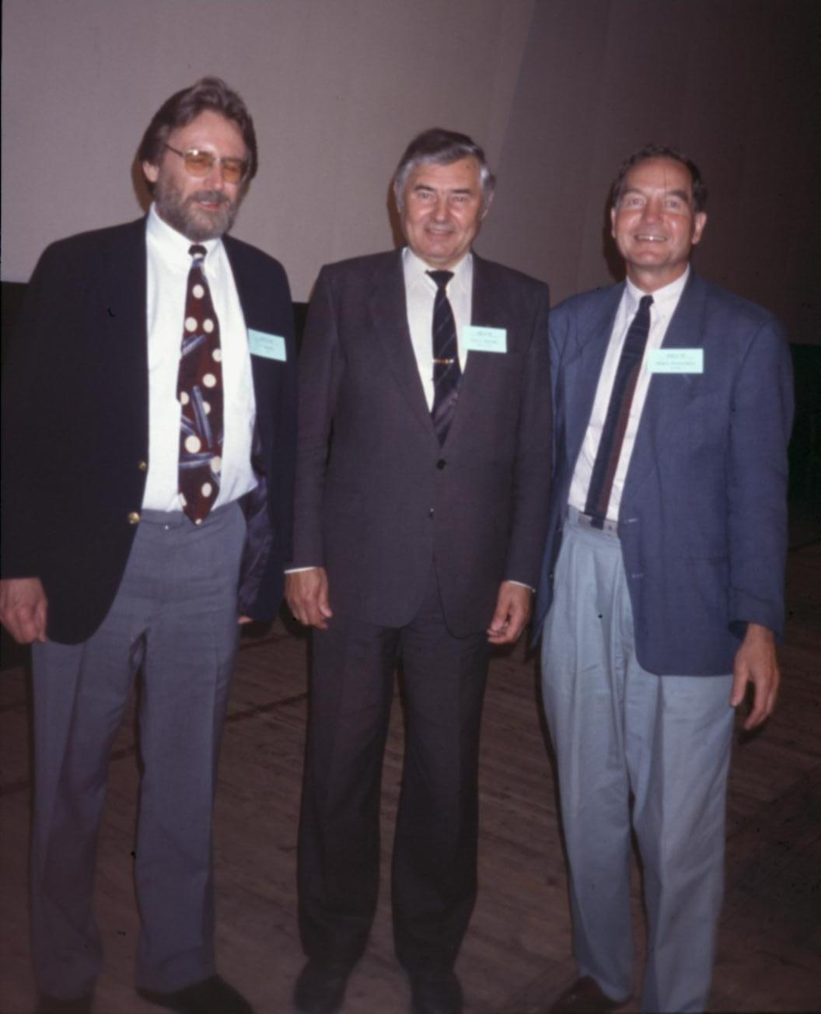
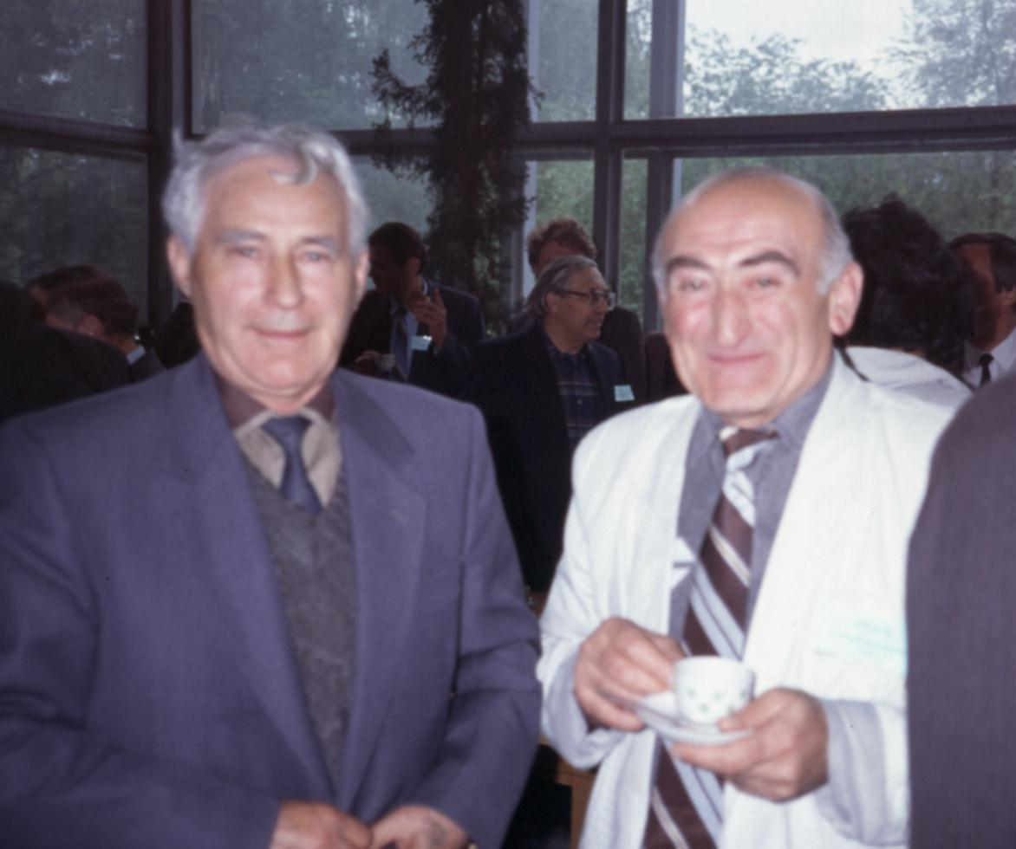
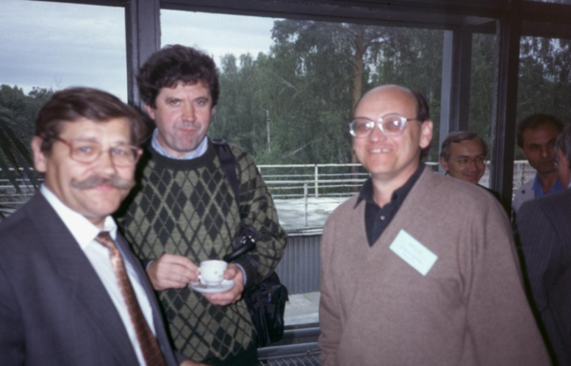
Novosibirsk 1995: 70th birthday of G.I. Marchuk

Slide 14
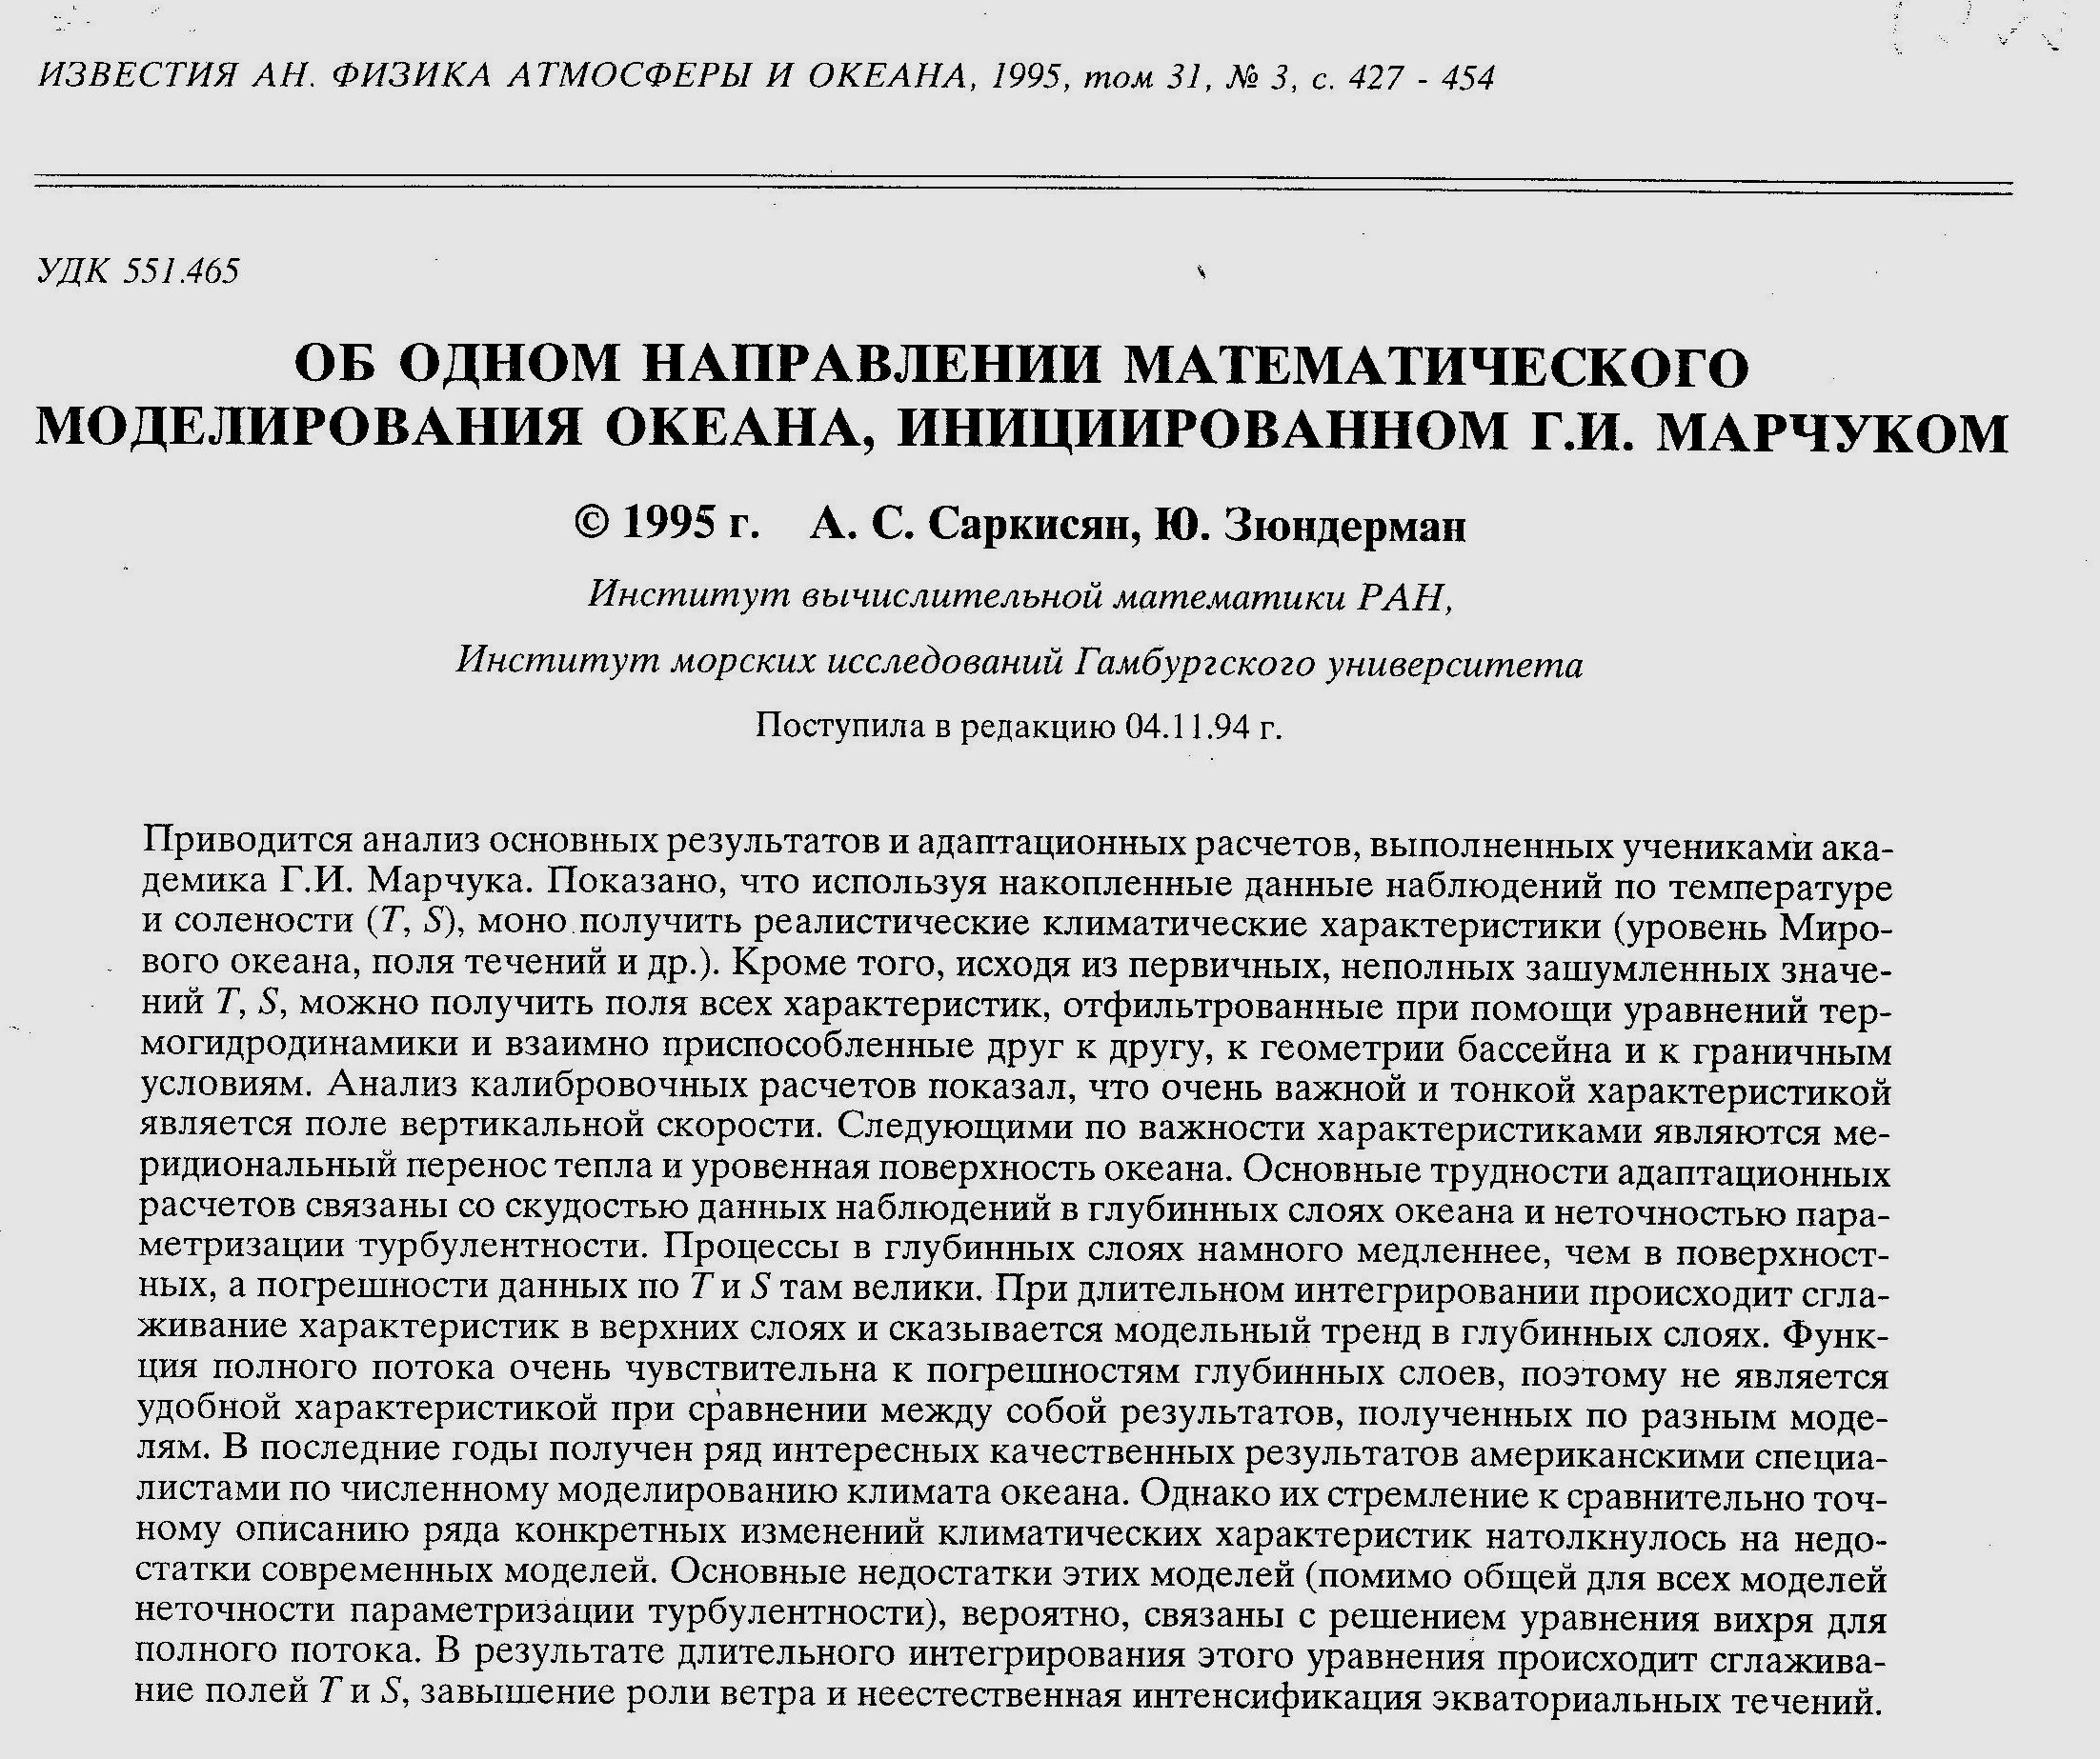

Slide 15
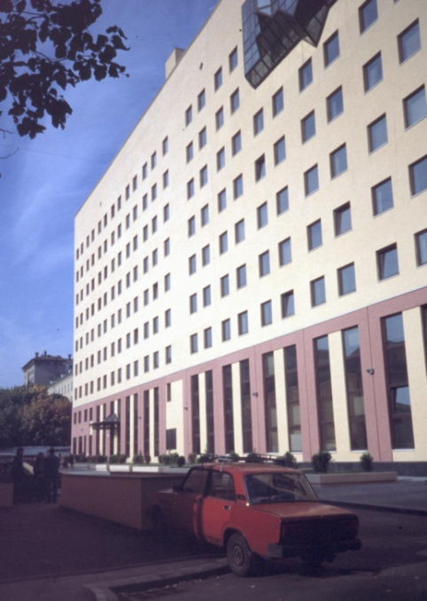
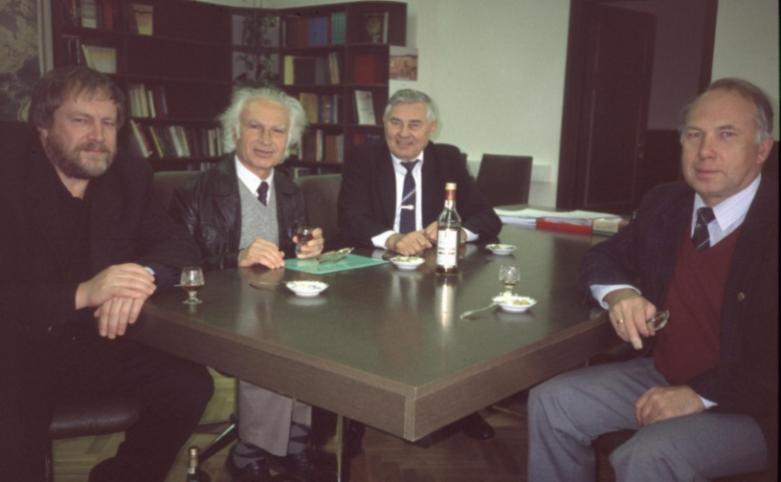
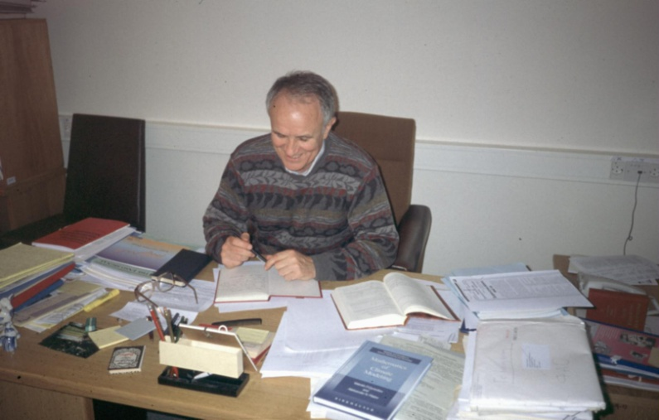
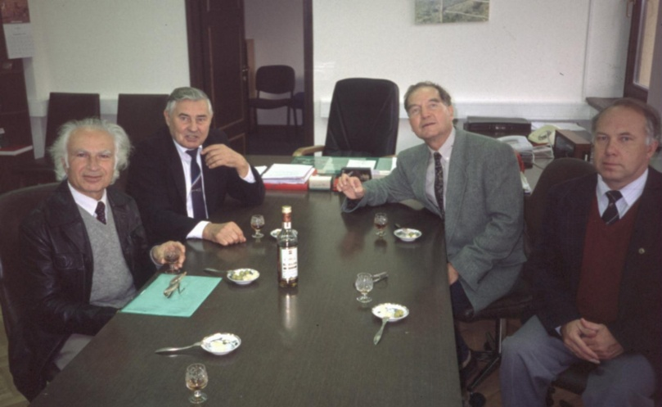
Institute of Oceanology
Partner
Institutes
in Moscow
Institute of
Numerical
Mathematics

Slide 16
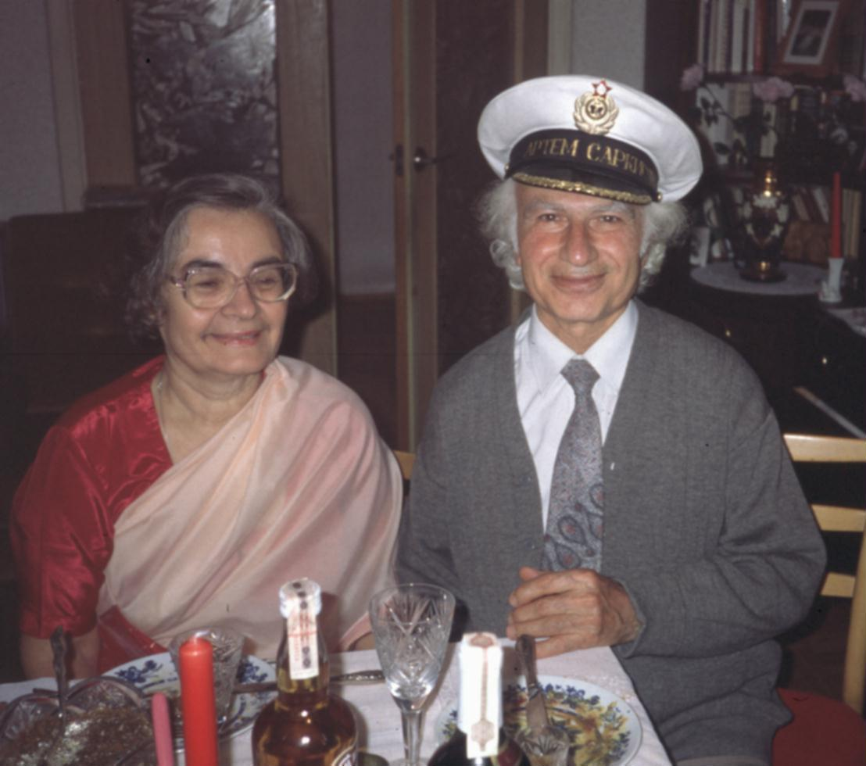
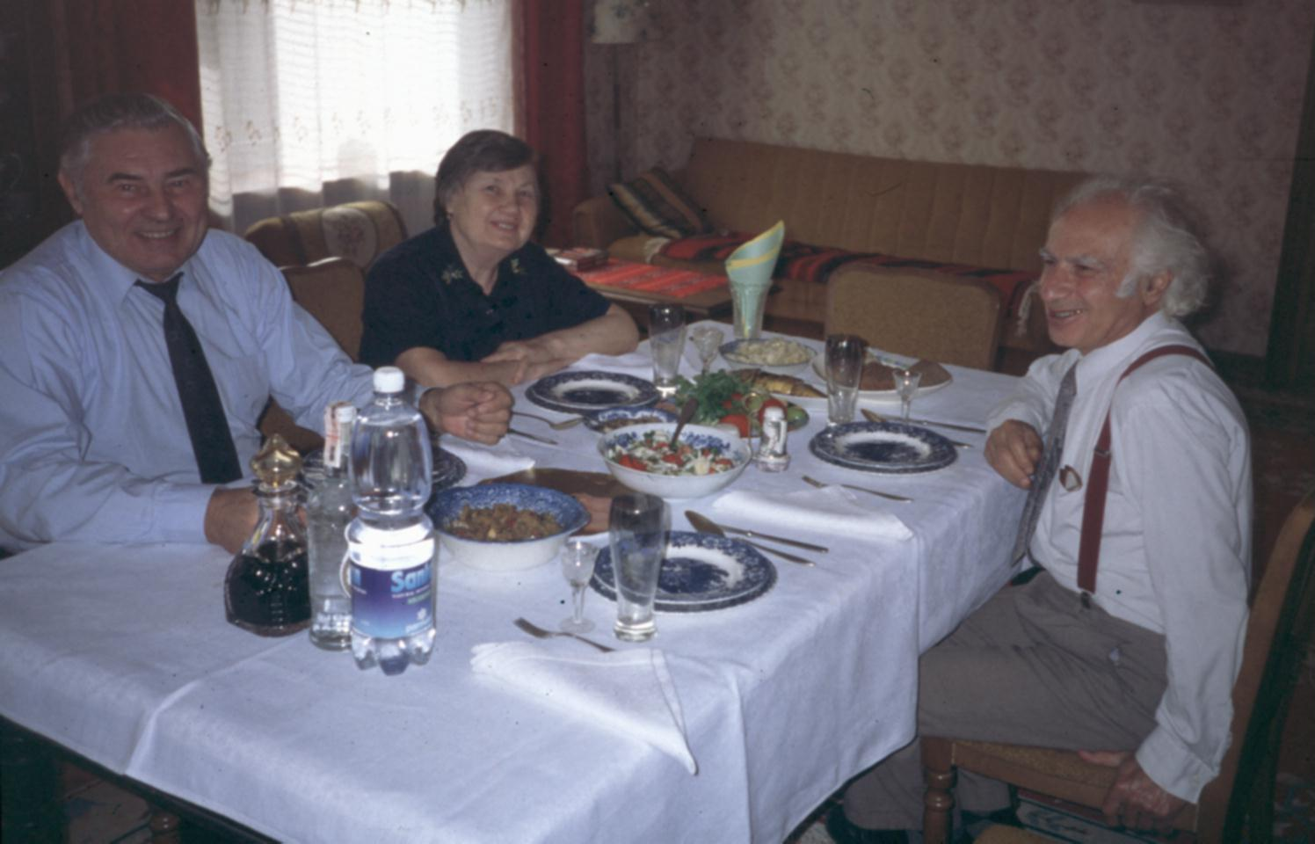
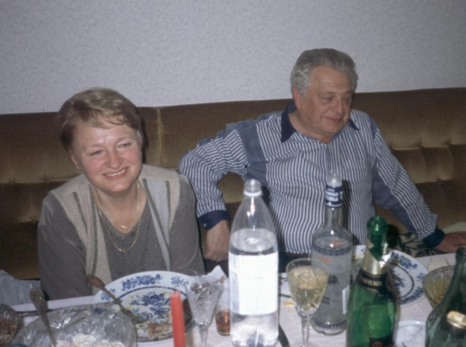
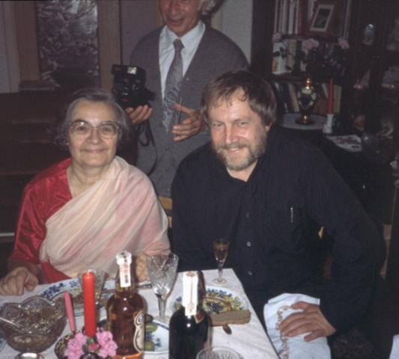
Beyond working…

Slide 17
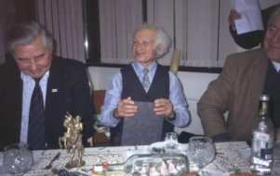
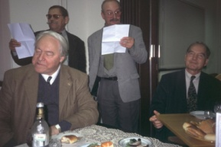
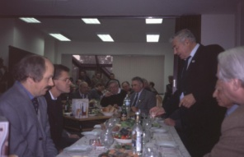
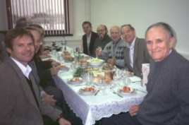
Conference „Circulation and Ecology Modeling and
Monitoring“, Moscow, September 8-12, 1998

Slide 18
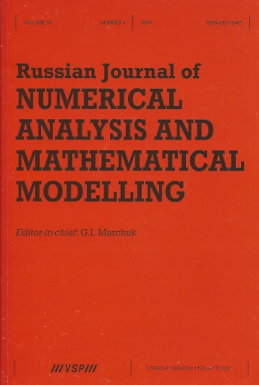
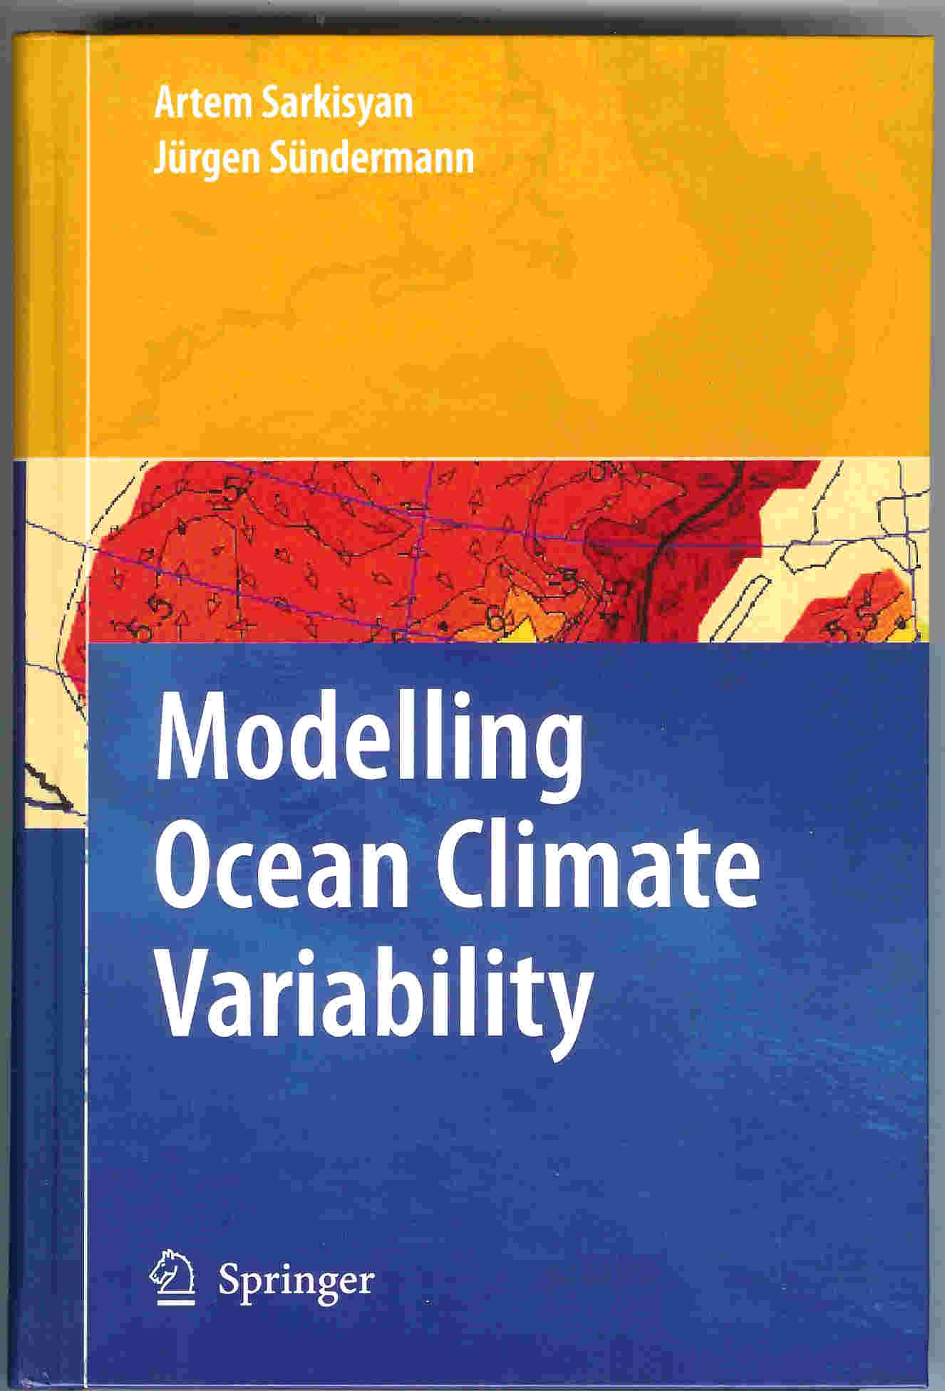
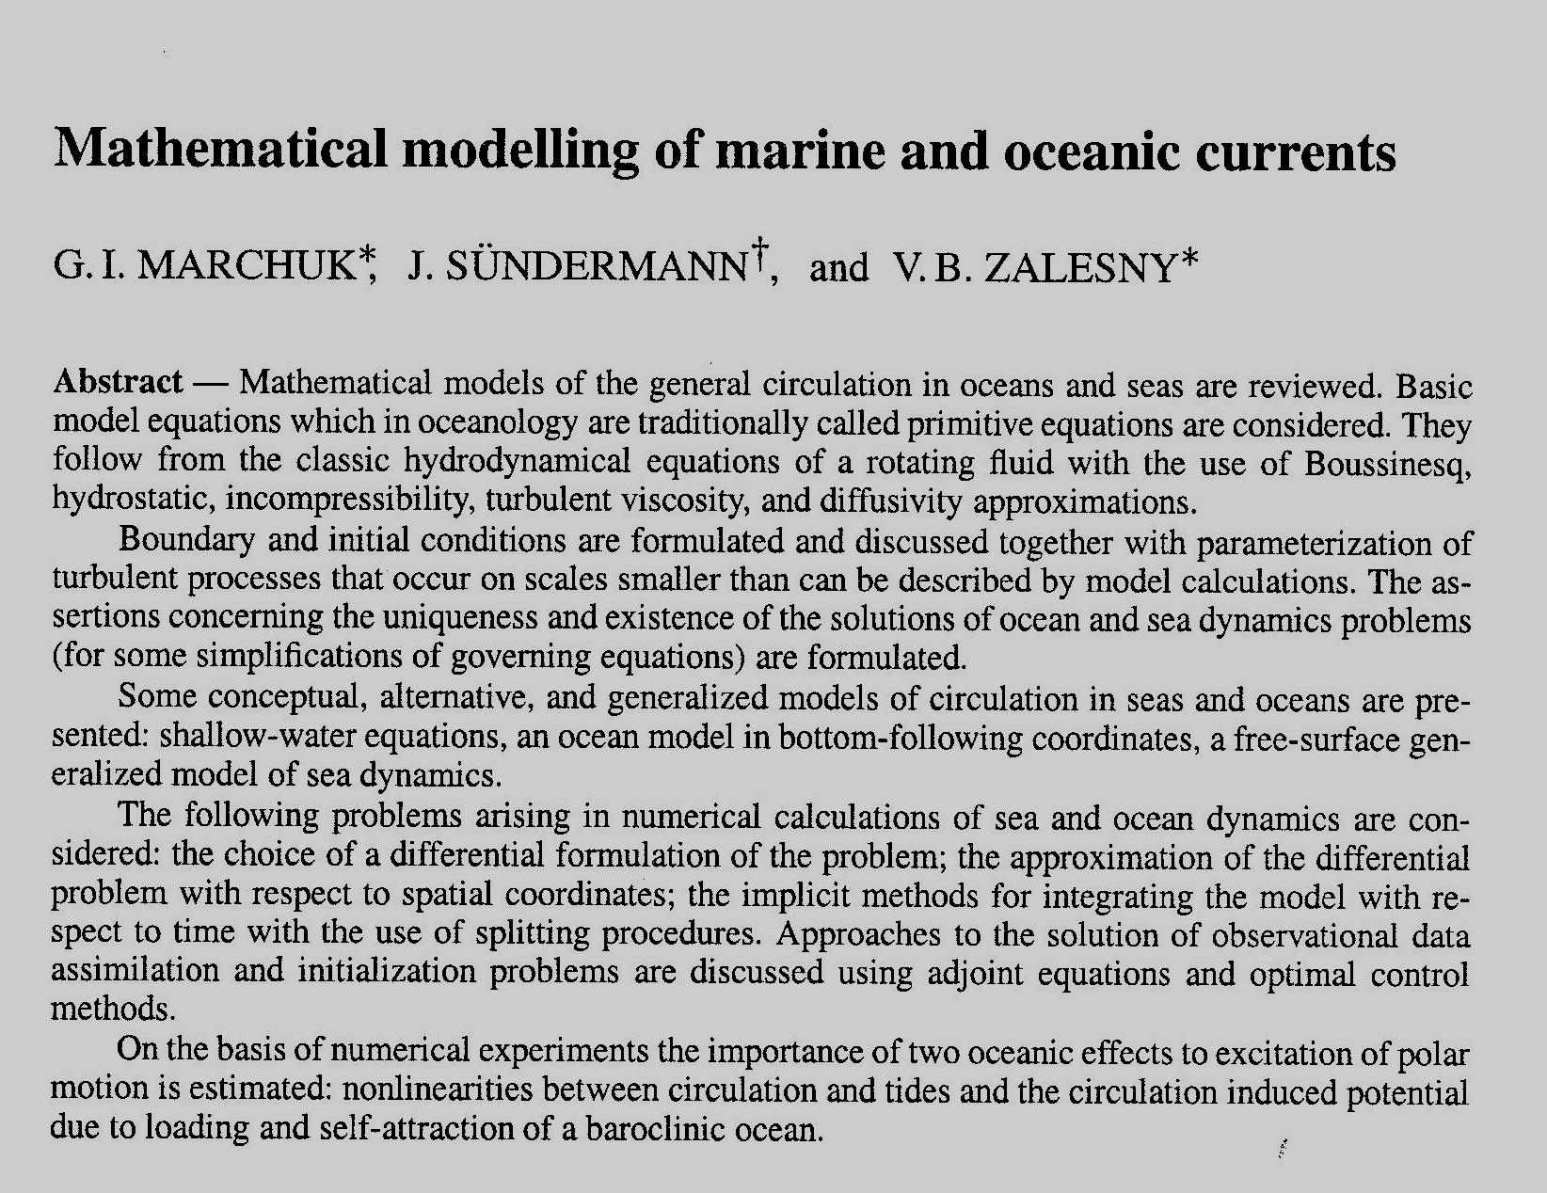
Joint
publications

Slide 19
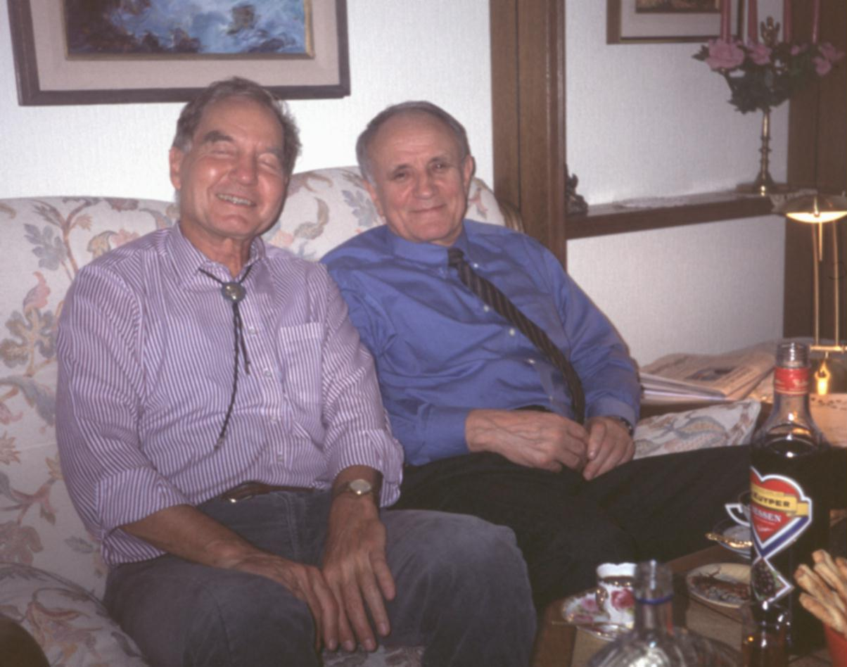
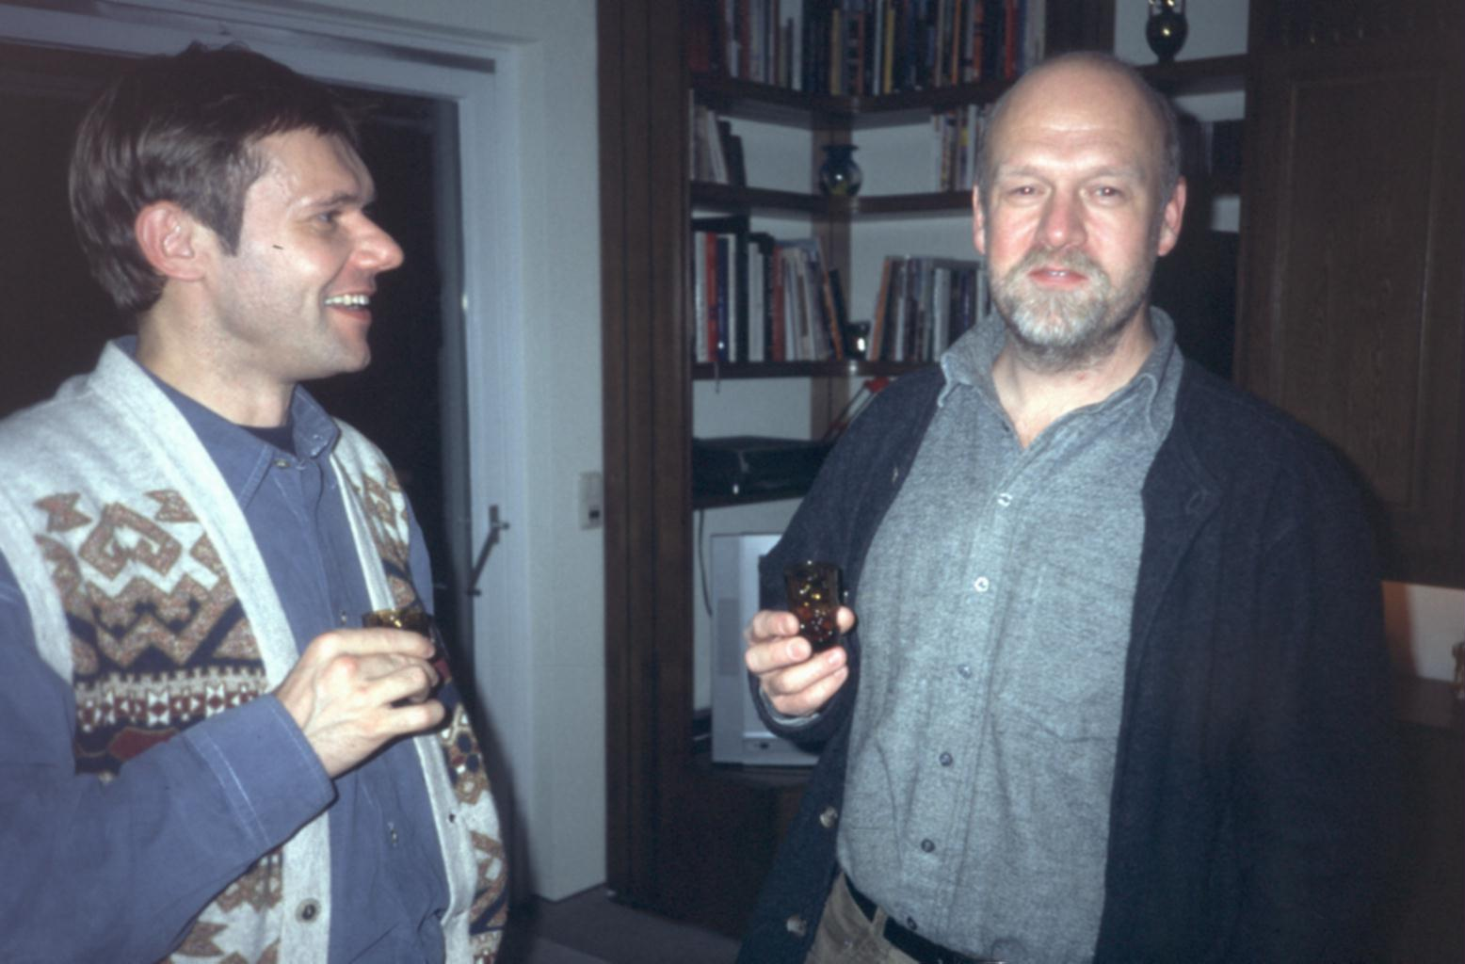
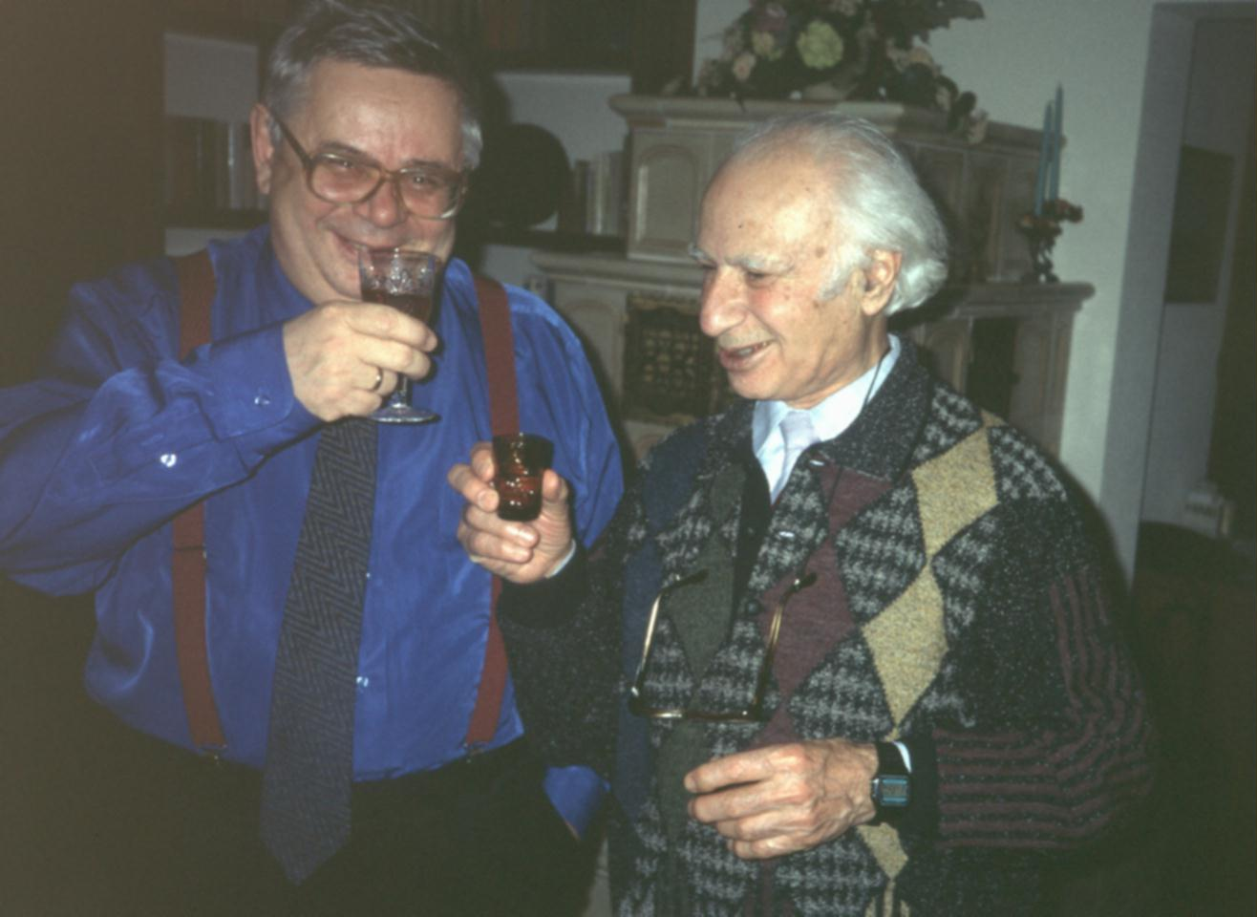
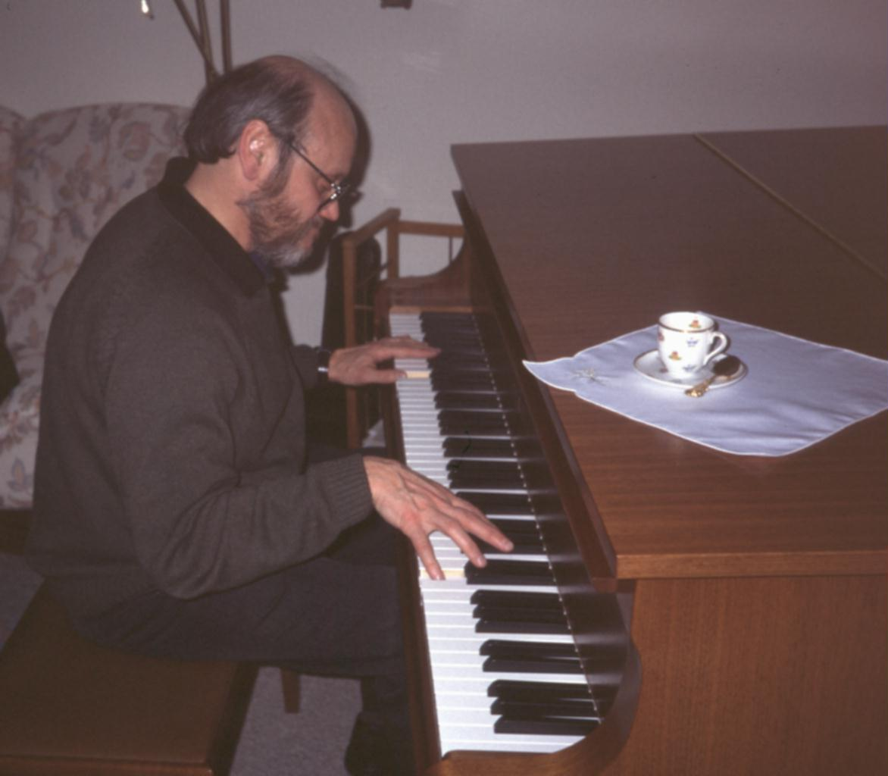
After hard work – Hamburg 2002

Slide 20
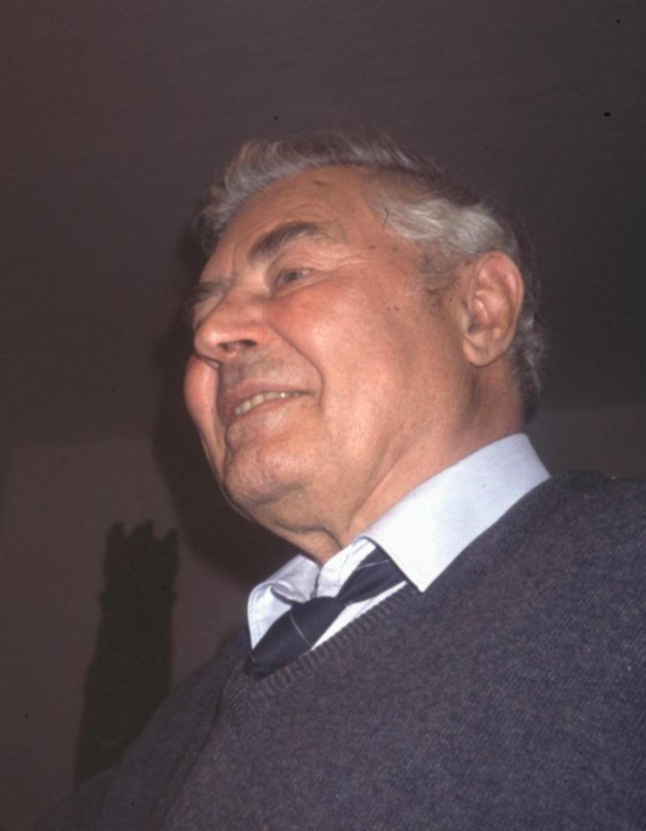
Thank
you,
Guri !

